Slide 1
(3) Servo and Stepper Motors

Slide 2
Objectives
Explain how to control the direction of rotation of a dc motor using H-bridge.
Review pulse width modulation (PWM) technique for motor speed control.
Identify servo and stepper motors and their operation.

Slide 3
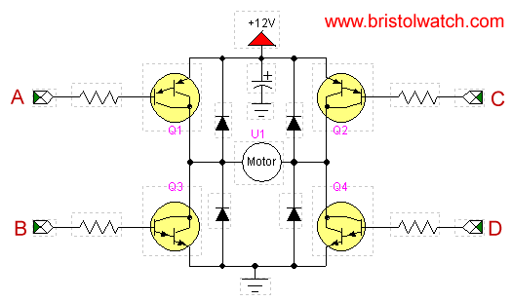
Bidirectional control of motors
The H-bridge allows current to flow through the motor in either direction with a single-polarity power supply.
It consists of four transistors (2 NPN and 2 PNP).
H-bridge IC examples: L293 and L298

Slide 4
H-bridge operation
A, B | Q1 | Q3 | C, D | Q2 | Q4 | Direction
GND | ON | OFF | VCC | OFF | ON | L → R
VCC | OFF | ON | GND | ON | OFF | R → L

Slide 5
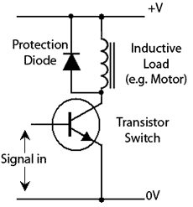
The flyback diode
Motors are inductive loads → they resist changes in the current passing through them (e.g. at switching instants).
This is achieved by generating “very large” reverse voltage spike on motor terminal in attempt to keep the current running. Recall that:
The diodes protect the transistors by providing an alternative way for the current to flow.
The same idea is used in H-bridges.

Slide 6
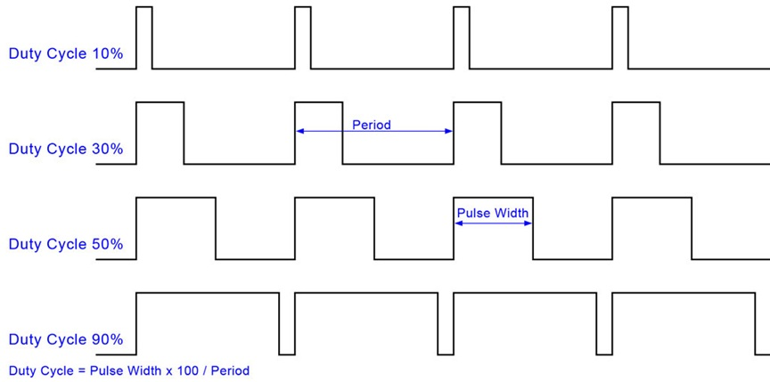
Pulse-Width Modulation (PWM)
PWM is a common technique for analog control of position or speed using a digital signal.

Slide 7
PWM
The idea is to switch the applied voltage to the motor on and off fast enough, so that the effect of switching is negligible, and the motor responds to the average value of the applied power.
Average voltage is proportional to duty cycle.
Duty cycle is the fraction of time the voltage is HIGH.
The period (1/switching frequency) should be small enough (e.g. 1/10 the time constant of the motor).

Slide 8
Servomotors
DC motors are not suitable for accurate position control.
Servo and stepper motors are used to obtain precise angular position and velocity.
Servomotor consists of a motor coupled to a sensor, e.g. a potentiometer, for position feedback. The control electronics use this feedback information to power the motor and stop it at the desired position.
Servomotors are used in applications such as robotics, CNC machinery or automated manufacturing.

Slide 9
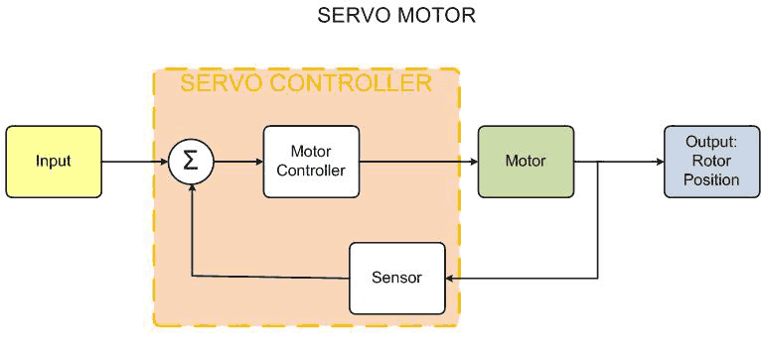
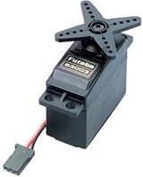
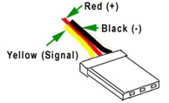

Slide 10
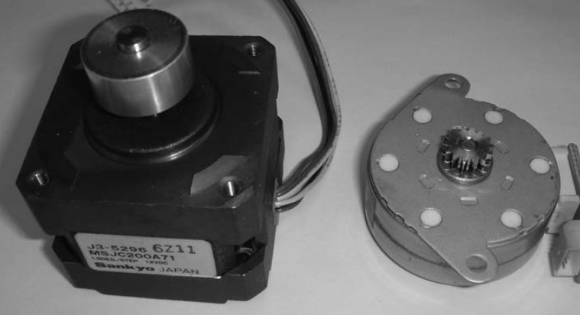
Stepper Motors
Stepper motors rotate by a known fixed angle (called the step angle) with each input pulse. Hence, feedback is not required.
Stepper motors have a holding torque (not present in DC motors) allowing it to hold its position firmly when not turning.
Types of permanent magnet stepper motors: unipolar, bipolar, and universal.
Left: A stepper motor from a disk drive. Right: A stepper motor for paper advance from an ink jet printer.

Slide 11
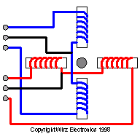
Unipolar Stepper Motors
Unipolar stepper motors are characterized by centre-tapped windings.
The figure shows a unipolar stepper motor with a single magnet rotor, and a four-phase stator in the form of two centre-tapped coils. Each coil is divided into two phases.
A common wiring scheme is to connect all the centre-taps to the +MV (Motor voltage).
The driver circuit would then ground each winding to energize it.

Slide 12
Rotation in Full-steps (Method 1)
For a stepper motor to rotate, its windings are energized in a prescribed sequence. The following sequence drive the motor with one coil energized at each step.
In1 | In2 | In3 | In4
1 | 0 | 0 | 0
0 | 1 | 0 | 0
0 | 0 | 1 | 0
0 | 0 | 0 | 1
Note that reversing the order of the sequence will cause the motor to rotate the other way.
If the control signals are not sent in the correct order, the motor may not move or turns in a rough or jerky manner.

Slide 13
Rotation in Full-steps (Method 2)
The following is another drive sequence in which two windings are energized at each step.
This yields around 1.5 times more torque than the standard sequence, but it draws twice the current.
In1 | In2 | In3 | In4
1 | 1 | 0 | 0
0 | 1 | 1 | 0
0 | 0 | 1 | 1
1 | 0 | 0 | 1

Slide 14
Rotation in half-steps
The previous two driving sequences give a full-step rotation of 90° per step.
It is also possible to make a stepper motor rotates at half step using the shown driving sequence.
In one step, one coil is energized. In the next step, two coils are energized, and so on.
In1 | In2 | In3 | In4
1 | 0 | 0 | 0
1 | 1 | 0 | 0
0 | 1 | 0 | 0
0 | 1 | 1 | 0
0 | 0 | 1 | 0
0 | 0 | 1 | 1
0 | 0 | 0 | 1
1 | 0 | 0 | 1

Slide 15
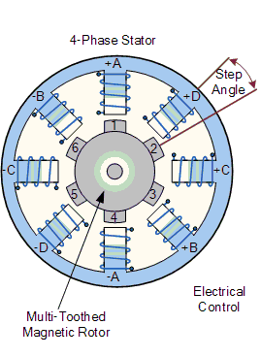
Common Step Angles
Different step angles are obtained by designing the rotor with fixed magnet composed of several poles and a stator with several windings.
Common step angles: 0.9°, 1.8°, 3.6°, 7.5°, 15°, 18°, and 90°.
It is possible to find the step angle of a given stepper motor by carefully counting the number of steps required to rotate the motor one complete revolution.

Slide 16
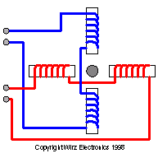
Bipolar & Universal Stepper Motors
Bipolar motors are designed with separate coils.
The terminals of each coil are connected either to LOW or HIGH.
The polarity needs to be reversed during operation for proper stepping to occur. This requires the use of an H-bridge for each coil.
Bipolar motors provide more torque than unipolar.
Universal stepper motors have 4 independent windings and 8 leads. By suitable connections of the leads, the user can obtain either a unipolar or bipolar motor.

Slide 17
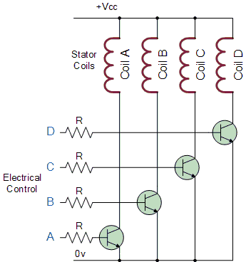
Stepper motor drivers
Similar to dc motors, stepper motors cannot be directly connected to a microcontroller as it will draw current that exceeds the capability of μC.
Usually, a driver circuit consisting of a set of high current-gain transistors (Darlington pairs) is used, such as ULN2004.
Commercial stepper motor drivers are also available. They receive commands such as step, direction and reset, and generate the required sequence to drive the motor as required.

Slide 18
Identifying an unknown motor
Motor type is determined by counting the number of motor leads:
2 Brush DC Motor - Not a Stepper 4 Bipolar Stepper 5 Unipolar Stepper - Common Center Tap 6 Unipolar Stepper 8 Universal Stepper
Use an ohm meter to determine the leads. For a bipolar motor, this is simple. For a unipolar stepper motor, the resistance V+ to common and V- to common should be equal and 1/2 the resistance between V+ and V-.

