Slide 1
(8) Timers and Counters

Slide 2
Timers
Timers are used to operate devices for certain period of time.
PLC contains three basic types of timers:
1- On-delay timer (TON)
2- Off-delay timer (TOF)
3- Pulse-timer (TP)

Slide 3
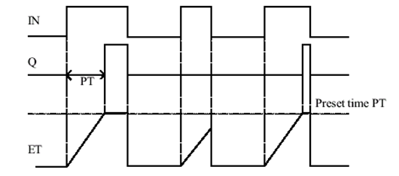
ON-Delay Timer

Slide 4
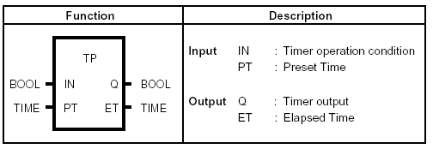
Pulse timer

Slide 5
Counters
Counters are used to count the occurrence of certain events.
When the current count reaches some preset value (PV), an action is taken.
Types of counters in PLC:
1- Up counter (CU)
2- Down counter (CD)
3- Up-down counter (CUD)

Slide 6
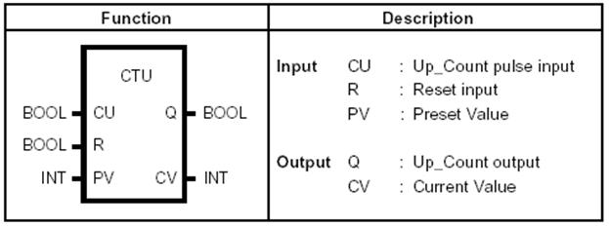
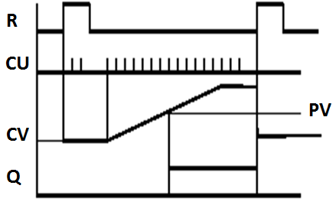
Up counter (CTU)
The current value CV increments by 1 when the input CU changes from 0 to 1 (i.e. positive edge).

Slide 7
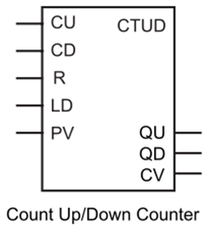
Up/Down Counter (CTUD)
Every +ve edge on CU increment CV by 1.
Every +ve edge on CD decrement CV by 1.
R: reset the counter (CV = 0)
LD: load CV with the value PV.
QU | QD | CV
0 | 1 | CV <= 0
1 | 0 | CV >= PV

Slide 8
Example 1
There are three machines, each with its own start and stop buttons.
One or two machines may run at one time.
Each start button is to have a latch circuit.
Construct a PLC program with appropriate interlocking for this problem.

Slide 9
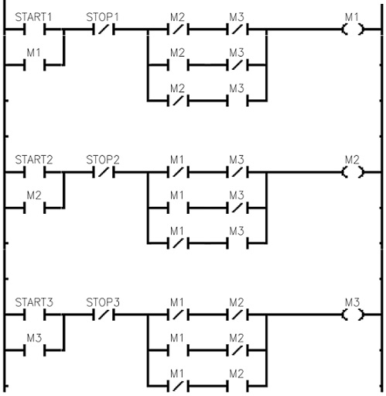

Slide 10
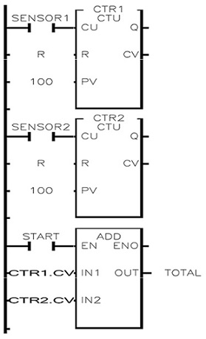
Example 2
There are 2 conveyor lines feeding a main conveyor.
Each of the two conveyor lines has its own counter.
Design a ladder logic program to give the total count of parts on the main conveyor.

Slide 11
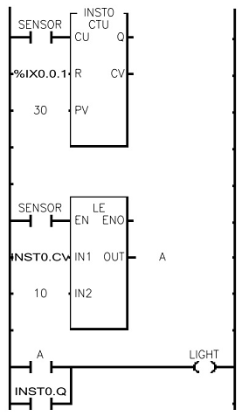
Example 3
Develop a ladder logic program that contains an up counter. If the counter current value CV is less than or equal to 10 or more than or equal to 30, a light turns on.
Hint: we can use LE (less than or equal) and GE (greater than or equal ) functions available in ladder diagram.

Slide 12
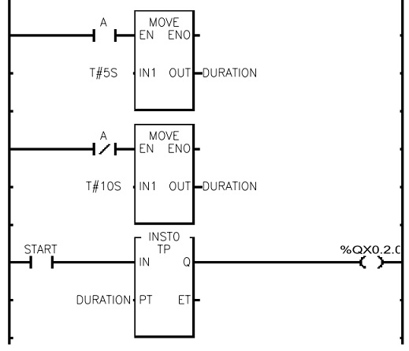
Example 4
Develop a ladder logic to turn a pump ON using a start switch. The pump runs on for either 5 or 10 min depending on the state of another switch A. If A=1, the duration is 5 min, otherwise, it is 10 min.
Hint: you may use the MOVE function to store or assign values to the variables in memory.

Slide 13
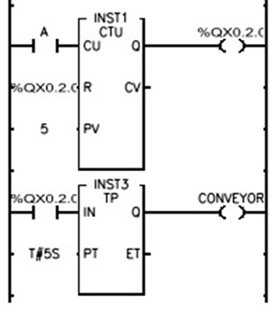
Example 5
Write a ladder program to count up 5 counts and then reset and at the same time turn a light on for 5 seconds.

Slide 14
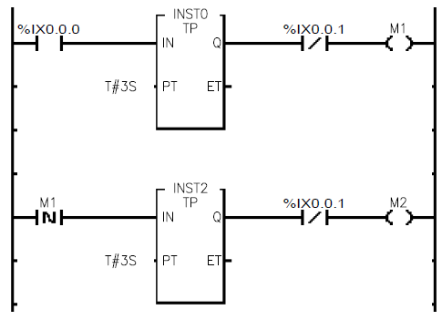
Example 6
Write a ladder program to turn on a motor for 5 min. The motor then stops and another motor runs for 10 min. The process has both Start and Stop switches.
Start
Stop
T#5m
Stop
T#10m

