Slide 1
Frequency Response Analysis

Slide 2
Frequency Response Analysis
In steady state, sinusoidal inputs to a linear system generate sinusoidal responses of the same frequency.
Sine in ⇒ sine out
However, both amplitude and phase shift angle of input and output are different.
These differences are functions of frequency.
In frequency response analysis, the frequency of the input signal is varied over a certain range and the resulting response is studied.

Slide 3
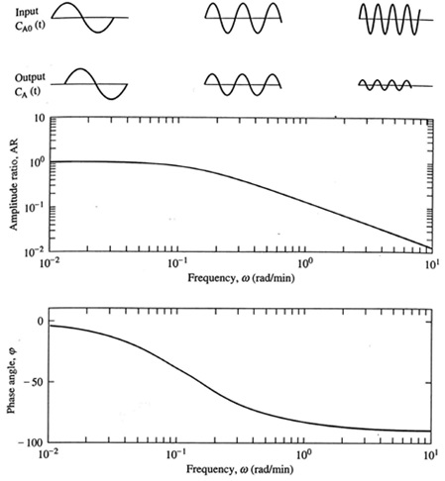
Frequency response
Time-domain
behavior.
Bode Plot - Shows
response for
a range of frequencies
20 Log (AR) vs log(ω)
Phase angle vs log(ω)

Slide 4
How to calculate frequency response?
At each frequency, the system can be represented by a complex number. Its magnitude is the gain and its angle is the phase shift between input and output.
The frequency response can be calculated from the transfer function G(s) by setting s = jω, where ω= frequency.
In MATLAB, the commands abs and angle give the magnitude and angle of a complex number.

Slide 5
Frequency Domain Plots: Bode Plot
A Bode diagram consists of two graphs:
  One is a plot of the logarithm of the magnitude of a sinusoidal transfer function.
  The other is a plot of the phase angle.
  Both are plotted against the frequency on a logarithmic scale.

Slide 6
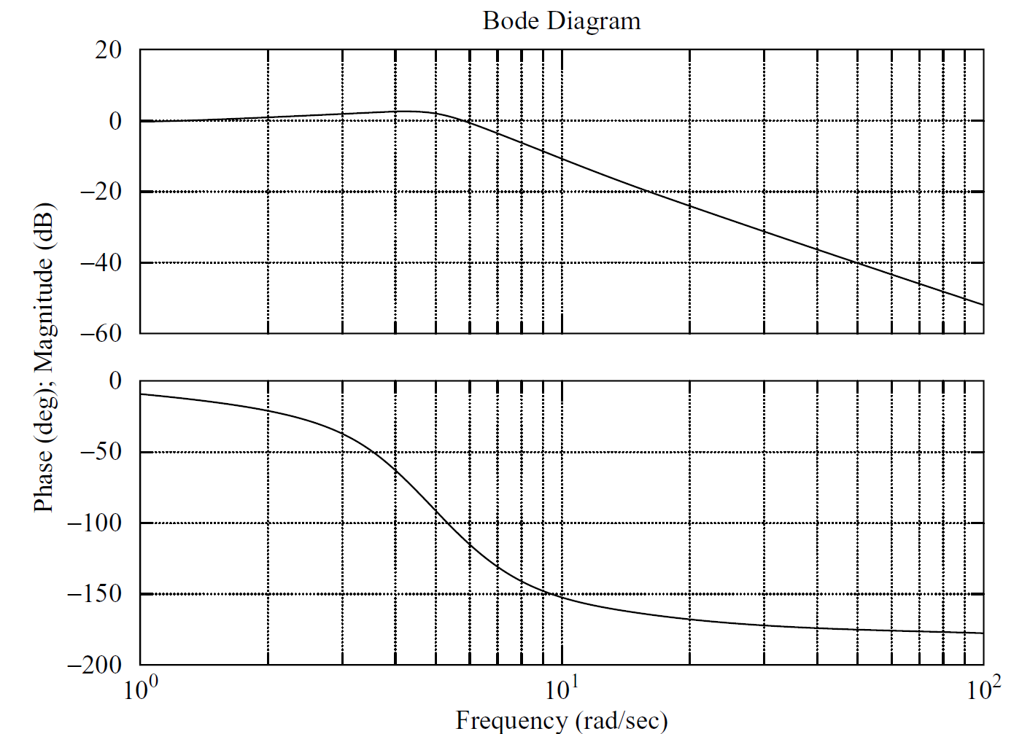
Decade

Slide 7
Basic Factors of a Transfer Function
The basic factors that frequently occur in an arbitrary transfer function are
  Gain K
  Integral and Derivative Factors (jω)^{±1}
  First Order Factors (jωT+1)^{±1}
  Quadratic Factors

Slide 8
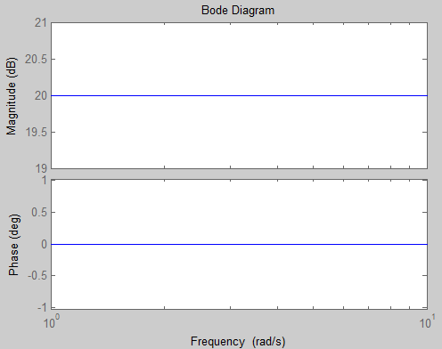
Gain K
The log-magnitude curve for a constant gain K is a horizontal straight line at the magnitude of 20 log(K) decibels.
The phase angle of the gain K is zero.
Example 1: K = 10.

Slide 9
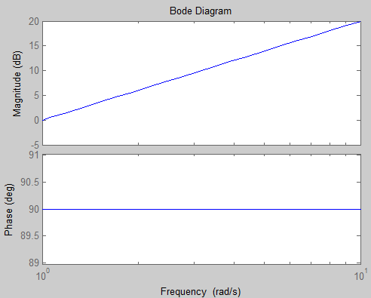
  Derivative Factor
20 dB/decade

Slide 10
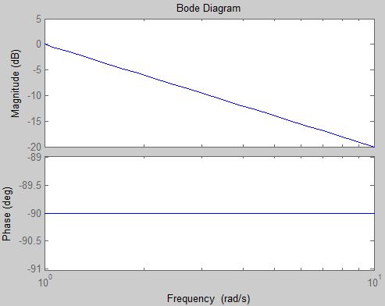
  Integral Factor
-20 dB/decade

Slide 11
First Order Zero
a: the corner frequency
  For Low frequencies ω<<a
  For high frequencies ω>>a

Slide 12
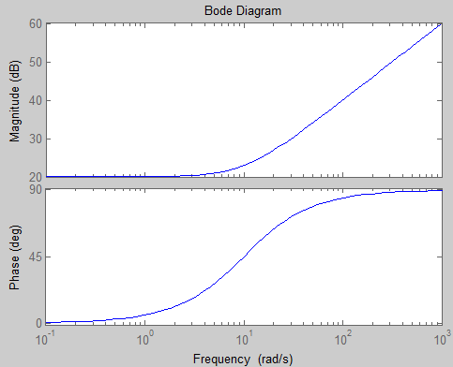
Example 2:
+20 db/decade

Slide 13
First Order Pole
a: the corner frequency
  For Low frequencies ω<<a
  For high frequencies ω>>a

Slide 14
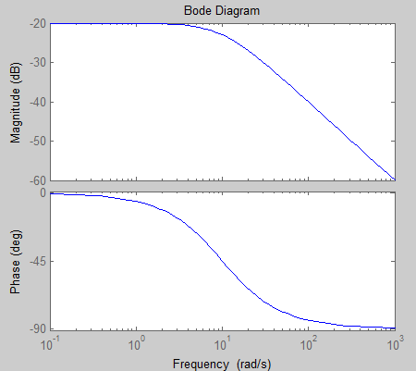
Example 3:
-20 db/decade

Slide 15
Example 4
Draw the Bode magnitude Plot of following Transfer function.
Solution:
The transfer function contains
  Gain Factor (K=20)
  Derivative Factor (s)
  First-order Order Pole (s+10)⁻¹

Slide 16
  Gain Factor (K=20)
  Derivative Factor (s)
  First-order pole (s+10)

Slide 17
26 dB
20
s
1/(s+10)
The sum:
20 db/decade
0 dB
-20 dB
10 rad/sec
-20 db/decade
26 dB
0 db/decade
6 dB
20 db/decade
1 rad/sec
10 rad/sec

Slide 19
More examples to try on your own
Draw the Bode magnitude Plot of following Transfer function.
Remember to determine the corner frequency for each factor and the trick of adding the slopes.

Slide 20
Bode plot and relative stability
As we have seen before, root locus can be used to design compensators. Bode plot is another important tool which can be used for this purpose.
However, what we are interested in now is to use Bode plot to determine the relative stability of a given system.
Remember that two systems may be stable, but one is more stable than the other.

Slide 21
Relative Stability
  Phase crossover frequency (ω_{p}) is the frequency at which the phase angle of the open-loop transfer function = –180°.
  The gain crossover frequency (ω_{g}) is the frequency at which the magnitude of the open loop transfer function = unity.
The gain margin (K_{g}) is the reciprocal of the magnitude of G(jω) at the phase cross over frequency.
  The phase margin (γ) is that amount of additional phase lag at the gain crossover frequency (ω_{g}) required to bring the system to the verge of instability.

Slide 22
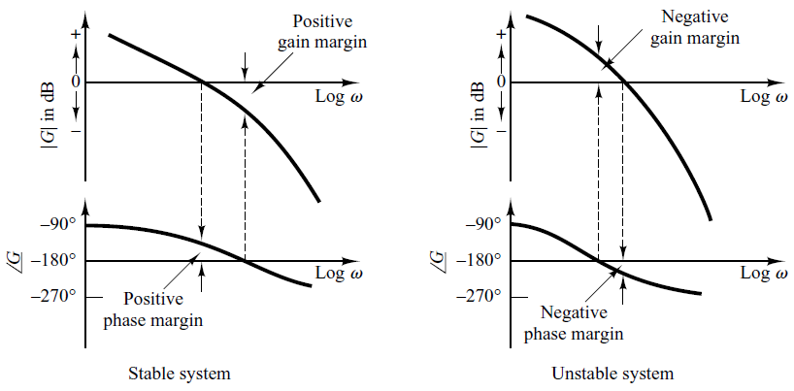
Relative Stability
ω_{g}
ω_{p}

Slide 23
Relative Stability
The higher the gain margin and phase margin, the more stable is the system.
If the gain margin or phase margin are negative, the system is unstable.

Slide 24
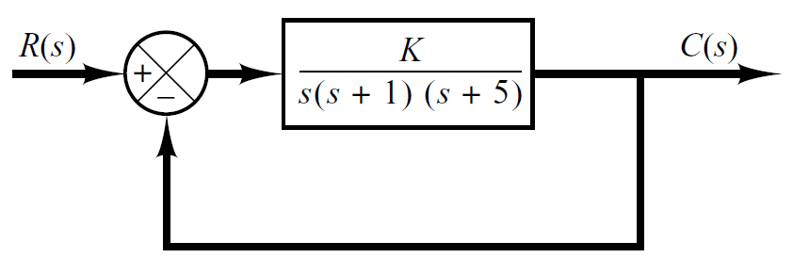
Example 5
Obtain the phase and gain margins of the system shown in following figure for the two cases: K = 10 and K = 100.
Note that in the exam you will be given the phase plot and you are required to plot the magnitude plot only.

Slide 25
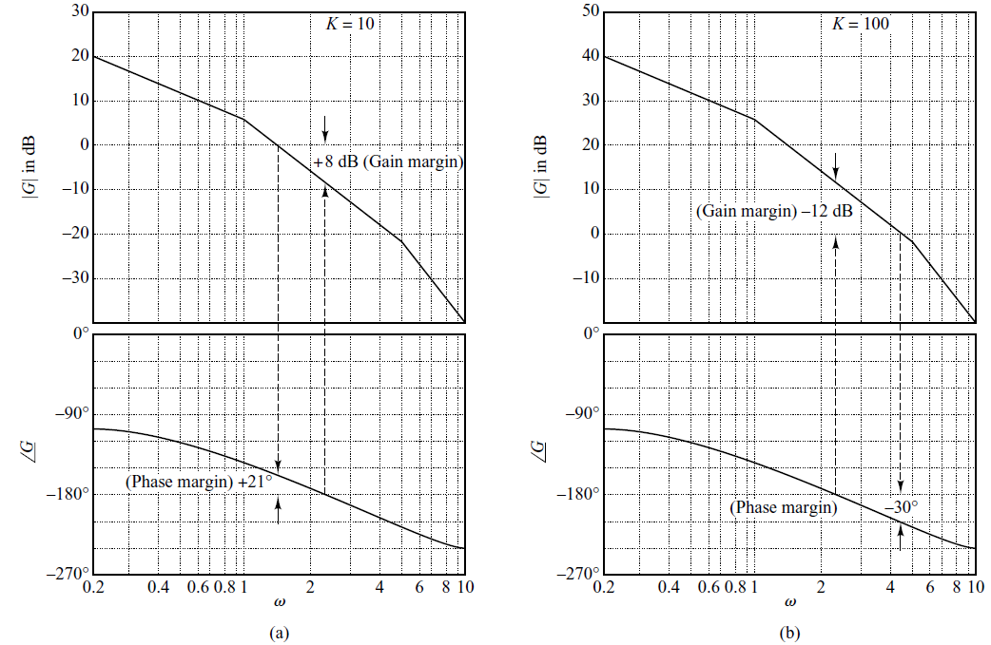
System is stable
System is unstable

