Slide 1
(4)
Filters

Slide 2
Frequency Response
If the quantity we are trying to measure is continually changing, will we be able to follow it? If the changes speed up, at what point will we fail to keep up with the changes? This is the cut-off frequency.
Some measurement components, e.g., piezoelectric accelerometers, also do not respond well if signals are fluctuating too slowly.
In order to assess the ability of the measurement system to follow low and high frequency fluctuations, we generate frequency response plots.
These are plots of how the amplitude and phase of a sine wave changes as a function of its frequency, when the sine wave is passed through the system.

Slide 3
Frequency Response
We track the behaviour of a sine wave because it’s a simple example of a fluctuating signal. The higher the frequency of the sine wave, the faster the fluctuations.
It is also possible to express more complicated signals as a sum of sines and/or cosines (Fourier Series).
If we assume that the system is linear, we can take each sine in the sum and pass it though the system. The frequency response function will tell us how the amplitude and phase of the sine will change as it passes through the measurement system.
We can then take the responses due to each of the sines and add them up to predict the measurement system's response to a complicated signal.

Slide 4
Filtering
Noise is always present in measurements. A good measurement is one where the level of the noise is small compared to the level of the signal we wish to measure.
It is necessary to filter out (eliminate) unwanted noise signals from the measurement. For this purpose, a filter circuit is required.
A filter is a circuit that is designed to pass signals with desired frequencies and eliminate or attenuate either high or low frequency noise or a combination of both.

Slide 5
Filtering example
Original signal
Filtered signal
Signal components

Slide 6
Filters
Filters can be either passive or active (using op amp or amplifiers).
They can also be classified based on the band of frequencies they pass into the following types :
High-pass
Low-pass
Band-pass (e.g. in Radio receivers)
Band-stop (e.g. Power line noise ﬁlter)
Active circuit: is a circuit that has its own power supply, such as op amps.

Slide 7
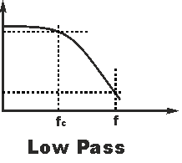
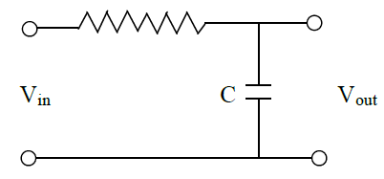
Low-Pass RC filter (first-order)
Passes low frequency and rejects high frequency
The following RC circuit can be used as a low-pass filter (LPF).

Slide 8
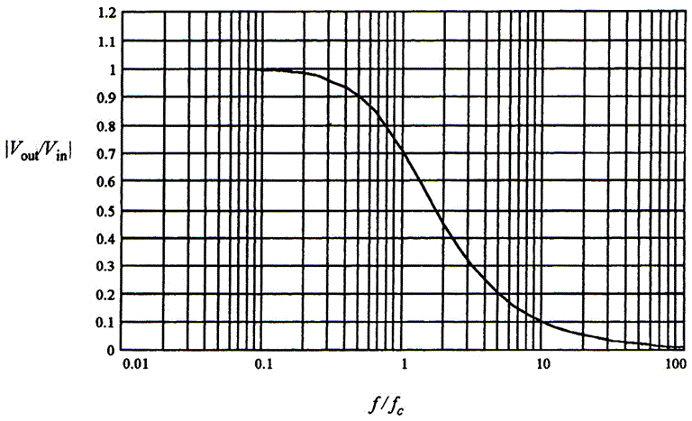
Frequency response of LPF filter

Slide 9
The cutoff frequency (f_{c}), also called corner or critical frequency, of a filter is defined as the frequency at which the output power is reduced to one-half of the input power (or at which the ratio of the output to the input voltage is 0.707).
In the case of the first order low-pass filter, the cutoff frequency is given by:
The output to input ratio is determined by

Slide 10
Filter Design
To design a filter we need first to choose a suitable corner frequency f_{c} which satisfies the specifications.
Then, determine suitable values for R and C according to the following guidelines:
Select a standard capacitor value in the pF to μF range.
Calculate the required resistance value, if R < 1kΩ or R > 1 MΩ, pick another capacitor.
Consider device tolerance.
If exact value is required, use trimmer resistor.

Slide 11
RC Filter Consideration
Very small resistance should be avoided because it can lead to large current and the so-called loading effect.
The output impedance of the filter must be much less than the input impedance of the next stage circuit, otherwise a voltage follower circuit must be added between the filter and the next stage circuit.

Slide 12
Example 1
A measurement signal has a frequency < 1 kHz, but there is unwanted noise at about 1 MHz. Design a low-pass filter that attenuates the noise to 1%?
Answer
At frequency f = 1 MHz, it is required to have
This gives the critical frequency f_{c} = 10 kHz.
Let us use 0.01 uF capacitor. Then, from the following relationship, we get R = 1.59 kΩ.

Slide 13
First and second–order LPF

Slide 14
Second–order LPF
In the case of the second order low-pass filter, the cutoff frequency is given by:

Slide 15
The gain in decibel
It is the log of the ratio of output to input voltage (or power) multiplied by 20 (or 10 for power):
For example, the ratio V_{o}/V_{i} = 0.707 is equivalent to -3dB.
Also, the ratio V_{o}/V_{i} = 0.1 is equivalent to -20dB.

Slide 16
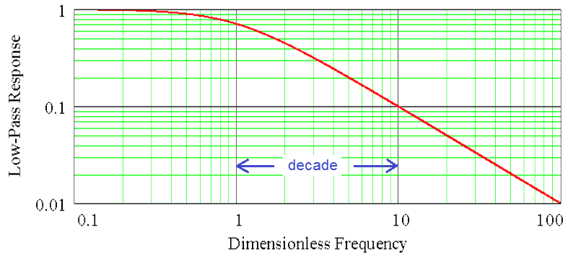
The frequency decade

Slide 17
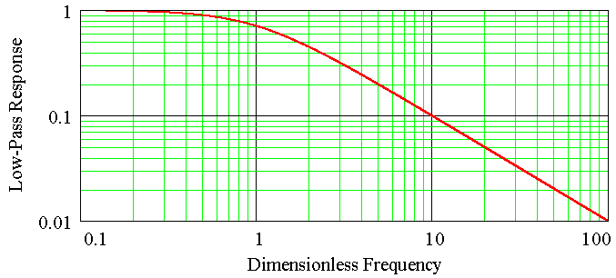
The decay of a first order filter
The decay of first-order filter after the corner frequency has a negative slope of 20 dB/decade.

Slide 18
General notes
The output voltage drops off at:
20 dB/decade for first order filter,
40 dB/decade for a second order filter,
60 dB/decade for a third order filter.
The number of resistive and capacitive elements determines the order of the filter (e.g., first order, second order, and so forth).
The circuit configuration determines the characteristics of the filters.

Slide 19
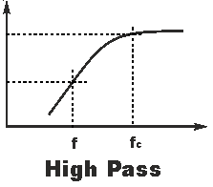
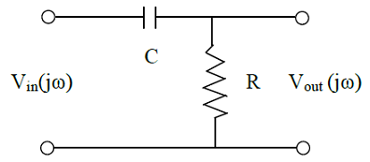
High-pass RC Filter
High-pass filter passes high frequencies and rejects low frequencies (completely attenuates signals at 0 frequency).
RC circuit for high-pass filter:
The ratio of output to input voltage of the HPF is:

Slide 20
Example 2
Pulses for a stepping motor are being transmitted at 2000 Hz. Design a filter to reduce 60 Hz noise (due to electric line frequency) but reduce the pulses by no more than 3 dB.
Answer
First, it is clear that a high pass filter is required.
In order to find its corner frequency, f_{c}, we know that at f = 2000 Hz, the ratio Vo/Vi = -3dB.
From the relationship

Slide 21
Answer (continued)
We substitute in the following relationship
to get the corner frequency f_{c} = 2000 Hz.
Let us use C = 0.01 uF capacitor, then using the following relationship we obtain R = 7.96 kΩ.

Slide 22
Answer (continued)
We have finished designing the filter, but we want to check to what extent the 60 Hz noise is attenuated.
Again, substitute by f = 60 Hz and f_{c} = 2000 in the following relationship
We can realize that the noise has been reduced to only 3% which is very good.

Slide 23
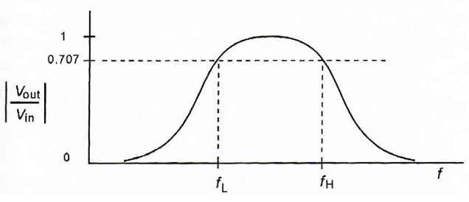
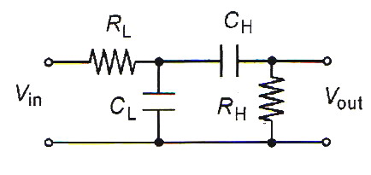
Band-pass Filter (BPF)
Band-pass filter passes frequencies in a certain band and attenuates frequencies below and above the band.
Band pass filters can be constructed by combining a low pass filter in series with a high pass filter.

Slide 24
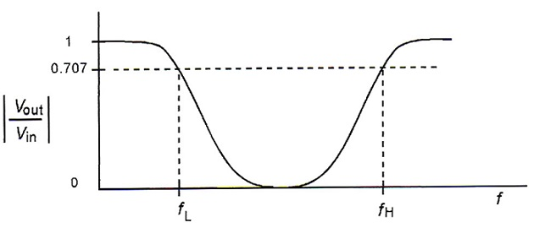
Band-reject Filter
Band-reject, band-stop, or notch filter blocks specific range of frequencies.
A notch filter can be obtained by passing the signal simultaneously through a low pass filter and a high pass filter in parallel and summing the output of the two filters.

Slide 25
Active Filters
It is almost impossible to design passive filters with low output impedances and high input impedances.
Therefore, the loading (interaction) effect will be present when we join passive filters together.
Operational amplifiers can be used either as impedance buffers or as an integral part of the filter circuit.
An added advantage of using active devices is the capability of increasing the static gain of the filter.

Slide 26
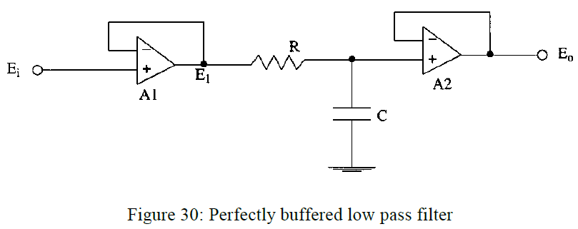
An Active Low Pass Filter
Here, op-amps are just impedance buffers.

Slide 27
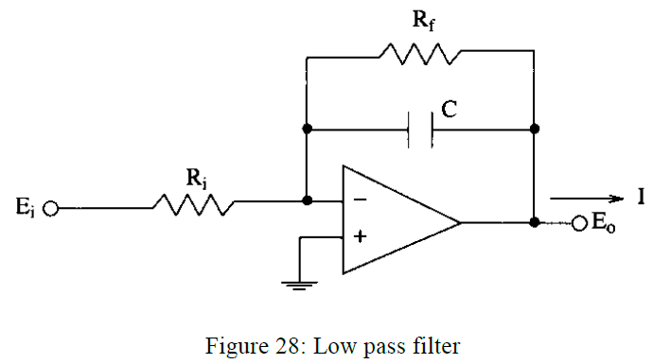
An Active Low Pass Filter
Here, the op-amp is an integral part of the filter circuit.
What is the static (dc) gain of this filter?

Slide 28
Final Note
In these slides, we have considered passive and active filters.
Filters can also be implemented digitally as a piece of software code written on a computer or a microcontroller (so-called digital filters).

