Slide 1
Modifications on PID Standard Form
CSE 425 Industrial Process Control
Lecture 6

Slide 2
Outlines
In this part, we talk about several modifications which are introduced to the standard PID controller to avoid some issues happened in practice:
Derivative on PV
Proportional on PV
Filter on D
Anti-reset windup
Setpoint softening or filtering
Bumpless transfer

Slide 3
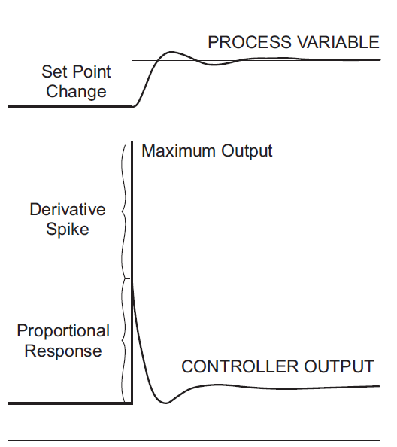
Proportional kick & Derivative Spike
For quick changes in set-point, the controller output suffers
a step change due to proportional response or proportional kick
a derivative spike due to the derivative term.
These abrupt changes are not desirable.

Slide 4
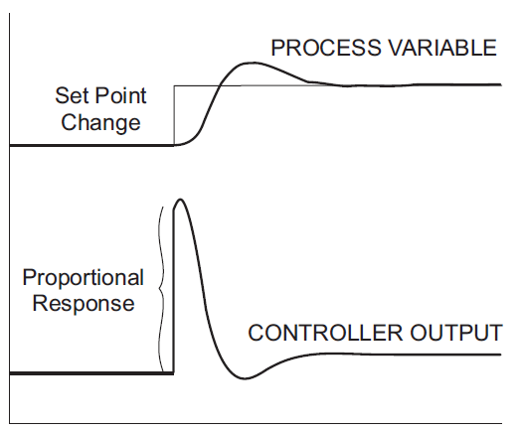
(1) Derivative on PV
To get rid of derivative spike, derivative is applied on the PV, instead of the error e(t).
This modification:
is used in all commercial PID controllers
makes the response a little bit slower
does not affect the response to a disturbance

Slide 5
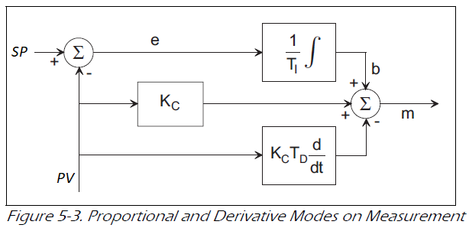
(2) Proportional on PV
The proportional response to a set point change can also be eliminated by making the proportional mode responsive only to the measurement signal rather than to the error as shown below.
This leaves only the integral mode acting on the error.

Slide 6
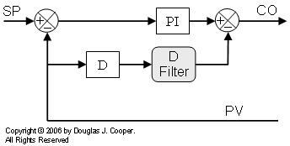
(3) Filter on D
Derivative action is not useful for systems with noisy signals.
In practice, derivative action is usually filtered using a first order lag filter

Slide 7
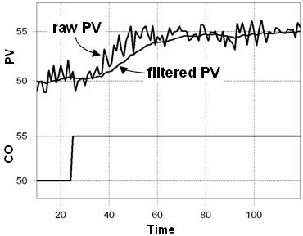
(3) Filter on D
In order to avoid having a fourth parameter to tune, α is set to 10.
Note that for high frequency, the maximum derivative output is now limited to α (called derivative gain) times the proportional action instead of infinity

Slide 8
(4) Anti-Reset Windup
As long as there is an error, integrator output grows. If it goes beyond 100%, we say that integral or reset winds up.
Even if error becomes zero, this is not enough; error must be negative for some time so that the integral component is “discharged”. This leads to larger PV overshoot and settling time.
Techniques to solve this problem are called anti-reset windup. One such method is Conditional Integration.

Slide 9
Conditional Integration
As there is no benefit from the continual increase in integral part beyond 100%, we can simply stop integration if the controller output reaches a limit.
When PID output is 100% while there is +ve error, integral is not allowed to increase further. If it wants to decrease, OK.
When PID output is 0% while there is –ve error, integral is not allowed to decrease further. If it wants to increase, OK.

Slide 10
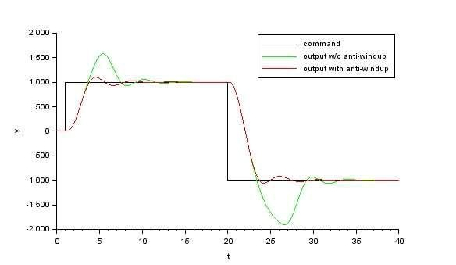
https://www.scilab.org/pid-anti-windup-schemes

Slide 11
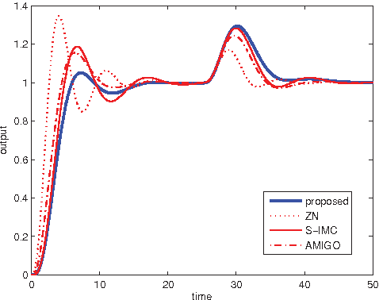
Set point vs. Disturbance Responses
Setpoint changes causes quick and big error signal as seen by the controller
On the contrary, disturbance causes small gradual error
In general:
Tuning for setpoint changes gives a relaxed controller. This causes very slow load rejection.
Tuning for load rejection is aggressive (higher gain and less T_{i}). This tuning causes large overshoot for setpoint changes.

Slide 12
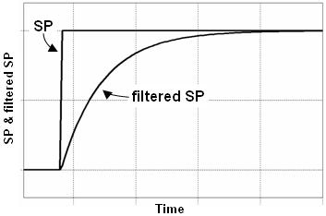
(5) Setpoint Filtering or Softening
To benefit from both, we use load disturbance tuning and apply the setpoint through a lead-lag filter
If the weighting factor
β = 0, there a 1st lag,
β = 1, no filtering
This jump is for β = 0.5

Slide 13
(5) Setpoint Filtering or Softening
Set point filtering is also called Two Degrees of Freedom (2DOF) controller
Note the error is E = SP_{f}-PV
Setpoint filtering has no effect on load response

Slide 14
(6) Bumpless Transfer
When the controller is transferred from MANUAL to AUTO mode, its output can change suddenly.
We need a method to make controller output moves gradually and avoid this proportional kick or bump
Note that when the controller is transferred from AUTO to MANUAL, there is no problem; just keep valve setting

Slide 15
(6) Bumpless Transfer
Let the controller output manually set by the operator be m₀
Let e₀ be the error at the switching instant from MAN to AUTO mode and I₀ be the integrator initial value
Then, the controller output in AUTO mode will be
We want
The controller can achieve this by readjusting the initial integrator value to

