Slide 1
Steady State Error
Acknowledgement: Slides are due to Dr. Imtiaz Hussain, Mehran University of Engineering & Technology, Pakistan. URL :http://imtiazhussainkalwar.weebly.com/

Slide 2
Introduction
Any physical control system inherently suffers steady-state error in response to certain types of inputs.
A system may have no steady-state error to a step input, but the same system may exhibit nonzero steady-state error to a ramp input.
The magnitudes of the steady-state errors due to individual inputs are indicative of the goodness of the system.
Whether a given system will exhibit steady-state error for a given type of input depends on the type of open-loop transfer function of the system.

Slide 3
Classification of Control Systems
Consider the unity-feedback control system with the following open-loop transfer function
It involves the term s^{N} in the denominator, representing N poles at the origin or N integrators.
The number N determines system type. For example, if N=0, the system is type 0, if N=1, the system is type 1, and so on.

Slide 4
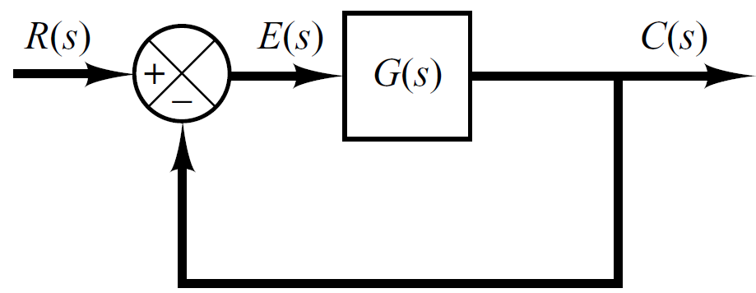
Steady State Error of Unity Feedback Systems
Consider the following position control system (the next analysis will be applicable to other systems).
The transfer function between the error signal E(s) and the input signal R(s) is
The final-value theorem provides a convenient way to find the steady-state performance of a stable system. The steady state error is

Slide 5
Steady-state error for step inputs
The steady-state error of the system for a unit-step input is
The static position error constant K_{p} is defined as
The constant K_{p} determines the ability to track step inputs (i.e. a constant or static position set point).
The higher K_{p}, the lower e_{ss} for step inputs.

Slide 6
Steady-state error for step inputs
For a Type 0 system
For Type 1 or higher systems
For a unit step input the steady state error e_{ss} is

Slide 7
Steady-state error for ramp inputs
The steady-state error of the system for a unit-ramp input is
The static velocity error constant K_{v} is defined as
The constant K_{v} determines the ability to track ramp inputs (i.e. a constant or static velocity set point).
The higher K_{v}, the lower e_{ss} for ramp inputs.

Slide 8
Steady-state error for ramp inputs
For a Type 0 system
For Type 1 system
For Type 2 system

Slide 9
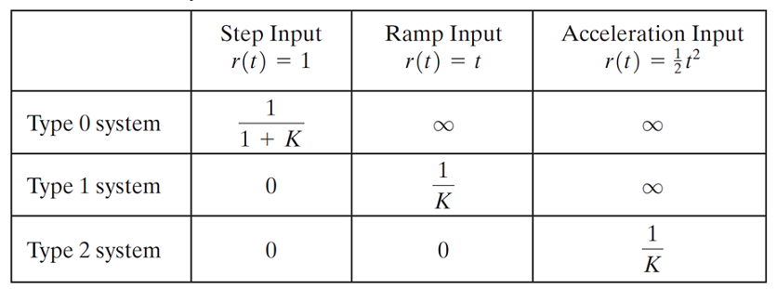
Summary
We see that as the system type number increases, accuracy is improved.
However, increasing the type number aggravates the stability problem.
A compromise between steady-state accuracy and relative stability is always necessary.

Slide 10
Example#1
For the system shown in figure below evaluate the static error constants and find the expected steady state errors for the standard step and ramp inputs.
R(S)
C(S)
-

