Slide 1
A/D Converters

Slide 2
Analog–Digital Conversion
Physical processes are analog in nature.
To monitor and control a process, using a computer, the analog output of the sensor need to be converted into digital codes to be processed by the computer and digital control signal generated by the computer need to be converted into analog to drive the physical system.

Slide 3
Objectives
Recognize the relation between digital and analog values analog-to-digital (A/D) converters.
Explain the operation of two types of ADCs:
Flash
Successive approximation

Slide 4
A/D and D/A converters
V_{max} = 7.5V
1111
4
4
7.0V
1110
6.5V
1101
3
3
6.0V
1100
5.5V
1011
2
2
5.0V
1010
analog input (V)
analog output (V)
4.5V
1001
1
1
4.0V
1000
3.5V
0111
3.0V
0110
t1
t2
t3
time
t1
t2
t3
t4
time
2.5V
0101
t4
2.0V
0100
0100
0110
0110
0101
0100
1000
0110
0101
1.5V
0011
Digital output
Digital input
1.0V
0010
0.5V
0001
V_{min} =
0V
0000
proportionality
analog to digital
digital to analog
Embedded Systems Design: A Unified Hardware/Software Introduction, (c) 2000 Vahid/Givargis

Slide 5
Relation Between Analog and Digital Values
An ideal ADC converts an analog voltage to a linearly proportional digital representation.
If input voltage V_{in} > V_{max}, the digital output N is 1...111.
Similarly, if V_{in} < V_{min}, N is 0...000.
Let the ADC has n-bit digital output and let V_{in} be Analog Value and N be the equivalent Digital Number. Then,

Slide 6
ADC Performance Characteristics
Offset: minimum analog value V_{min}
Span (or Dynamic Range): is the difference between maximum and minimum analog values V_{max} - V_{min}
Step Size (or Resolution, Q): is the smallest change in V_{in} that results in a change in the digital output N.
The number of bits n determines the resolution.
The smaller is the resolution, the less is the quantization error.

Slide 7
Example
Given a 4-bit A/D converter having an analog input that ranges form 0V to 7.5V. What is the resolution of this A/D converter?
Answer:

Slide 8
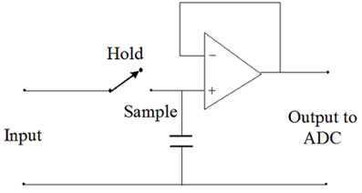
A/D converter
ADC converts analog signals into binary words.
The first stage in an ADC is a Sample & Hold (S/H) circuit which measures (samples) the analog voltage at a particular instant in time and then holds this value constant until it is converted into a digital code.
We will consider two ADC types: parallel or flash and Successive Approximation.

Slide 9
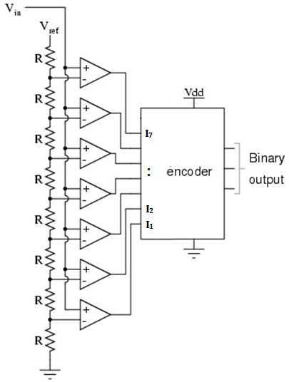
Flash Converters
Flash ADC consists of a precise voltage divider, dividing V_{ref} into equal voltage increments.
The divided voltages are fed to one input of each comparator.
The analog input voltage V_{in} (which we want to convert into digital) is fed to the other input of each comparator.
The output of the comparators feeds an encoder.

Slide 10
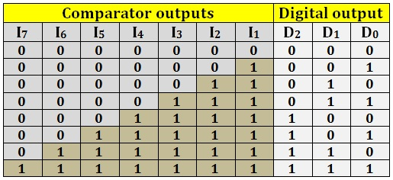
The truth table of the encoder:
Flash ADCs are very fast (suitable for e.g. video conversions).
However, due to their complex circuit, they are expensive. The number of comparators and resistors required increases rapidly. The 3-bit example required 7 comparators, 6-bits would require 63, while an 8-bits converter would need 255 comparators and equivalent precision resistors.

Slide 11
Successive approximation ADC
This is the most common ADC used in the laboratory environment.
Reasonably priced for large bit values, i.e. 10, 12.
Conversion time (typically ~ 10-20 μs) is adequate for most laboratory functions. Good tradeoff between speed and cost
The digital output is generated successively (one bit at a time). For n-bit successive approximation ADC, the digital output is generated in n clock cycles.

Slide 12
V_{ref}
analog input Vin
D/A Converter
Digital Output Data
comparator
Successive Approximation Register
clock
STRT
Initially, all bits of SAR are set to zero.
Conversion begins by taking STRT line low.
The SAR sets the MSB bit to 1 (+5 V). Remember that this is equivalent to half of the full scale.
The output of SAR feeds the D/A converter producing an analog output. This is compared to Vin. If D/A output < Vin then MSB bit is left at 1 otherwise, it is set to 0.
Next bits are tested and set in the same way.

Slide 13
Example
Calculate the conversion time of a 8-bit successive approximation A/D if the clock rate is 2MHz.
Solution:
For a 8-bit successive approximation A/D, the conversion time is equal to

