Slide 1
(3)
Signal Conditioning
Some of these slides are prepared by Dr. Chok Keawboonchuay, Assumption University.

Slide 2
Signal Conditioning
Signal conditioning is the operation performed on the signal to convert it to a form suitable for interfacing with other elements in the system.
Example of signal conditioning:
Signal-range and offset changes
i.e. amplification and zero adjustment
Conversions
e.g. current to voltage and voltage to current
Filtering
removing unwanted frequencies

Slide 3
Signal Conditioning
Before discussing signal conditioning, it is important to examine the following topics:
the loading effect.
the buffer circuit.
the difference amplifier.
the instrumentation amplifier.

Slide 4
Effect of Loading
Measurement systems are made up of many components. Ideally, the gain of the whole system is found by multiplying the gains of the individual components together.
However, this will only give the correct result if very little current flows through the connection circuits.
In reality some current flows. This results in a much more complicated expression for determining the gain for the entire measurement system.
This problem is called loading. We use operational amplifier circuits to help stop this loading problem.

Slide 5
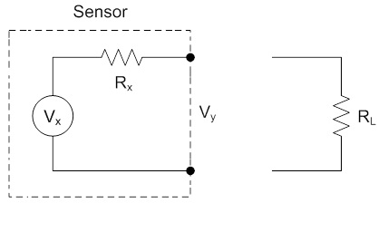
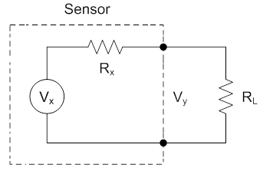
Effect of Loading
Connecting a sensor or circuit to a load introduces uncertainty in the measurement (i.e. in the amplitude of the output voltage) as shown below.
without load: V_{y} = V_{x} with load: V_{y} < V_{x}

Slide 6
The output voltage is calculated using voltage division as
The output voltage is reduced by the voltage drop over the internal resistance of the sensor R_{X}.
To reduce the uncertainty (i.e. to keep V_{y} $≈$ V_{x}), the internal resistance (the sensor output resistance), R_{x}, should be much smaller than the load resistance

Slide 7
Example 1
An amplifier outputs a voltage that is 10 times the voltage on its input terminals. It has an input resistance of 10 kΩ. A sensor outputs a voltage proportional to temperature with a transfer function of 20 mV/°C. The sensor has an output resistance of 5.0 kΩ. If the temperate is 50 °C, find the amplifier output.
Sensor
(20 mV/°C)
Amplification
(gain =10)
50 °C
? V

Slide 8
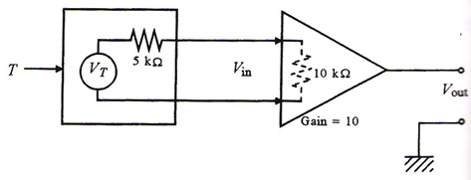
Answer
The sensor output V_{T} = (50°C)*(20 mV/°C) = 1V.
Due to non-zero sensor output resistance (5kΩ) and finite amplifier input resistance (10kΩ), the sensor delivers only
This is amplified 10 times to give V_{out} = 6.67V.
Note: if the sensor o/p impedance is zero or the amplifier i/p impedance is infinite, V_{out} = 10V.

Slide 9
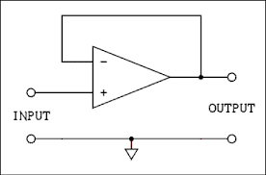
The buffer circuit
To minimize the loading effect, we must look for a circuit that has very large input impedance to obtain the whole sensor output voltage.
Furthermore, as this circuit is probably going to drive other circuits, it should have very small output impedance.
A device having these two properties is called a buffer. One example of buffer is the voltage follower:

Slide 10
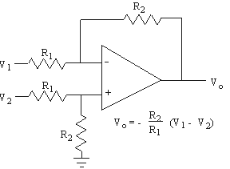
Difference Amplifier
In signal conditioning, it is sometimes required to find the difference between two signals. This can be achieved using the following difference amplifier circuit.

Slide 11
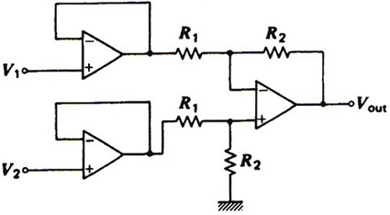
The instrumentation amplifier
The input impedances of the difference amplifier can be relatively low and, hence, tend to load the sensor output.
To have high input impedance, the difference amplifier is preceded by two voltage follower circuits to form the so-called instrumentation amplifier.

Slide 12
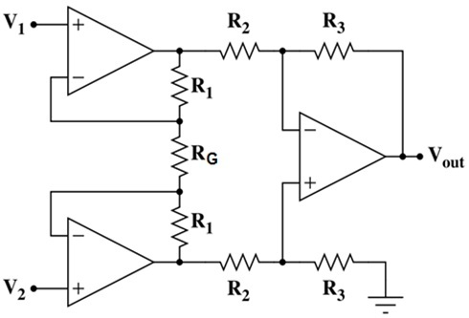
The instrumentation amplifier
One disadvantage of the previous differential circuit is that in order to change the gain, 2 pairs of resistors need to be changed.
A more common differential amplifier in which the gain can be adjusted using one resistor (R_{G}) is shown below.

Slide 13
Signal conditioning
Now, let us discuss the following signal conditioning categories:
Signal-range and offset changes
i.e. amplification and zero adjustment
Conversions
e.g. current to voltage and voltage to current
Filtering will be discussed in the next lecture.

Slide 14
Signal-range and offset (bias)
Example 2
Design a circuit to achieve the following voltage conversion.
Signal conditioning circuit
0.2 V – 0.7 V
0 V – 5 V

Slide 15
Answer
It is clear that we need to subtract 0.2V, then multiply the signal by 10.
Zero shift
Amplification
0.2 V – 0.7 V
0 V – 0.5 V
0 V – 5 V
This looks like a differential amplifier with a gain of 10 and a fixed input of 0.2 volts to the inverting side. The following circuit shows how this could be done using an instrumentation amplifier.

Slide 16
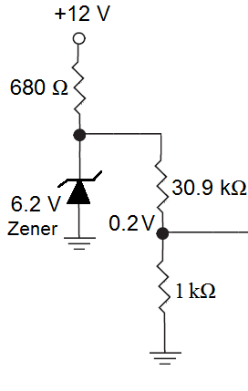
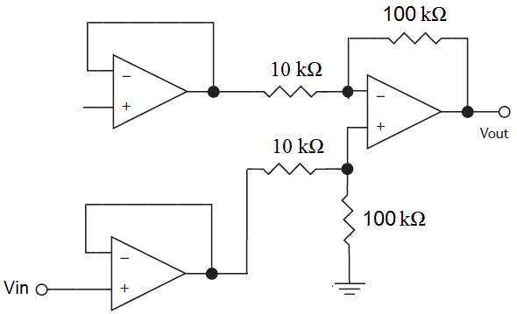
Note that a voltage divider is used to provide the 0.2V offset. The zener diode is used to keep the bias voltage (i.e. the 0.2V) constant against changes of the supply.

Slide 17
Example 3 (Johnson, page 89)
A sensor outputs a voltage in the range of 20 to 250 mV. Develop signal conditioning so that this become 0 to 5 V. The circuit must have very high input impedance.
Answer
Let us develop an linear equation for the output in terms of the input
where a and b are to be found.

Slide 18
For the given two conditions we can write
Hence, the required equation is
Therefore we need a differential amplifier with a gain of 21.7 and a fixed input of 0.02V to the inverting side. The following circuit shows how this could be done using an instrumentation amplifier.

Slide 19
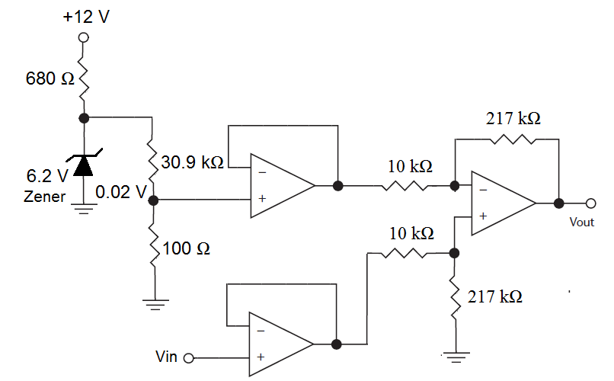

Slide 20
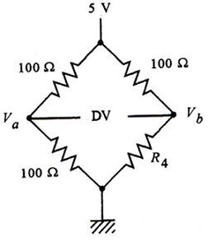
Example 4
A bridge circuit for which R₄ varies from 100Ω to 102Ω is shown below. Show how this bridge could be connected to the given instrumentation amplifier to provide an output of 0 to 2.5V for that change in R₄. Assume that, in the instrumentation amplifier circuit, R₂ = R₃ = 1 kΩ and R₁ = 100 kΩ.

Slide 21
Answer
Clearly, the bridge nulls when R₄=100 Ω. So, we do not need zero adjustment.
When R₄ = 102Ω the bridge offset voltage is found as
To get an output of 2.5V at 102Ω we need a differential gain of (2.5 V/24.75 mV) = 101.
For the given instrumentation amplifier we have

Slide 22
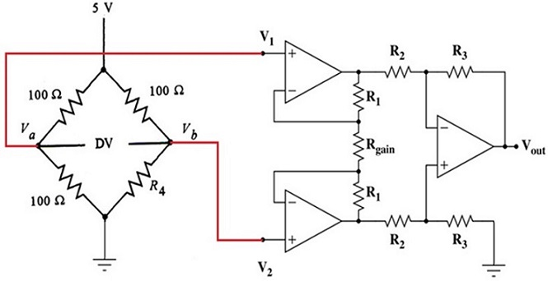

Slide 23
Conversion
In many situations it is required to convert one form of signal or physical value into another form such as
resistance to voltage
voltage-to-current
current-to-voltage
For example, a typical standard in process control systems is to use current signals in the range 4 to 20 mA for transmission. This requires conversion from voltage to current at the sending end and a conversion from current to voltage at the receiving end.

Slide 24
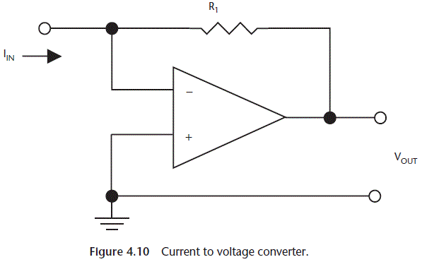
Current to voltage converter

Slide 25
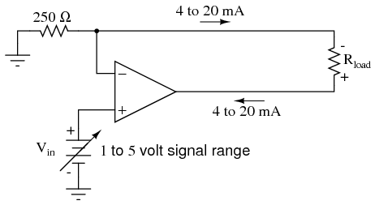
Voltage to current converter
In the following circuit, the current through the load resistor R_{Load} is equal to V_{in}/(250Ω). No matter what value of R_{Load} is, the current through it will be function of V_{in} only.

Slide 26
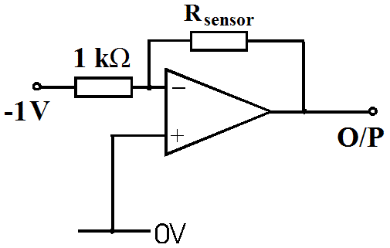
Assignment
Temperature is to be measured in the range of 250˚C to 450˚C. The sensor is a resistance that varies linearly from 200Ω to 1200Ω for this temperature range. The following circuit to convert the sensor resistance change into voltage.
Check that the power dissipated in the sensor is below 5mW. Then, develop analog signal conditioning that provides a voltage varying linearly from -5 to +5 V for this temperature range.

