Slide 1
Feedforward & Ratio Control
CSE 425 Industrial Process Control
Lecture 8

Slide 2
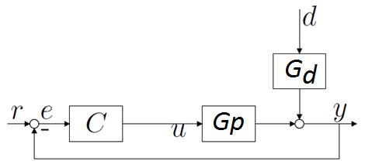
Feedforward Control
Consider the following closed-loop system.
C: feedback controller
Gp: process transfer function
G_{d}: disturbance transfer function
If we assume that the disturbance d can be measured, how to eliminate its effect on the controlled variable y?

Slide 3
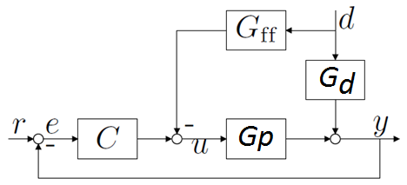
Idea
To achieve this goal, we can add a feedforward controller block G_{ff} whose output manipulates the process G_{p} with negative sign.

Slide 4
Feedforward Control Design
For the moment, we omit the feedback path from our picture. Then, the relationship between d and y will be given by
To eliminate the effect of d on y, we should have the feedforward controller designed as

Slide 5
FOPDT Approximations
If we approximate G_{p} and G_{d} as first-order plus dead time:
Then
Note that if L_{p}>L_{d}, the dead time appears as a positive exponent. This makes G_{ff} not physically realizable as it needs to predict the future. In this case, G_{ff} is just implemented as a lead–lag element:

Slide 6
Feedback-Feedforward Control
In practice, the transfer functions G_{p} and G_{d} are not known exactly and so we can’t expect perfect rejection of disturbances.
Therefore, feedforward control is never used alone; it is implemented in conjunction with a feedback loop.

Slide 7
Feedback-Feedforward Control
The feedback loop handles
Errors in the feedforward function
Unmeasured disturbances that feedforward control does not handle
Set-point changes
The closed-loop characteristic polynomial of feedforward–feedback system is
Therefore, the feedforward controller G_{FF} does not affect system stability.

Slide 8
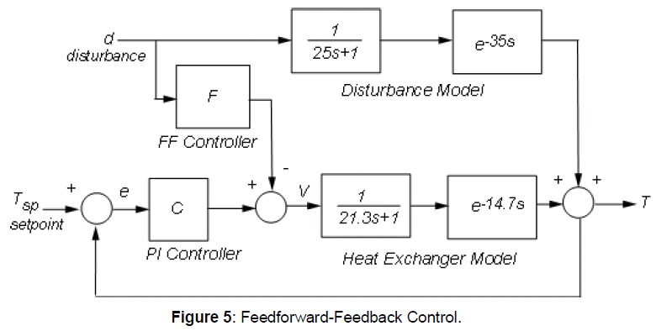
Example
Consider the following feedforward-feedback control system where the feedback controller is PI:
Design the feedforward controller F.

Slide 9
Answer
From the figure, we have
The feedforward controller G_{FF} is then given by:
To get a better sense of how the feedforward scheme would perform, increase the ideal feedforward delay by 5 seconds.

Slide 10
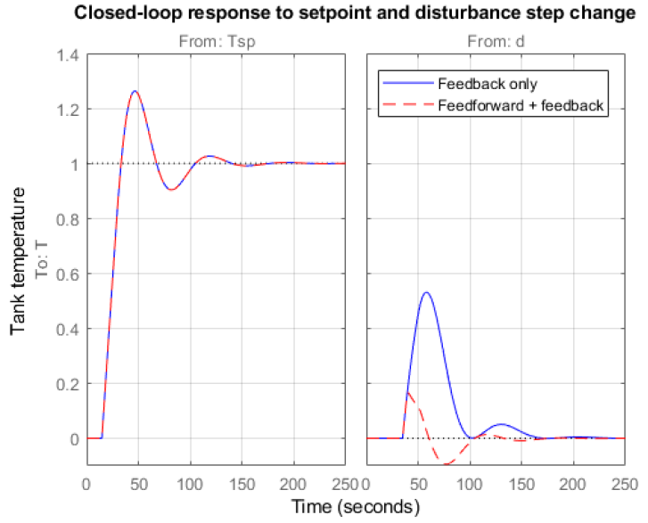
Simulations
Let us compare the closed-loop responses with and without feedforward control.
The two designs have identical performance for setpoint tracking.
However, the addition of feedforward control is clearly beneficial for disturbance rejection.

Slide 11
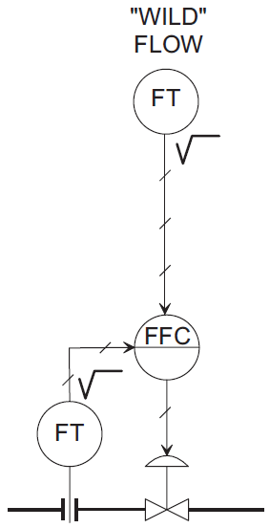
Ratio Control
The objective of ratio control is to maintain a specific ratio between the flow rate of two streams.
For example, in Air-fuel ratio control for a combustion process, fuel flow (called the “wild” flow) is measured and multiplied by the required air-to-fuel ratio.
The product then becomes the set point for the controlled air flow rate loop (called the “secondary” loop) as shown
FT: Flow transmitter
FFC: Flow ratio control

