Slide 1
CSE 323b: Measurements & Testing (1)b

Slide 2
Topics to be covered:
Sensors
Motors
A/D and D/A converters
Serial interfaces
Programmable logic controllers (PLC)

Slide 3
References:
William Dunn, Introduction to Instrumentation, Sensors, and Process Control, Artech House, 2006.
William Bolton, Instrumentation and Control Systems, Elsevier, 2004.
Curtis Johnson, Process control instrumentation technology, Prentice-Hall, 6th edition, 2000.
William Bolton, Programmable Logic Controllers, Elsevier, 4th edition, 2006.
John Hackworth and Frederick Hackworth, Programmable Logic Controllers: Programming Methods and Applications, Prentice Hall, 2003.

Slide 4
Motion Sensors
Many processes such as robotics, numerically controlled tool applications, and conveyors require information and control of both linear and angular position and velocity.
It is also important to detect the presence of objects e.g. a work piece to work on or a person to issue an alarm in burglar systems.
Displacement sensors can be classified into: contacting or non-contacting (using e.g. light, infrared beams, or magnetic effect).

Slide 5
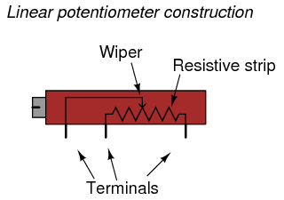
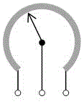
Potentiometer
Potentiometers can be used to convert displacement into voltage.
The wiper or slider arm of a linear potentiometer is mechanically connected to the moving object.
For angular displacement, a circular potentiometer is used.
The lifetime of the potentiometer is limited due to wear.

Slide 6
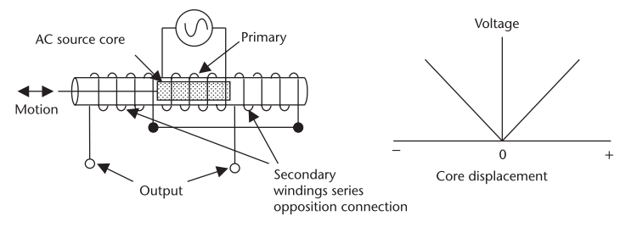
LVDT
Linear variable differential transformers (LVDT) is used to measure small displacements (±1 mm to ±25 cm).
They are more accurate and have longer life time compared to potentiometers, however, they are more expensive.
The device consists of a primary coil and two secondary windings, one on each side of the primary. An AC voltage is applied to the primary.

Slide 7
A movable core, centrally placed in the primary, will give equal coupling to each secondary and so equal voltages are obtained from the secondary windings
As the secondary are wired in series opposition, the output voltage is zero.
When the movable core travels away from the center, an output voltage proportional to displacement is obtained.
The transfer function is normally expressed in mV/mm.

Slide 8
Capacitive displacement sensor
Capacitance variation is a very accurate method of measuring displacement, and is extensively used in micromechanical devices where the distance is small, giving high capacitance per unit area.
The capacitance between two parallel plates is given by:
Where K is the dielectric constant of the material between the plates, A is the area of the plates, and d is the distance between the plates.

Slide 9
Figure. Basic capacitance model of displacement sensors: (a) variable area, (b) movable plate, and (c) movable dielectric.

Slide 10
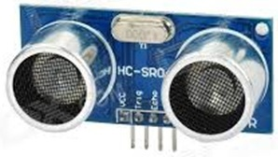
Ultrasonic displacement sensor
The sensor consists of a transmitter and a receiver of ultrasonic waves.
The transmitter sends a pulse which hits the object and then reflected back to the receiver. The time elapsed between sending and receiving the pulse is measured. Knowing the speed of ultrasonic waves (340 m/s), the distance from the object can be calculated.
Measurement distance Ranges from 2cm to 400cm.

Slide 11
Optical encoders
An encoder is a device that converts angular displacement into a digital output.
Encoders can be classified into two categories:
Absolute encoders, which give the current position directly.
Incremental encoders, which detect changes in displacement from some reference position.

Slide 12
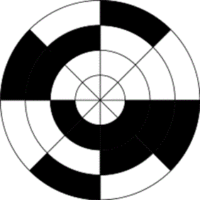
Absolute Optical Encoder
Absolute encoders are made using patterned disks.
An array of LEDs with a corresponding photodetector for each LED give the position of the wheel at any given time encoded in an n-bit binary number.
Typically designed with either binary or Gray code. What is the advantage of Gray code over binary code?
3-bit binary Rotary encoder
3-bit Gray code Rotary encoder

Slide 13
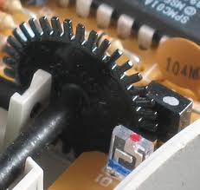
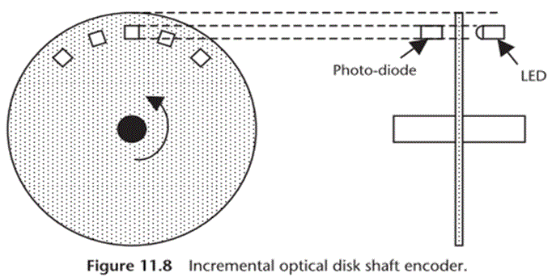
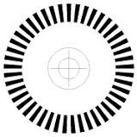
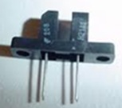
Incremental Optical Encoder
In an incremental encoder, the disk contains a number of holes. When the light emitted by the LED passes through a hole onto the photodiode a pulse is generated.
Reflective strips can replace the slots, in which case the light from the LED is reflected back to a photodiode.

Slide 14
Incremental Optical Encoder
The angle Δθ rotated by the wheel with respect to its previous location can be obtained as:
where n is the number of pulses counted during the rotation and N is the total number of slots in the disk.
The resolution of the encoder is 360ᵒ/N. Only one slot in the disk is required to measure revolutions per minute.
Optical encoders can also be used to measure speed by counting the number of pulses obtained per 1 second.
Disadvantage: with only one track, the direction of rotation can not be determined.

Slide 15
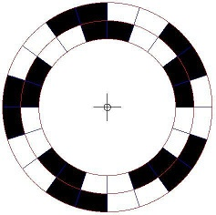
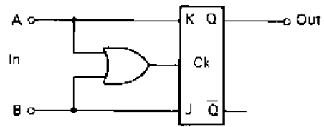
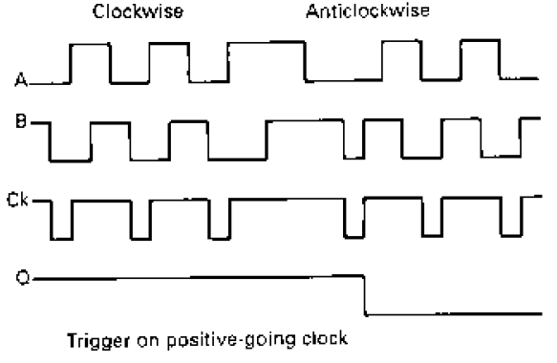
Incremental Encoder with 2 tracks
Two tracks A and B (which are 90° out of phase) are used to determine the direction of motion.
Signals A and B from the encoder are connected to a J-K flip-flop.
The OR gate generates the clock.
The flip-flop output Q will be 1 for one direction and 0 for the other.

Slide 16
Tachogenerator
Tachogenerator is simply a generator which gives a voltage proportional to the speed of rotation.

Slide 17
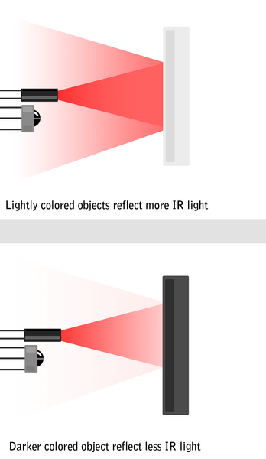
Infrared Proximity Sensor
IR Sensors use a specific light in the Infra-Red (IR) spectrum.
When an object is close to the sensor, the light from the LED bounces off the object and into the light sensor.
This results in a large jump in the intensity, which can be detected using a threshold.
Useful for line tracking.
Detection distance: 2 ~ 30cm

Slide 18
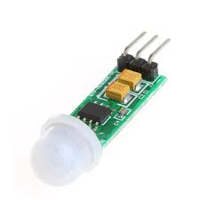
Pyroelectric Sensor
Pyroelectric Sensor is used for motion detection in e.g.
burglar alarms
turning light on when someone walks up the drive to a house.
Some materials such as Lithium tantalate generate voltage when the infrared radiation falling on them changes.
The heat of a human or animal from several feet away is enough to generate such voltage.

Slide 19
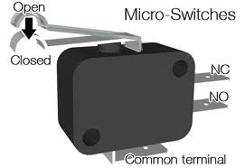
Limit Switch
Detect the presence of some object.
For example, a work piece closes the switch by pushing against it when it reaches the correct position on a work table.
Another example is turning the light of a refrigerator on when the door is opened. Opening the door closes the contacts in a switch and trigger an electrical circuit to switch on the lamp.

Slide 20
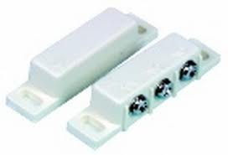
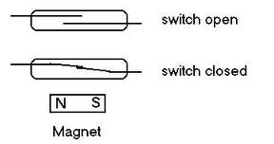
Reed switch
Non-contact switch sensor.
Reed switch can be used to detect the opening of doors in security systems.

