Slide 1
Block Diagrams of Discrete Systems
CSE 421 Digital Control
Lecture 6

Slide 2
Example 1
Derive an expression for the transfer function of the following discrete-time system.
Where

Slide 3
Solution
The output of the system can be found as:
Where
Hence

Slide 4
Example 2
Calculate the response of the following system to a unit step, Assuming a sampling period of T = 1.

Slide 5
Solution
As there is no sampler between G₁ (the ZOH) and G₂, the output is obtained as
Where

Slide 6
For a unit step input, the output is given by
Y= {0, 0.6321, 0.8647, 0.9502, 0.9817, 0.9933, …}
The following Matlab code can be used to solve this example.
s = tf('s');
G = 1/(s+1);
Gd = c2d(G,1,’zoh’);
t = 0:1:10;
y = step(Gd,t)
plot(t,y,'o',t,y)

Slide 7
MATLAB command dlsim
The command dlsim can be used to simulate the response of discrete systems to different kinds of input signals.
For example, to find the step response of the following system:
u = ones(size(0:10)); % input is step
num = [0 0.1813]; % Numerator coefficients of z
den = [1 -0.8187]; % Denominator coefficients of z
y = dlsim(num,den,u);
plot(0:10,y,’o’,0:10,y); % Plot samples as "o" connected by lines

Slide 8
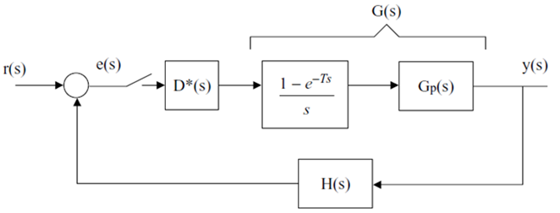
Example 3
Derive the transfer function of the following closed-loop sampled data control system.

Slide 9
Effect of sampling interval
Consider the following continuous-time system.
Let us add a sampler (A/D converter) and a ZOH (D/A converter) to this system to form an discrete-time system.
Let us compare step responses of both systems.

Slide 10
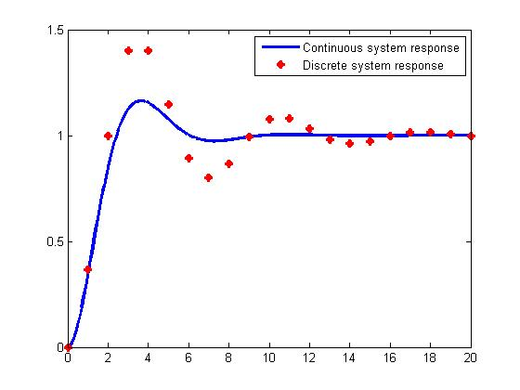
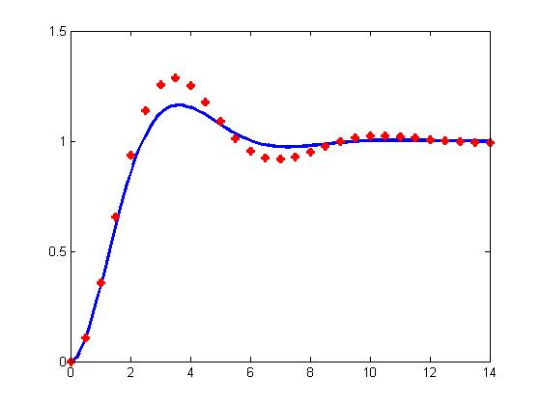
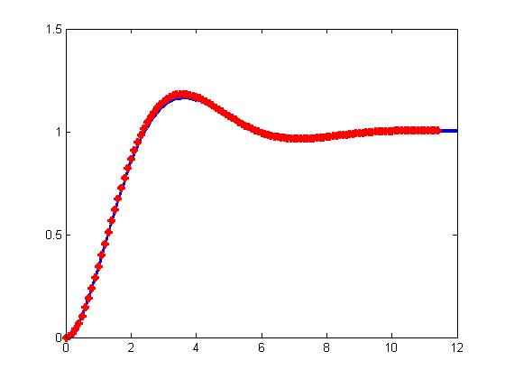
Time response of continuous & discrete systems
Discrete system has higher overshoot. This indicates that the sampling process makes the system less stable.
If we decrease the sampling interval to 0.5 and 0.1, the response of discrete-time system approaches continuous system response.
T = 1.0
T = 0.5
T = 0.1

Slide 11
The closed-loop step response of continuous system is
The closed-loop step response of discrete system is
s = tf('s')
t = 0:0.1:35;
% The continuous system
G = 1/(s^2+s);
Gcl = G/(1+G)
y = step(Gcl,t)
plot(t,y,'LineWidth',2.5),
hold on
% The discrete system
T = 1; % sampling interval
Gd = c2d(G,T);
Gcld = Gd/(1+Gd);
[y,t1] = step(Gcld)
plot(t1,y,'*r','LineWidth',2.5)
axis([0 20 0 1.5])

Slide 12
Sample period selection
Large sampling interval has destabilizing effects on the system as the controller has no information about what is going on for the process output between samples.
In practice, a sampling interval of 1 second is short enough for e.g. pressure, temperature and ﬂow control.
Faster electromechanical systems (e.g. motors) require much shorter sampling intervals in the order of milliseconds.
Some empirical rules for selecting sampling interval:
If the plant has dominant time constant τ, then choose sampling interval T < τ /10.
The sampling frequency should be 6-20 times larger than the bandwidth of the plant.

