Slide 1
(5) Serial Interfaces

Slide 2
Introduction
Communications are needed to connect computers, microcontrollers, sensors, etc.
There are two types of communications: parallel and serial.
Parallel communications have higher transmission rates but requires more lines than serial communications.

Slide 3
Objectives
In serial communications, explain the difference between the following modes:
half and full duplex.
synchronous and asynchronous.
Recognize the following three serial interfaces:
Standard RS-232.
SPI (Serial peripheral interface).
I2C (Inter-integrated circuits).
Very important in embedded system interfacing.

Slide 4
Half & full duplex
One-way: data sent in one direction only.
Half-duplex: two-way transfer, but only in one direction at a time.
Full-duplex: send and receive data simultaneously.
RS-232 and SPI is full-duplex.
I²C is half-duplex.

Slide 5
Synchronous vs. Asynchronous
In synchronous communication, both transmitter and receiver share a common clock. Thus, one line is assigned to the clock.
RS-232 (and also USB) is asynchronous
SPI and I2C are synchronous.

Slide 6
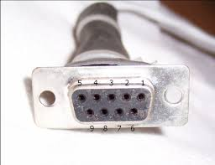
RS-232 Interface
Recommended Standard RS-232 (also called serial or COM port) is a common interface to connect computer to other devices.
Note: most modern laptops do not have serial port!
The DB-9 com port has 9 pins. Main lines are:
Pin 2 – Tx (transmit data)
Pin 3 – Rx (receive data)
Pin 5 – Ground
To connect two PCs (or two μC), we simply use a cross cable:

Slide 7
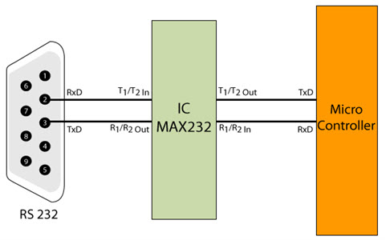
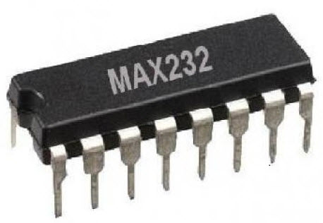
Connecting PC to µC
More difficult.
RS 232 logic levels: -3 to -15V for logic 1 and +3 to +15 V for logic 0.
TTL: 0&5V.
We need to use a converter, e.g. MAX 232 IC.

Slide 8
RS-232 protocol
Line is initially idle (no transmission).
To start communication, Tx pulls the line low for 1 bit interval called the start bit.
A number of data bits are then sent in ASCII format.
Tx sends 1 stop bit to retain the original state of the line.
An interrupt is issued to the processor.

Slide 9
RS-232 protocol
Each transmitted character is packaged in a frame consisting of:
Start bit which signals the receiver that data is coming.
Data bits actual data (5, 7, or 8 bits).
Optional Parity bit for error checking. There are two types of parity: even and odd.
Stop bit to indicate the end of a single packet. Typical values are 1, 1.5, and 2 bits.
Tx and Rx must agree on the transmission bit rate (i.e. the duration of each bit), number of data bits, parity type, and the number of stop bits.

Slide 10
Example
Assume that the bit rate is 9600 bit/sec (bps). How many bytes can be sent in one second if there is one start and one stop bits?
Answer:
Interval of one bit = 1/9600 = 104 μsec.
For each 8 bits (one byte) of data, we transmit additional 1 start + 1 stop bit. This is a total of 10 bits.
Hence, we can send 9600/10 = 960 Byte/sec.

Slide 11
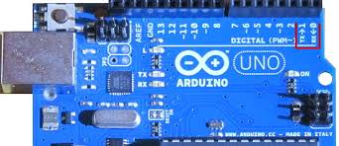
Example: Arduino Serial Port
int incomingByte = 0; // for incoming serial data void setup( ) { Serial.begin(9600); // opens serial port, sets data rate to 9600 bps } void loop( ) { if (Serial.available() > 0) // send data only when you receive data:
{ incomingByte = Serial.read(); // read the incoming byte Serial.print("I received: "); Serial.println(incomingByte); // say what you got } }

Slide 12
SPI Interface
SPI is a 4-wire interface used by many µp and µc to connect to devices such as ADC, memory modules, sensors, or other µp and µc.
Speed up to 10Mbps.
Full duplex.
Synchronous type.
SPI 4 wires are:
Serial Clock (SCLK) - generated by the Master
Master Out Slave In (MOSI)
Master In Slave Out (MISO)
Slave Select (SS)

Slide 13
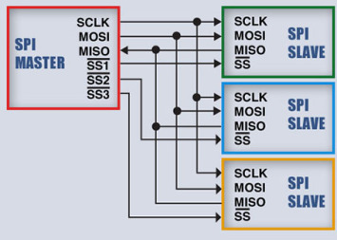
SPI & multiple slaves
A master can communicate with multiple slaves (however only one at a time).
You need one SS line for each slave.
The master asserts SS for one slave and de-asserting it for all the others.

Slide 14
SPI protocol
To begin communication, the bus master configures the clock with a frequency supported by the slave device, typically up to a few MHz.
The master select the desired slave by pulling the line (SS) low.
Data transfer is preformed using shift register in both transmitter and receiver.
When there are no more data to be transmitted, the master stops its clock.

Slide 15
Pros and cons
Advantages:
Full duplex communication
Slaves use the master's clock, and don't need precision oscillators
No overhead (information other than the data) needs to be sent.
Disadvantage:
Requires more pins on IC packages than I²C.

Slide 16
#include "SPI.h" // necessary library
void setup()
{
pinMode(10, OUTPUT); // we use this for SS pin
SPI.begin(); // wake up the SPI bus
SPI.setBitOrder(MSBFIRST); // MSB bit first
}
void setValue(int value)
{
digitalWrite(10, LOW); // using digital pin 10 for SPI slave select
SPI.transfer(value); // send value (0~255)
digitalWrite(ss, HIGH);
}
void loop()
{
for (int a=0; a<=255; a++)
{
setValue(a);
delay(del);
}
}
SPI in Arduino Uno:
Pin 11 -> MOSI
Pin 12 -> MISO
Pin 13 -> SCK
Pin 10 -> SS (slave)

Slide 17
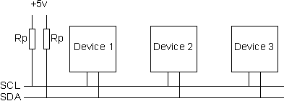
Inter Integrated Circuits (I²C) Interface
I²C is a 2-wire bus widely used for serial communication between integrated circuits on the same circuit board and to attach low-speed peripheral devices, sensors, and components to embedded systems.
I²C has two bi-directional lines: Serial Data line (SDA) and Serial Clock line (SCL).

Slide 18
I²C Bus interface
Only two devices exchange data during one conversation.
The device that initiates communication is called MASTER, and the device being addressed by the Master is called SLAVE.
The Master generates the clock.
I²C has a 7-bit address space with 16 reserved addresses, which makes the maximum number of nodes 112.
I²C bus is a multi-master bus: any of the devices on the bus can initiate data transfer.

Slide 19
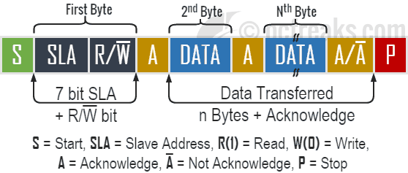
I²C interface protocol
MASTER waits until it sees no activity on the bus (SDA & SCL HIGH).
Master STARTs using the bus.
Slave devices start listening on SDA line.
Master provides clock, address of target slave, and one-bit R/W.
Target Slave responds with acknowledgement.
Master transmits/receives 8-bits of data to/from slave, which replies with a 1-bit acknowledgement and so on.
When communication is complete, Master issues a stop condition to free up the bus.

Slide 20
I²C pros and cons
Pros:
Only two wires -> reduces cost & complexity of the circuit - well suited for boards with many devices on the bus.
Cons:
Overhead of addressing and acknowledgments.
This can be inefficient in simple configurations and a direct-link interface such as SPI might be preferred.

Slide 21
I2C in Arduino
#include "Wire.h"
void setup()
{
Wire.begin();
}
void loop()
{
for (val=0; val<128; val++)
{
Wire.beginTransmission(address);
Wire.send(val);
Wire.endTransmission();
delay(dt);
}
}
I2C in Arduino Uno:
Pin A4 -> SDA
Pin A5 -> SCL

