Slide 1
Discrete Controller Design
CSE 421 Digital Control
Lecture 8

Slide 2
Approaches for Digital Control Design
Design a continuous controller D(s) (e.g. PI, lag, lead, PI, PID, …) for plant G(s). Then, convert D(s) into discrete equivalent D(z) using numerical integration methods
Convert plant G(s) into discrete equivalent G(z). Then, design controller D(z) in z-domain (using root locus, bode plot, or the direct synthesis method of Ragazzini)

Slide 3
Direct Synthesis
Consider the following closed loop system consisting of a given plant G(z) and a controller D(z) which we are looking for.
The closed-loop transfer function is given by

Slide 4
Direct Synthesis
Assuming that we want the closed-loop system to have some “desired” transfer function T(z), the controller can be obtained as:
Note that the denominator of D(z) must be at least of the same order as the numerator so that the controller is realizable.

Slide 5
How to Specify T(z)?
This can be done by specifying some performance measures of the control system such as:
rise time,
settling time,
maximum overshoot, and
steady-state error.
The performance of a control system is usually measured in terms of its step response. The step input is easy to generate and gives the system a nonzero steady-state condition which can be measured.

Slide 6
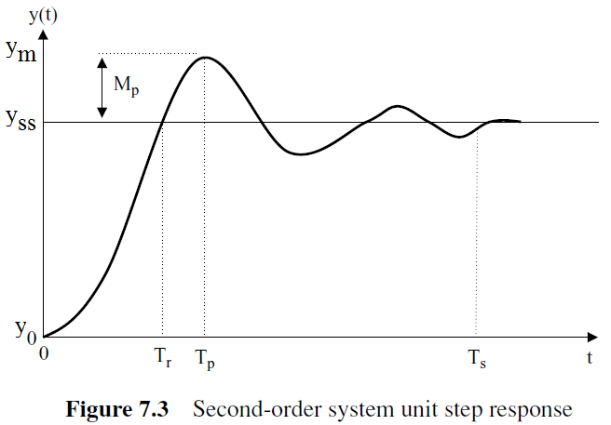
Review of Time domain Specs
Recall the typical step response of a 2nd order system: ω_{n} is the undamped natural frequency and ζ is the damping ratio of the system.

Slide 7
Rise & Settling Times
Rise Time (T_{r} ): time for response to go from 0% to 100% of its final value for the first time.
It is a measure of the speed of response. Smaller rise time results in faster response but with higher overshoot.
Settling Time (T_{s}): time taken to reach and stay within 2% around the final value of the response.
An approximate formula

Slide 8
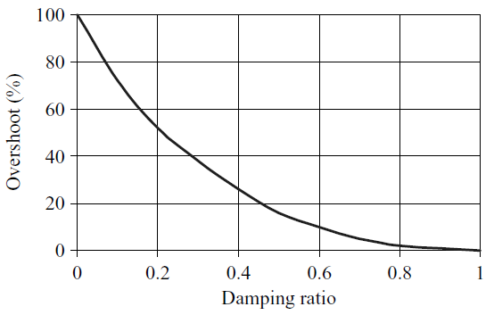
Percent Overshoot (Mp)
The percent overshoot is defined as
It indicates the relative stability of the system.
The lower ζ, the higher Mp.

Slide 9
Pole Placement Approach
We realize that the performance indices are functions of ζ, ω_{n}.
Also, the poles of the system is related to ζ, ω_{n}:
Therefore, system response is related to the location of its poles.
By placing closed-loop poles at good locations, we can shape the response of the system and achieve desired time response characteristics.

Slide 10
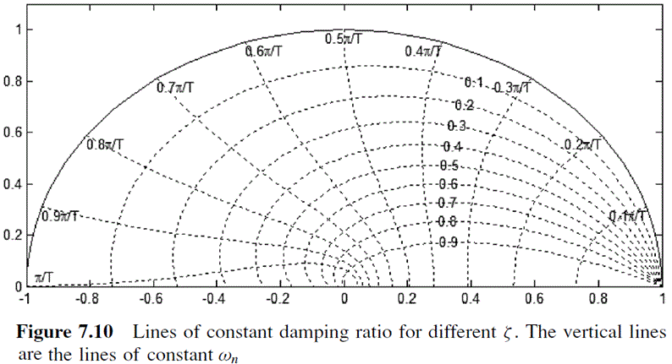
ζ and ω_{n} in the z-plane
Although the previous analysis is conducted for 2nd order continuous-time system, pole placement is also applicable to discrete-time systems thanks to the mapping, z = e^{sT}, between s- and z-plane poles .

Slide 11
Example 1
The open-loop transfer function of a system together with a ZOH is given by
Design a digital controller so that the closed-loop system has:
settling time of 1.78 sec,
percent overshoot is 10%,
zero steady-state error for step input.
zero at -1.
Assume that T = 0.2 sec.

Slide 12
Solution
From the required percent overshoot and settling time,
The desired poles are
The desired closed-loop transfer function is thus given by:

Slide 13
Note the degree of the numerator N(z) is 1 so T(z) has a delay of one sample which is equal process delay (i.e. order of denominator exceeds that of numerator by 1). This insures the controller is realizable.
Let us find b from the steady-state requirement.
For input R(z), the error is given by
So, the steady-state error is given by

Slide 14
For a unit-step input:
The required controller is thus given by:

Slide 15
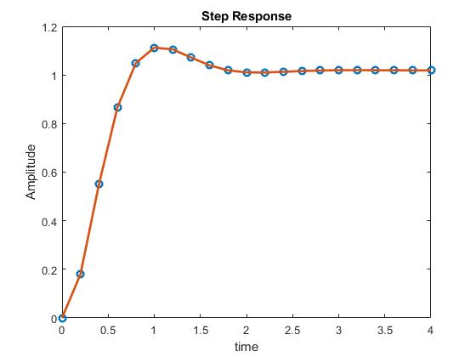
The step response of the designed closed-loop system:

Slide 16
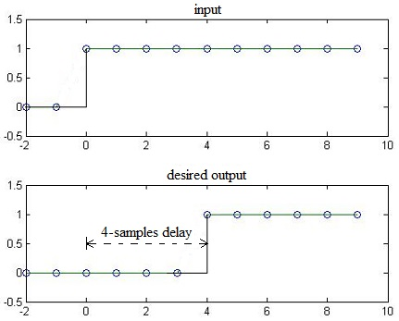
Deadbeat Controller
The aim of dead-beat controller is to bring the output to steady state in the minimum number of time steps. This achieves an ideal fast response.
For simplicity, assume the set point is a step input.
N
L

Slide 17
Deadbeat Controller
For deadbeat response, the desired closed-loop transfer function is thus
The controller achieving this response is given by:
It is interesting to note that deadbeat control is equivalent to placing all closed-loop poles at z = 0. These poles correspond to the fastest response possible.
Usually, this comes at the expense of large control signal.

Slide 18
Example 2
The open-loop transfer function of a plant is given by
Design a dead-beat controller for the system. Assume that T = 1 s, and note that there is a ZOH before the plant.
Answer:
The transfer function of the system with a ZOH is given by

Slide 19
From z-transform tables
Note that the plant has 3 samples delay. For realizability, we select T(z)=z⁻³.
Hence, the dead-beat controller is given by

Slide 20
With this controller, the block diagram of the closed-loop is
Let us simulate the step response of the closed-loop system and also plot the control signal.

Slide 21
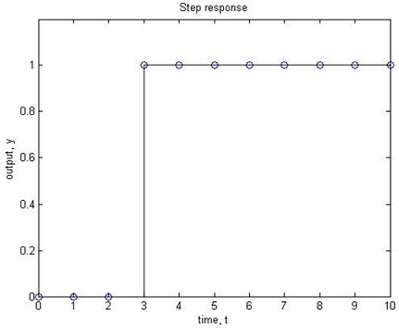
The step response is reaches 1 after 3 seconds.
It is important to realize that the response is correct only at the sampling instants and the response may oscillate between samples.

Slide 22
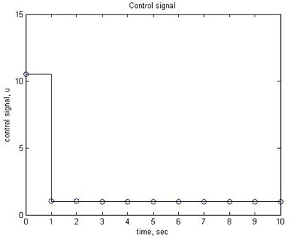
From the figure below, the magnitude of the control signal is very large at the beginning (≈11).
The main drawback of dead-beat control is that it requires excessive (large) control efforts which may not be acceptable in practice.

Slide 23
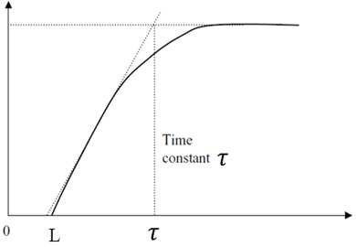
Dahlin controller
Dahlin controller is a modification of the deadbeat controller that produces an exponential response that is smoother than deadbeat response.
The desired closed-loop response for step input looks like:

Slide 24
The desired closed-loop step response is:
Where N = L/T.
As the input is step, then the closed loop transfer function is

Slide 25
Example
The open-loop transfer function of a plant is given by:
Design a Dahlin controller for the system to achieve a closed-loop time constant of 5 s.
Assume that T = 1 s and the plant is preceded by a ZOH.

Slide 26
Answer
First, we need to find the z-transform of the process (preceded by a ZOH). From the previous example, this is found to be:
Second, the desired closed-loop transfer function T(z) can be written as
Note that the desired closed-loop time constant is 5 sec and N = L/T = 2 to achieve the same process delay of 3 samples.

Slide 27
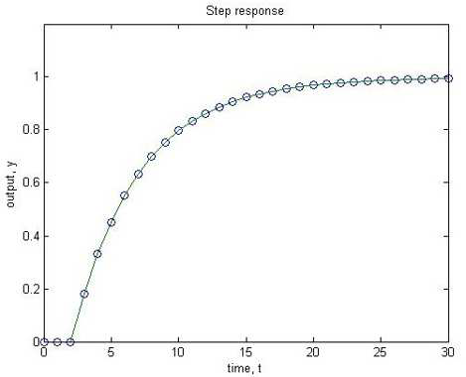
The controller can be found as
Using the designed controller, the closed-loop step response is as shown below. The response is exponential as designed but slower than deadbeat control.

Slide 28
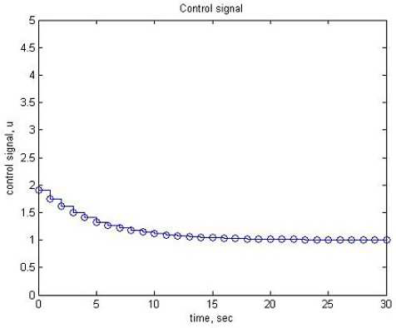
The maximum control signal magnitude (1.9) is much smaller than the control signal obtained using a deadbeat controller (11). This is more acceptable in practice.

