Slide 1
PID Tuning
CSE 425 Industrial Process Control
Lecture 7

Slide 2
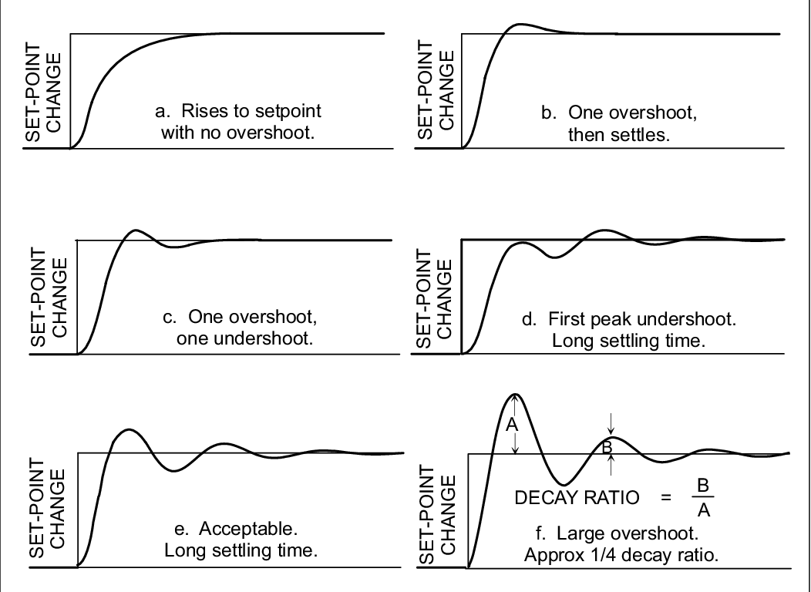
Controller Tuning
Tuning is about adjusting the parameters K_{c},T_{i},and T_{d}, to give “best” response
It is a compromise between minimizing settling time (speed) & overshoot (stability)
Both are very good

Slide 3
How to judge step response?
Overshoot: acceptable 5-10%
Decay ratio = 2nd peak / 1st peak, the smaller the quicker the response
Period of oscillation
If the response makes one or two cycles before reaching setpoint, we make a good job!

Slide 4
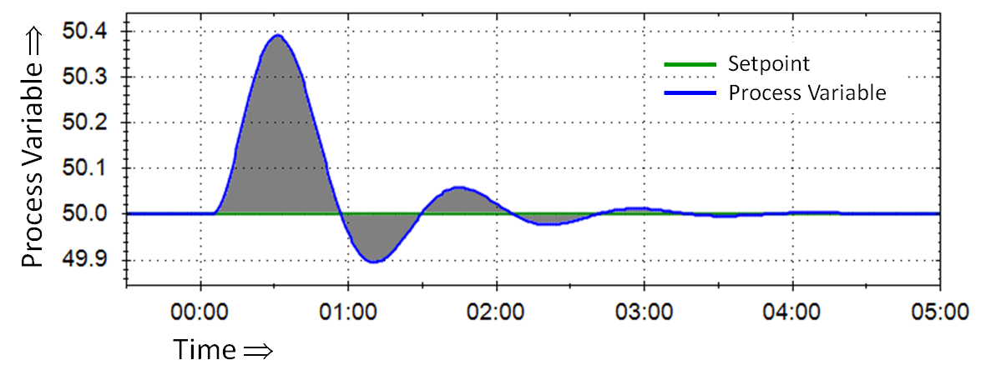
Error Integral Criteria
Error criteria penalize both Size & Duration of Error
Integral of Squared Error (ISE)
Integral of Absolute Error (IAE)
Integral of Time-weighted Absolute Error (ITAE): penalizes late errors (gives best settling time)
Error = SP - PV

Slide 5
PID Controller Tuning
Tuning can be done by trial and error
time-consuming
costly
There are many systematic methods for PID tuning such as classical Ziegler–Nichols (ZN) tuning rules.
We will study ZN’s two methods.

Slide 6
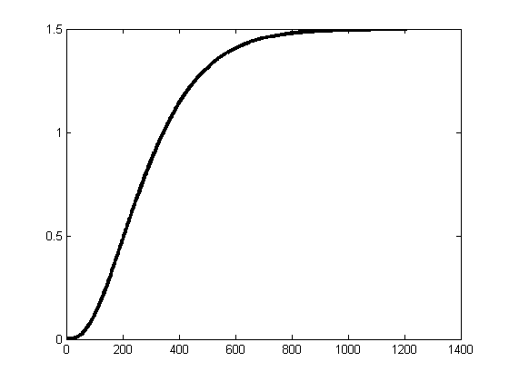
ZN’s first method
Start at steady state
Turn the controller into Manual mode (open-loop)
Apply a step input, of suitable magnitude, to the process.
Record the step response (also called process reaction). It has to be S-shaped in order for this method to be applicable.
Fit a first-order plus dead time (FOPDT) model to the curve.

Slide 7
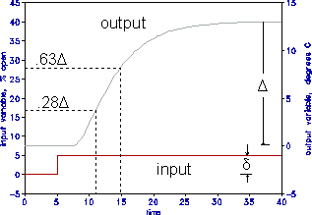
Two-points method
The Two-points method is used to fit FOPDT model to process reaction curve
Where θ is time delay, τ is time constant, and K is dc gain.
Times t₂₈ and t₆₃ are measured from the time step input is applied
Remember K is dimensionless

Slide 8
Process Identification
Bump test: 5% (Avoid 0-100% change)
Stay around the middle of normal range of operation to avoid nonlinearity of the valve.
Apply more than one bump test as shown below.
If the tests give different parameters:
Use a larger value for process gain
Use a long estimate for dead time
Use a short estimate for time constant
This gives conservative tuning

Slide 9
Dead Time-to-Lag Ratio (θ/τ)
This ratio tells us how much is the process easy to control
θ/τ < 0.33 easy to control
0.33 < θ/τ < 1.0 controllable
1.0 < θ/τ a bit difficult to control
(most pronounced S shape)
The controller gain is inversely proportional to θ/τ.
if θ/τ is large, the gain should be low; i.e. the controller must be cautious

Slide 10
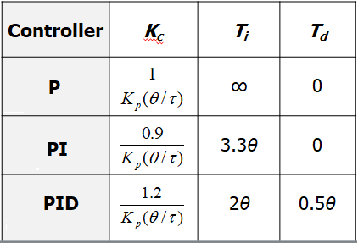
ZN Tuning rules
Using the following table, find the P, PI, or PID controller parameters corresponding to the FOPDT model obtained.
Note how adding D allow increasing controller gains to obtain faster response.

Slide 11
ZN’s Second Method
If the process reaction curve is not s-shaped or the process is open loop unstable, the first method is not applicable.
This method is called the Ultimate-Cycle method.
In contrast to the first method, the ultimate cycle method is used in closed-loop.

Slide 12
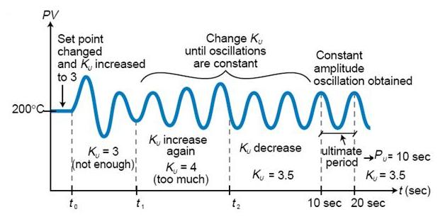
Procedure
Put the process under closed-loop proportional control.
Create a small disturbance in the loop by changing the set point.
Adjust the proportional gain, increasing and/or decreasing, until the response shows oscillations with constant amplitude (a sustained oscillation called hunting).
Record the gain value (K_{u}) and period of oscillation (T_{u}).

Slide 13
ZN’s 2nd Tuning rules
Use the following table to find controller parameters.
Controller | K_{c} | T_{i} | T_{d}
P | 0.5K_{u} | ∞ | 0
PI | 0.455K_{u} | 0.833T_{u} | 0
PID | 0.6K_{u} | 0.5T_{u} | 0.125T_{u}

Slide 14
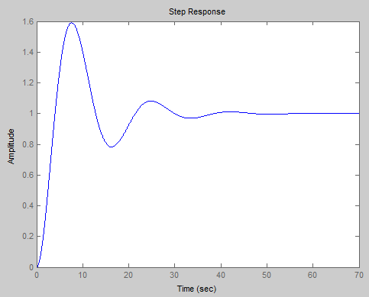
Simulation Example
Consider the following process
As the process has an integrator, we use ZN’s 2nd method. This yields K_{u}=1 and P_{u}=12.54.
Closed-loop step set-point response using ZN-tuned PID controller is shown below.
% MATLAB code
t=0:0.01:70;
s=tf('s');
G = 1/(s*(2*s+1)^2);
% Process parameters
Ku = 1; Pu = 12.54;
% PID parameters, Method 2
Kc = 0.6*Ku; Ti = 0.5*Pu;
Td = 0.125*Pu;
Gc = pid(Kc, Kc/Ti, Kc*Td);
% Set point step response
cloop = Gc*G/(1+Gc*G);
figure(2)
step(cloop,t)

Slide 15
Summary
ZN are designed to give quarter cycle decay ratio.
This gives good disturbance rejection but exhibits large overshoot for set point response which is not always acceptable.
Despite this drawback, ZN tuning serves as a good starting point for fine tuning.
Many other methods are available in the literature (e.g. those minimizing ITAE or ISE criteria)

