Slide 1
Discrete-Time State Space Models
CSE 421 Digital Control
Lecture 9

Slide 2
Introduction
A physical system is usually modeled by differential equations (i.e. continuous-time).
For digital control, it is required to transform state space models from continuous to discrete-time (i.e. discretization).
Here, we study the conversion of continuous-time state-space into discrete-time with the assumption that the input is constant between samples.
Let us first review the response of a continuous-time system.

Slide 3
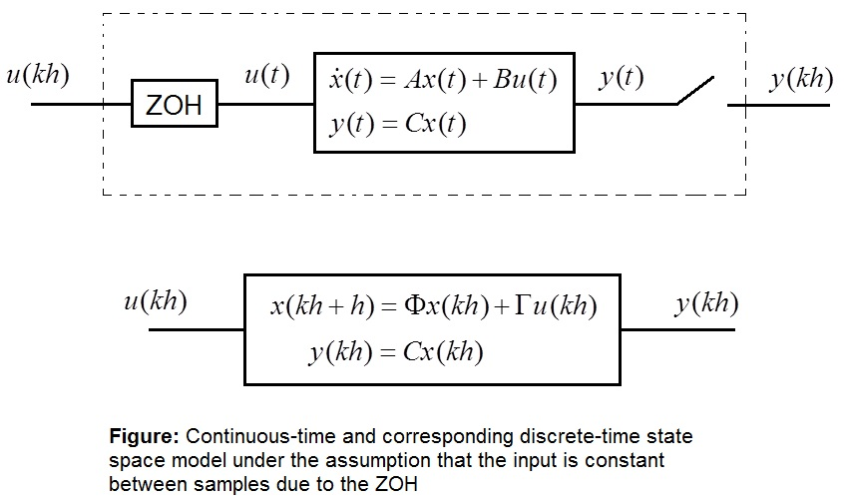
Discrete-time state space model
To avoid confusion with the continuous system, we’ll use symbols Φ and Γ instead of A and B for the discrete system.
The sampling period is denoted by h.

Slide 4
Solution of Continuous State Equation
Consider the state equation
The right-hand side consists of two parts:
Ax(t): the homogeneous part and
Bu(t): the input portion
Let us first examine the homogeneous part

Slide 5
Homogeneous Solution
Consider the homogeneous (no input) state equation
It can be shown by direct substitution that the solution to this equation is given by
where the matrix exponential is defined as
MATLAB function expm can be used for numerical evaluation of the matrix exponential.

Slide 6
Another method to evaluate e^{At}
Take the Laplace transform of
Now, take the inverse Laplace transform, we get
Comparing this result with the previous solution gives another way to calculate the matrix exponential:

Slide 7
Special Case
If the system matrix A is diagonal (the eigenvalues λ_{i} will be along the diagonal), then the matrix exponential is also diagonal and given by

Slide 8
The General State Equation
Now consider the general state equation:
Take Laplace transform
Now, taking the inverse Laplace transform, we get

Slide 9
At the end of the sampling interval, t = h
Then
Let us assume, thanks to the ZOH, that:
Then

Slide 10
In general, we can write:
Thus we arrive at the following discrete-time state space description
Where
Note that the c2d command can also be used to convert continuous into discrete state space models.

Slide 11
Example 1
Find a discrete-time state space description of an integrator.

Slide 12
Solution
Let
Then a continuous-time state space model of the system is
Then we evaluate the matrices Φ and Γ of the discrete model:

Slide 13
Example 2
Find a discrete-time state space description of a double integrator.
Let
A continuous-time state space model of the system is
The matrix exponential is found as follows:

Slide 14
The matrices Φ and Γ are then found as:
The discrete-time state space model is thus given as:

