Slide 1
State Feedback Control
CSE 421 Digital Control
Lecture 10

Slide 2
Eigenvalues
We have seen that the eigenvalues λ of a matrix Φ are those scalars achieving the following equation
Where v is called an eigenvector
This equation can be written as
The non-useful solution is v = 0. The useful solution is the one in which the columns of (λI – Φ)are dependent. Thus, we are looking for λ which makes
This is the equation we solve to obtain the eigenvalues λ of a matrix Φ.

Slide 3
Eigenvalues and Poles
Consider the following discrete time system:
Taking z-transform of both equations
This means that the eigenvalues of the state matrix Φ are the same as the poles of the system.

Slide 4
Controllability
A system (Φ, Γ) is controllable if there is a control input sequence u₀, u₁, . . . u_{n-1} that can move the system from an arbitrary initial state x₀ to an arbitrary final state x_{n} = x_{f}.
Controllable system
Uncontrollable system: there is no input to move the system from state x₀ to x_{f}

Slide 5
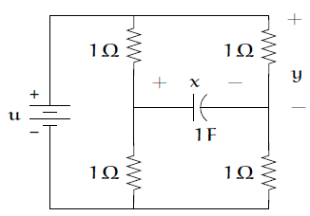
Example 1: Uncontrollable system
Consider the following circuit. It is a system of first order; state variable x: voltage on the capacitor.
If the capacitor has no initial charge, x(0) = 0, then x(t) = 0 for all t > 0, no matter what input is applied. The input has no effect over the voltage across the capacitor. This system, or the state equation that describes it, is not controllable.
Source: Prof. Julio H. Braslavsky, University of Newcastle, Australia.
https://www.eng.newcastle.edu.au/~jhb519/teaching/elec4410/docs.html

Slide 6
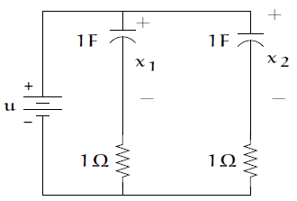
Example 2: Uncontrollable system
The following system has two state variables.
The input can transfer x₁ or x₂ to any desired value, but no matter what input is applied, x₁(t) will always equal x₂(t). This system is not controllable either.
Controllability means the ability to move the states independently.

Slide 7
Condition for Controllability
The system is controllable if the following so-called controllability matrix ∆_{c} is full rank n.
For single-input systems, ∆_{c} is of size n x n.
The rank of a matrix is the number of linearly independent columns or rows.

Slide 8
Example 3
Check the controllability of the system
Answer:
The controllability matrix is given by
MATLAB commands to compute controllability matrix and check its rank:
CO = ctrb(A,B)
rank(CO)

Slide 9
Example 4
Check the controllability of the system
Answer

Slide 10
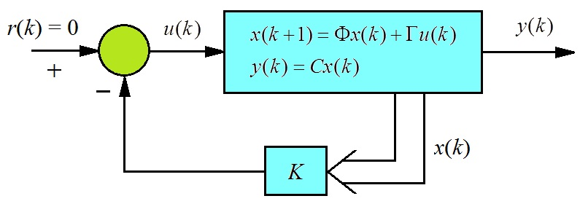
State Feedback
In the state feedback approach, instead of using controllers with fixed configuration in the forward path, the control u(k) is a calculated as a linear combination of the measured state variables, i.e.
It is assumed that the reference input r(k) is zero (regulator problem). The aim here it to drive the system state to zero starting from any initial condition.

Slide 11
State Feedback
Note that this type of control is said to be static, because u only depends on the present values of the state x and it requires that all states of the system be measured.

Slide 12
State Feedback
The system and the feedback control law are given by:
Substituting u_{k} in the state equation yields the closed-loop state equation
Where Φ_{cl} = Φ-ΓK is the state matrix of the closed-loop system.
There is a chance to adjust the closed-loop poles by a suitable design of the gain matrix K.

Slide 13
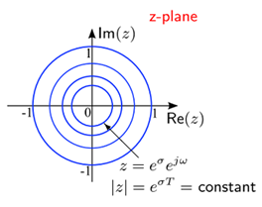
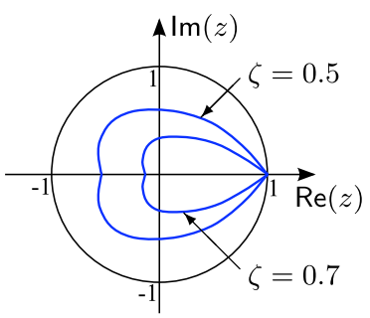
Pole Placement
As we know, pole (eigenvalue) locations in z-plane are directly related to the transient response of the system (speed and overshoot).
The closer the pole to the origin, the faster the response.
The contours of constant damping ratio (which determines percent overshoot) are spirals.

Slide 14
Theorem: State Feedback
The eigenvalues {λ₁, λ₂, …, λ_{n}} of the closed-loop system matrix
can be arbitrarily assigned using some feedback gain matrix K if and only if the system (Φ,Γ) is controllable.

Slide 15
Designing Gain Matrix K by Equating Coefficients
Find the desired characteristic polynomial from the specified eigenvalues λ_{i} using the expression
Find the closed-loop characteristic polynomial using the expression
Compare the two polynomials in 1 & 2 to get the entries of the gain matrix K.

Slide 16
Example 3
Assign the eigenvalues {0.3± j0.2} to the pair
Solution:
For the given eigenvalues, the desired characteristic polynomial is
The closed-loop state matrix is

Slide 17
The closed-loop characteristic polynomial (in terms of K) is
Comparing with the desired characteristic polynomial,
Gives
To check this result, we can use the following MATLAB commands:
>> A = [0, 1; 3, 4];
>> B = [0; 1];
>> poles = [0.3+j*0.2, 0.3–j*0.2];
>> K = place(A, B, poles)

Slide 18
Controllable canonical form
The algebra for ﬁnding the state feedback gain matrix K for systems with n > 2 becomes quite tedious.
However, if the system matrices take the controllable canonical form, the problem is more simple.
For a third order system, this form is given as:

Slide 19
Example 4
Design a feedback controller for the pair
So that the closed-loop eigenvalues are {0.1, 0.4±j0.4}.

Slide 20
Solution
For the given eigenvalues, the desired characteristic polynomial is
The closed-loop state matrix is

Slide 21
State Estimation
In designing state feedback controller, we assumed that all states are measurable. In most applications, this may be impossible or prohibitively expensive.
To deal with this problem, an estimate of the state vector can be found from input and output measurements using the so-called a state estimator or observer.
Simply, a state estimator is a mathematical model implemented as a part of the controller program.
The combination of state feedback and state estimation yields a dynamic output feedback controller.

Slide 22
State Observer
Consider the following system:
To estimate all the states, one could in theory use a system with the same state equation:
Of course, we assume perfect knowledge of the system dynamics (i.e. the matrices Φ, Γ).

Slide 23
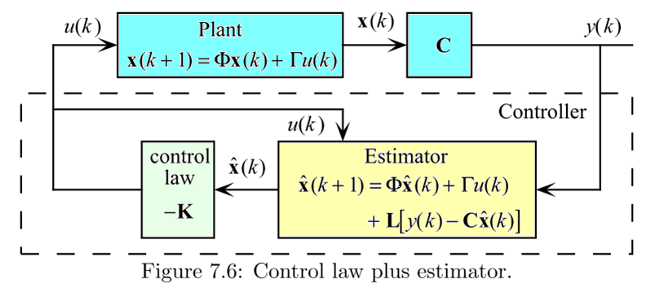
State Observer
In practice, we provide the estimator with an additional term: which denotes the prediction error of the observer. This corrects the state estimate.
The gain is a design variable to make the observer state estimation error decay to zero quickly (i.e. to guarantee fast convergence of the estimated state to the true state).

Slide 24
Theorem: State Estimation
If the pair (Φ, C) is observable, then there exists a matrix L that arbitrarily assigns the observer poles (eigenvalues of the matrix Φ_{o} = Φ - LC) to any set {λ_{i}, i = 1, . . . , n}.
Typically, estimator pole locations are selected so that the estimator responds two to six times faster than the controlled plant.
The matrix L is designed in the same we designed the state feedback gain matrix K.

Slide 25
Observability
A system is said to be observable if the knowledge of the input u(0), u(1), …, u(n-1) and the output y(0), y(1),…,y(n-1) is sufficient to determine the initial state x(0).
The system is observable if the following so-called observability matrix Δ_{o} (of size n x n for single output systems) is full rank n.

Slide 26
Example 5
Given the following discrete-time system
Check if the system is observable.
This means that x(0) can not be uniquely estimated (calculated) from input-output data sequence.

Slide 27
Example 6
Given the following discrete-time system
Check if the system is observable and controllable.
If the system is controllable, design a state feedback controller such that the eigenvalues of the state feedback system is ±½.

Slide 28
Solution
The controllability matrix
The observability marix

Slide 29
Solution, continued
Computing the state feedback gain matrix K.

Slide 30
Summary
We have presented an overview of the process of control design via state space methods. It involves the design of
A state feedback gain K
A state estimator (observer)
The design of the state feedback and the design of the state estimator can be carried out independently.
The eigenvalues of the closed-loop system, as designed by the state feedback law, are unaffected by the use of a state estimator.

