Slide 1
The z-Transform
CSE 421 Digital Control
Lecture 5

Slide 2
The z-transform
The z-transform of a discrete sequence r_{k} with values {r₀, r₁, r₂,...}, is defined as:
The z-transform consists of an infinite series in the complex variable z, with r_{k} are the coefficients of this power series at different sampling instants.

Slide 5
Example 1
The Laplace transform of a continuous time signal g(t) is given as
Determine the z-transform G(z) of the sampled signal g(kT) where T is the sampling period and k is the discrete time index.

Slide 6
Answer:
Using partial fraction expansion
Method 1: finding the time domain signal
Method 2: using Laplace to z-transform table

Slide 7
Properties of z-Transform
Some of the properties of the z-transform are:
Right shift
Left shift
Final value theorem
z-differentiation (Multiplication by time k)

Slide 8
Right-shifting property
Suppose we have the following z-transform pair
Also, let
assuming that f(k) = 0 for k<0.

Slide 9
Left-shifting property
Suppose we have the following z-transform pair
Also, let
If f(k) = 0 for k = 0 to m-1, then

Slide 10
Final value theorem
Given the following z-transform pair, the final value of the time response is given by
Note that this theorem is valid only if the poles of F(z) are inside the unit circle or at z = 1 (i.e. the system is stable and so reaches final value).

Slide 11
Example 2
Given the function
find the final value of g(k).
Solution:
Using the final value theorem,

Slide 12
DC gain of transfer function
Given a transfer function H(z) = Y(z)/U(z), for a step input of amplitude A, the output is given by
The final value of y(k) is:
Hence the DC gain of the transfer function H(z) is
Again, all poles of the transfer function must be inside the unit circle.

Slide 13
Example 3
Consider the transfer function given by
It is necessary to ﬁnd the pole locations to make sure it is stable.
The DC gain is H(1) = (1+1)/(1-0.5+0.5) = 2. If this system were given an input that eventually reached a constant value, the output would eventually reach twice that value.
If the denominator polynomial were (z² − 0.5z + 2), the DC gain would be H(1) = 0.8, but that is meaningless since the system is unstable (the roots are outside the unit circle).

Slide 14
Multiplication by k
Example
z-differentiation

Slide 15
Inverse z-Transforms
Given the z-transform Y(z) of a function y(k), it is required to find the time-domain function y(k).
Here, we will study the following methods:
power series (long division).
expanding Y (z) into partial fractions and using z-transform tables to find the inverse.

Slide 16
Method 1: Long Division
This method involves dividing the denominator of Y (z) into the numerator such that a power series of the form
is obtained. The values of y(n) are, directly, the coefficients in the power series.

Slide 17
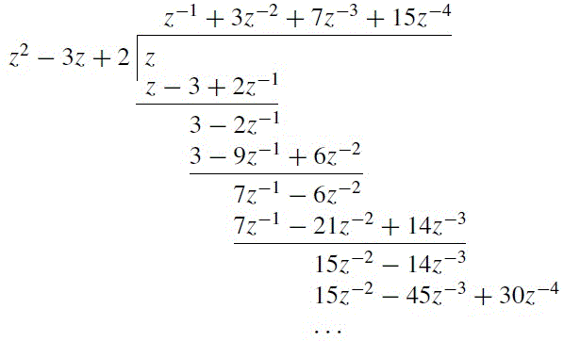
Example 4
Find the inverse z-transform for Y(z) given by
Solution:
Dividing the denominator into the numerator gives

Slide 18
The coefficients of the power series are
y(0) = 0, y(1) = 1, y(2) = 3, y(3) = 7, y(4) = 15, …
Alternatively, the required sequence is
y(t) = δ(t-T) + 3δ(t-2T) + 7δ(t-3T) + 15δ(t-4T) + …
To perform long division using MATLAB, you can use the following commands:
delta = [1 zeros(1 , 4)];
num = [0 1 0];
den = [1 -3 2];
yk = filter(num, den, delta)

Slide 19
Method 2: Partial fractions
Long division method does not give a closed form of the resulting sequence.
Alternatively, we can find a partial fraction expansion of Y(z) and use z-transform tables to determine the inverse z-transform.
Looking at the z-transform tables, we see that there is usually a z term in the numerator. It is therefore more convenient to find the partial fractions of Y (z)/z and then multiply the partial fractions by z to obtain a z term in the numerator.

Slide 20
Example 5
Find the inverse z-transform of the function
Answer:
The above expression can be written as

Slide 21
Using the inverse z-transform, we find
y(0) = 0, y(1) = 0, y(2)=1, y(3) = 3, y(4) = 7, y(5) = 15, …
MATLAB command residue performs partial fraction:
[r, p, k]=residue(Num , Den)
[r, p, k]=residue([1],[1 -3 2 0])

Slide 22
Example 6
Find the inverse z-transform of
Solution
Rewriting the function as

Slide 24
We can now write Y(z) as
The inverse transform is found from the tables as
Note that for the last term, we used the multiplication by n property which is equivalent to z-differentiation (slide 14).

