Slide 1
Root Locus Method

Slide 2
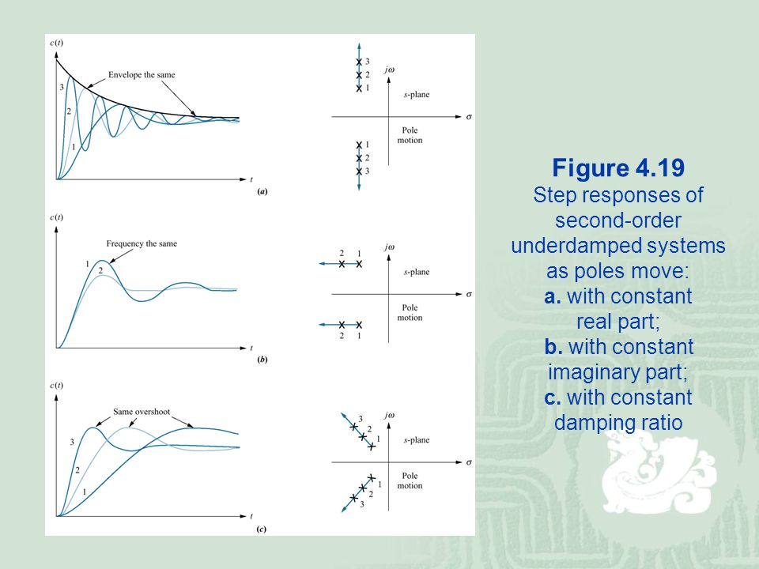
Introduction
As we know, the speed and shape of system response are related to the locations of its poles.

Slide 3
Root Locus
The root-locus method, used extensively in control engineering, plots the roots of the characteristic equation for all values of the gain or other system parameter.
By using the root-locus method the designer can predict the effects of varying the gain on the location of the closed-loop poles.

Slide 4
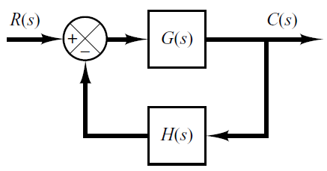
Root Locus of 2nd Order System
Consider the following open-loop transfer function
The characteristic equation of the closed-loop system is:
Root loci of the closed loop poles, as the gain K varies, take the following form:
Is it possible that the system becomes unstable for some value of K?
jω
σ
-2
-1

Slide 5
Root Locus of 2nd Order System
Now consider a second order system with one zero:
In this case, the root loci are either horizontal lines or circular depending upon pole-zero configuration.
In general, a root locus consists of a number of branches equal to the number of open-loop poles.
Also, a root locus always starts at open-loop pole and ends at open-loop zero (or ends at infinity).
jω
jω
jω
σ
σ
σ
-2
-β
-1
-β
-1
-2
-2
-1
-β

Slide 6
Angle & Magnitude Conditions
In constructing the root loci angle and magnitude conditions are so important.
The closed-loop characteristic equation is given by:
Or
Where G(s)H(s) is a ratio of polynomial in s.
Since G(s)H(s) is a complex quantity it can be split into angle and magnitude part.

Slide 7
Angle & Magnitude Conditions
The angle of G(s)H(s)=-1 is
The magnitude of G(s)H(s)=-1 is
The values of s that fulfill both the angle and magnitude conditions are the roots of the characteristic equation, or the closed-loop poles.

Slide 8
Angle and Magnitude Conditions (Graphically)
To apply Angle and magnitude conditions graphically we must first draw the poles and zeros of G(s)H(s) in s-plane.
For example if G(s)H(s) is given by

Slide 9
Angle and Magnitude Conditions (Graphically)
p
θ₁
θ₂
ɸ₁
θ₃
If angle of G(s)H(s) at s=p is equal to ±180º(2k+1) the point p is on root locus.

Slide 10
Angle and Magnitude Conditions graphically
p
B
A₁
A₃
A₂

Slide 11
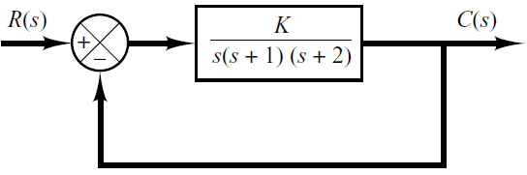
Example 1: Construction of root locus in details
In this example, we will draw the root locus of the following closed-loop system as K varies from 0 to infinity.
Step-1: The first step in constructing a root-locus plot is to locate the open-loop poles and zeros in s-plane.
Step-2: Determine the root loci on the real axis. Any segment on the real axis lying to the left of an odd number of open-loop poles and zeros will satisfy the angle condition and hence is part of the root locus.

Slide 12
Step-3: Determine the asymptotes of the root loci.
  An asymptote is a straight line that touches the root locus curve at infinity.
where
n-----> number of poles
m-----> number of zeros
For this Transfer Function

Slide 13
Step-3: Determine the asymptotes of the root loci.
Since the angle repeats itself as k is varied, the distinct angles for the asymptotes are determined as 60°, –60°, and 180°.
Thus, there are three asymptotes having angles 60°, –60°, 180°.

Slide 14
Step-3: Determine the asymptotes of the root loci.
Before we can draw these asymptotes in the complex plane, we must find the point where they intersect the real axis.
Point of intersection of asymptotes on real axis (or centroid of asymptotes) can be find as out
For

Slide 15
Step-3: Determine the asymptotes of the root loci.

Slide 16
  Step-4: Determine the breakaway or break-in points.
  The breakaway (or break-in) point corresponds to a point in the s plane where multiple roots of the characteristic equation occur.
  It is a point at which the root locus branches leaves the real axis and enter in complex plane
  The breakaway or break-in points can be determined from the roots of
  It should be noted that not all the solutions of dK/ds=0 correspond to actual breakaway points.

Slide 17
The characteristic equation of the system is
The breakaway point can now be determined as
Since the breakaway point must lie on a root locus between 0 and –1, then s = –0.4226 is a breakaway point.
Point s = –1.5774 is not on the root locus and hence it is not breakaway point.

Slide 18
Step-5: Determine the points where root loci cross the imaginary axis.

Slide 19
Step-5: Determine the points where root loci cross the imaginary axis.
  These points can be found by use of Routh’s stability criterion.
  Since the characteristic equation for the present system is
  The Routh Array Becomes
The value(s) of K that makes the system marginally stable is 6.
The crossing points on the imaginary axis can then be found by solving the auxiliary equation obtained from the s² row, that is,

Slide 20
An alternative approach is to let s=jω in the characteristic equation, equate both the real part and the imaginary part to zero, and then solve for ω and K.
For present system the characteristic equation is
Equating both real and imaginary parts to zero
yields

Slide 22
Example#2
Consider again the following unity feedback system.
Determine the value of K such that the damping ratio of a pair of dominant complex-conjugate closed-loop poles is 0.5.
The damping ratio of 0.5 corresponds to

Slide 23
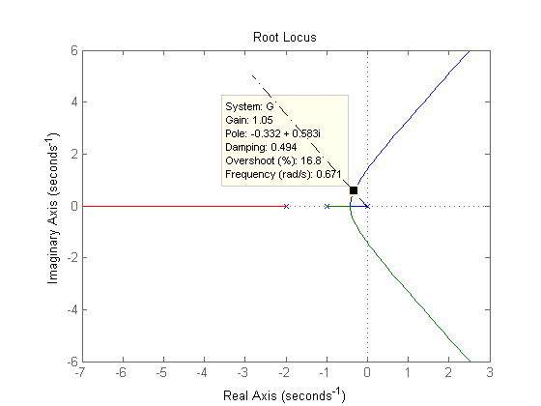
We have already draw the root locus of the system.
So, we draw a straight line from the origin having an angle of 60 with the negative real axis. This will intersect our root locus in a point. This is one of the closed-loop poles of the system.
The value of K that yields such poles is found from the magnitude condition

Slide 24
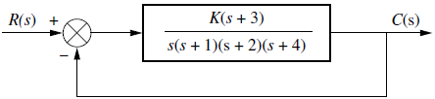
Example 3
Sketch the root locus of following system and determine the location of dominant closed loop poles to yield maximum overshoot in the step response less than 30%.
Step-1: Pole-Zero Map
Step-2: Root Loci on Real axis
Step-3: Asymptotes
Step-4: breakaway point
Mp<30% corresponds to

Slide 25
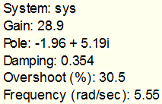
A3
B1
A1
A2
-1.55

Slide 26
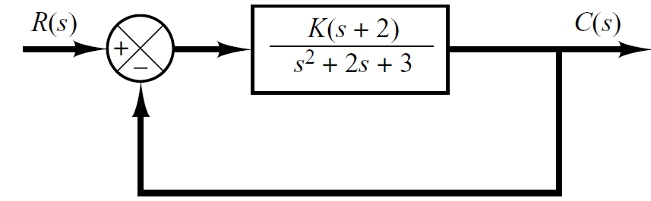
Example 4
Sketch the root-locus plot of following system with complex-conjugate open loop poles.
G(s) has a pair of complex-conjugate poles at

Slide 27
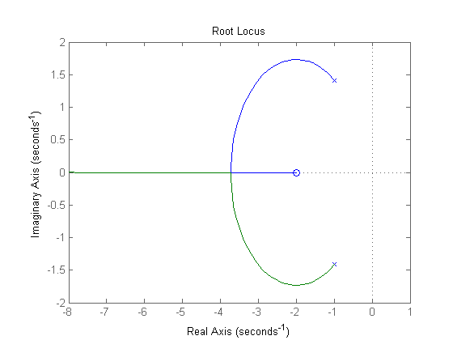
Step-1: Pole-Zero Map
Step-2: Determine the root loci on real axis
Step-3: Asymptotes
Step-4: Break-in point

