Slide 1
PID Control
CSE 425 Industrial Process Control
Lecture 5

Slide 2
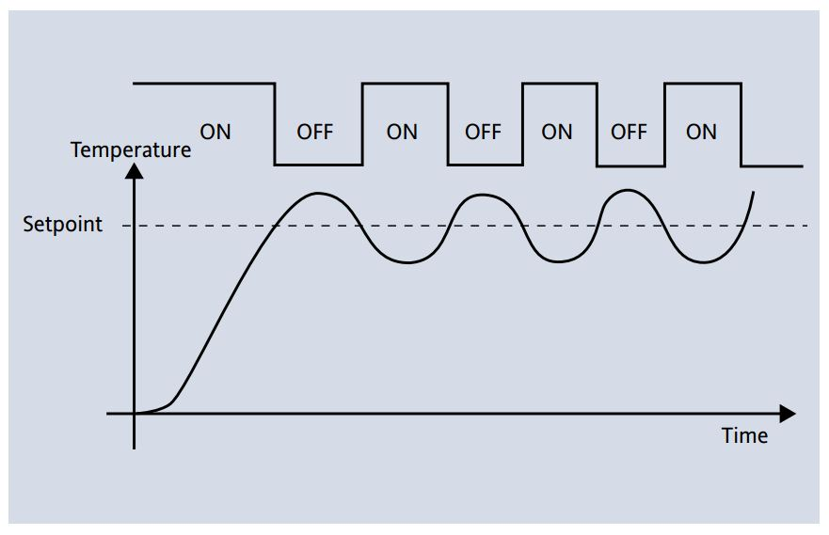
ON/OFF Control
Simple control
Also called differential gap control

Slide 3
% of Span Notation
In a feedback loop, the units of controlled variable y(t) depend on the process. Also, the control signal u(t) may have units of mA or psi depending on the actuator.
It is desirable to unify units no matter what is the nature of the actual system.
Let us assume that:
We can express control signal and error as % of span:
Now, all variables are expressed in %.

Slide 4
Example
A standard control signal assumes a value in the range of 4-20 mA. Find the % of span value corresponding to the following values of the control signal:
4mA
12mA
16mA
20mA
0%
50%
75%
100%

Slide 5
PID Controller
Nearly 95% of industrial controllers are PID.
The output m(t) of PID controller is the sum of three terms:
e
m
r(t): Setpoint
y(t): Process Variable
e(t) = r(t) − y(t): error
m(t): control signal
K_{c} … Controller Gain (always positive)
T_{i} … Integral Time
T_{d} … Derivative time (T_{i} and T_{d} are usually expressed in minutes)

Slide 6
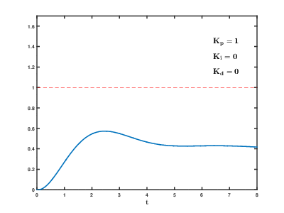
Nice Animation
By Physicsch - Own work, CC0, https://commons.wikimedia.org/w/index.php?curid=40528698

Slide 7
Proportional Mode
Here, the controller output responds immediately to instantaneous error e(t)
Where m₀ is called the bias. It is the controller output when the error is zero.
The higher the gain, the less the rise time (faster response).
However, high gain increases overshoot (stability is reduced).

Slide 8
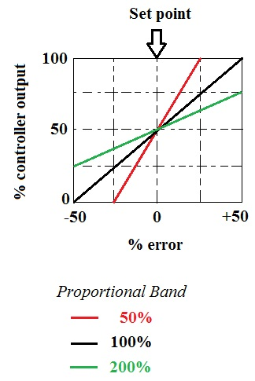
Proportional Band (PB)
PB is the range over which the error (or PV) must change in order to drive the controller output (MV) over its full range (0 to 100%)
For example, a 50% PB means that as the controlled variable varies by 50% of its range, MV varies by 100% of its range.
Note that out of this range the controller output is saturated

Slide 9
Reverse Acting Controller
Most processes have positive gain.
Example: you are driving a car and your foot is on gas pedal.
In this case, if PV (car speed) increases, the controller should decrease its o/p (you release the pedal)
I.e. if PV increment → CO decrement. This is a reverse acting controller
When PV (speed) increases, error e(t) decreases and hence m decreases also.

Slide 10
Direct Acting Controller
Now imagine you are driving a car and your foot is on the brakes. This is a process with negative gain
Here, you need a direct acting controller, i.e. if the speed increases, you should press the brakes more
If PV increases, controller o/p also increases (increment-increment)

Slide 11
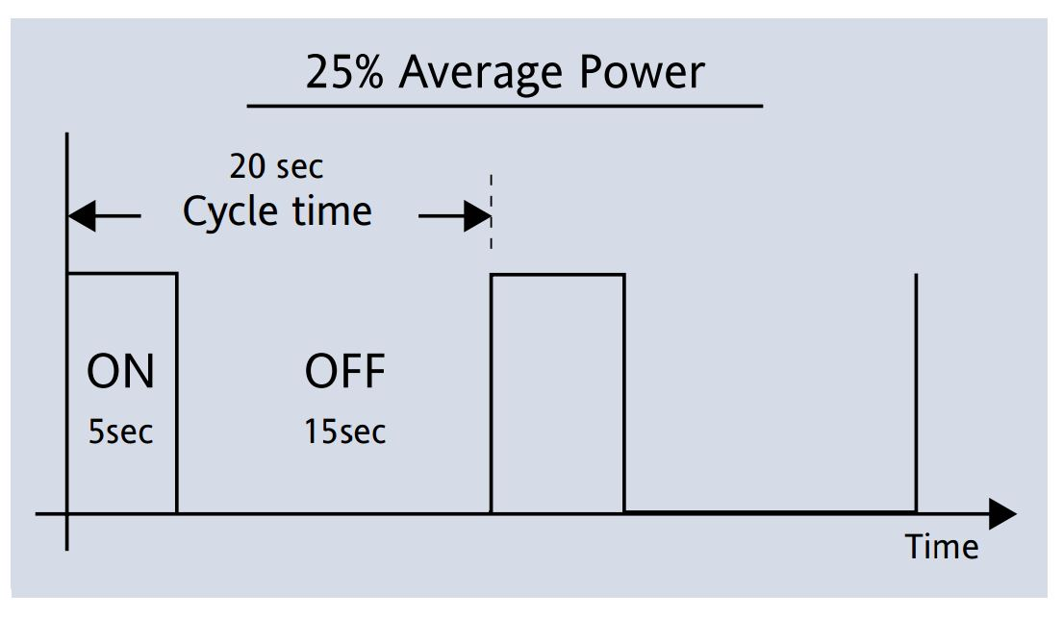
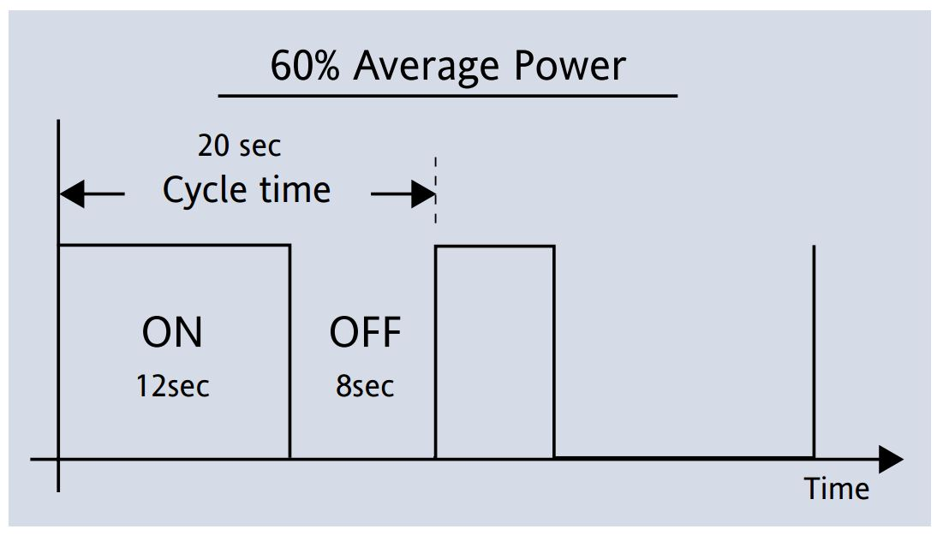
Time Proportional Control
Traditional proportional control provides variable MV.
Time-proportional control achieve proportional response using an on/off final control device (e.g. electric heater). On/off elements are generally simpler and less expensive.
In each time cycle, the fraction of time in which controller output is “on” is equivalent to output of a conventional P controller. The cycle must be short enough, so that the system averages out the control signal over time.

Slide 12
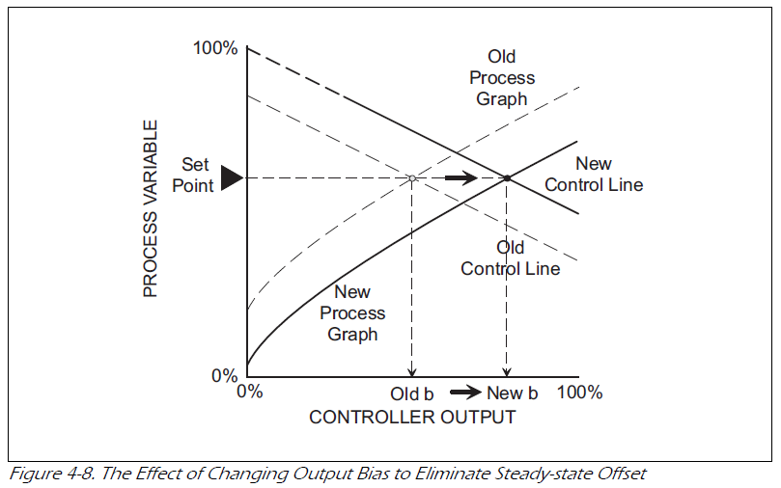
P Control & offset
When there is a load disturbance change, P control can not remove steady-state error (Offset).
Changing controller gain can’t remove offest.
Need to change (reset) controller bias (called manual reset)

Slide 13
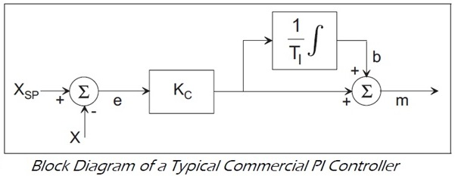
Automatic Reset
Integral mode can change the bias automatically.
if error is +ve increase bias,
if error is –ve decrease bias.
if e = 0, do not change bias

Slide 14
Integral Term
Called automatic reset.
Eliminates steady-state error.
At steady-state, PID controller output is due to integral mode alone. Hence, it is called the persistent mode.
Extra integral leads to oscillatory behavior with excessive overshoot and settling time. So, we should detune the controller (lower the proportional gain) when we add integral mode.

Slide 15
Integral Term
Note that, for slow processes, the integrator will continue integrating the error causing more oscillations.
Hence, integral action is good for fast processes (e.g. flow and pressure).
Hence, the rule
Where τ is the process time constant

Slide 16
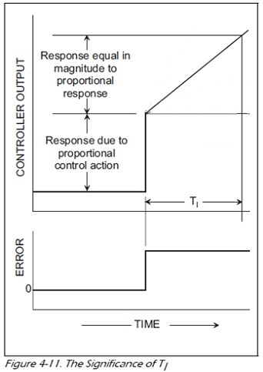
Significance of reset time Ti
Consider a PI control and assume the error is constant.
T_{i} is the time the integral mode needs to repeat the proportional action.
T_{i} is measured in minutes per repeat
Integral mode is slow. So, it is combined with P mode.

Slide 17
Derivative action
Derivative control action is based on the rate of change of error (rate action).
Consider a PD control
Recall Taylor series
We can see that
Derivative action predicts future error and acts in advance (pre act). PD gives the output T_{d} time ahead of P only Hence, called predictive mode.

Slide 18
Derivative as a Brake
We see that derivative does not care about the SP.
Derivative counteracts any variation in PV. It tries to drive PV to steady state quickly -> Reduce overshoot and settling time.
If P and I are gas pedal, D will be the brake
The difference between PID and a car is that we can’t press both pedals simultaneously, while in PID both work at the same time.

Slide 19
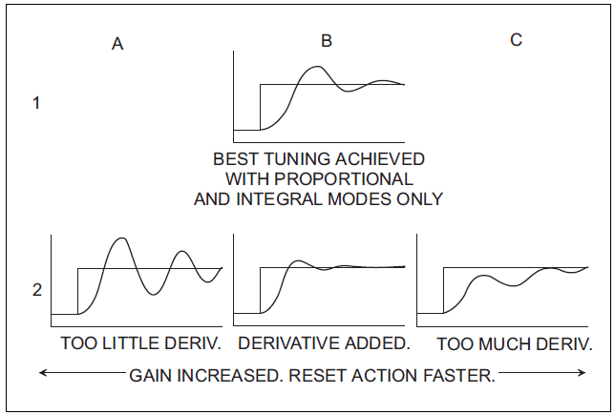
The Effect of Adding D
Too much derivative results in slow response. Normally T_{d} <T_{i}.

Slide 20
PV Response for Load Change

Slide 21
Drawbacks of derivative mode
For fast processes (e.g. pressure and flow), PV fluctuates quickly. This causes large derivative action which translates into large changes in valve opening. If something like this happens, the operator will turn into manual mode -> not a good practice.
So, derivative is good for slow processes e.g. temperature (process variable changes slowly)
Another problem with derivative is to amplify noise superimposed on PV.

