Slide 1
(9) Recursive Least Squares

Slide 2
Recursive identification
Suppose, at time instant n, we have a new output value y(n) and we want to calculate θˆ(n).
In off-line or batch identification, the whole data up to time n is used to compute θˆ(n) without exploiting the previous estimate θˆ(n-1).
In this case, the whole computations are repeated every time instant and the computational time and memory storage requirements increase with time as the data size getting larger.
We would like a way of efficiently recalculating the model each time we have new data.

Slide 3
General recursive formula
θˆ(n) and θˆ(n−1) are estimated parameter vector at time n and n − 1, respectively.
ε(n) is the difference between the measured output y(n) and the model output using previous parameter vector θˆ(n − 1). If ε(n) is small, θ(n-1) is good and should not be modified too much.
K(n) is a scaling - also known as the Kalman Gain.

Slide 4
Advantages of recursive estimation
Gives an estimate of the model from the first time step.
Computationally more efficient and less memory intensive, especially if we can avoid large matrix inverse calculations.
Ideal for real-time implementations.
Can adapt to changing systems → forms the core of adaptive control and signal processing.

Slide 5
Derivation of recursive least squares
In the following we will derive the recursive form of the least squares algorithm by modifying the off-line algorithm.
Let us form the regression matrix and output vector from the data collected up to time n:
The least squares solution is given by

Slide 6
Derivation of recursive least squares
Let’s look at the expression for

Slide 8
Yet we still need a matrix inverse in (6) which is computationally expensive.
This can be avoided using the matrix inversion lemma

Slide 9
The matrix inversion lemma is given by
Let us apply the matrix inversion lemma to step (6)
With
The final RLS algorithm becomes

Slide 10
Comments
The prediction error ε_{n} is the difference between measured output y_{n} and the one-step ahead prediction made at time n − 1:
K _{n} is a weighting factor showing how much the value of ε_{n} will modify different elements of the parameter vector.
RLS needs initial values of θ₀ˆand P₀. It is convenient to set θ₀ to zeros and P₀ to LN × I (LN is a large number and I is the identity matrix).

Slide 11
Example 1
An input-output data of a certain process is measured as shown in the following Table. Suppose the process can be described by a model
If the recursive least squares algorithm is applied for on-line parameter estimation and at time

Slide 13
RLS with forgetting factor
RLS can be modified to track time-varying parameters of a slowly changing process. For this purpose, consider modifying the least squares loss function to
where λ < 1 (e.g. λ = 0.99 or 0.95) is called a forgetting factor because older measurements have less effect on the coefficient estimation, hence forgotten.
The smaller the value of λ, the quicker the information in previous data will be forgotten. When λ = 1 this is simply the standard RLS.

Slide 14
RLS with forgetting factor

Slide 15
Summary of RLS algorithm
Initialization: Set n_{a}, n_{b}, λ, θ₀ and P₀.
Step 2-5 are repeated starting from t = 1:
At time step n = t, measure current output y_{n}.
Recall past y’s and u’s and form ϕ_{n}.
Calculate θ_{n} and P_{n}.
θ_{n-1} ← θ_{n} and P_{n-1} ← P_{n}.
t ← t +1, go to step 2.

Slide 16
Example 2
Consider a system described by
where {e(t)} is a white noise sequence with variance 1.
The input u(t) is a uniformly distributed random signal in [-2,2].
The system parameters are a₁ = −0.8, a₂ = 0, b₁ = 1.0 for the first 500 data samples and then change to a₁ = −1.1, a₂ = 0.3, b₁ = 2.0 for the next 500 data samples.
Implement the RLS algorithm with forgetting factor to estimate system parameters. Plot the evolution of parameter estimate with λ = 1 and λ = 0.99.

Slide 17
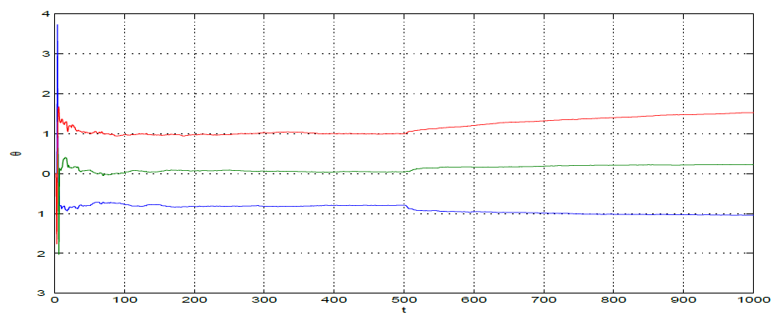
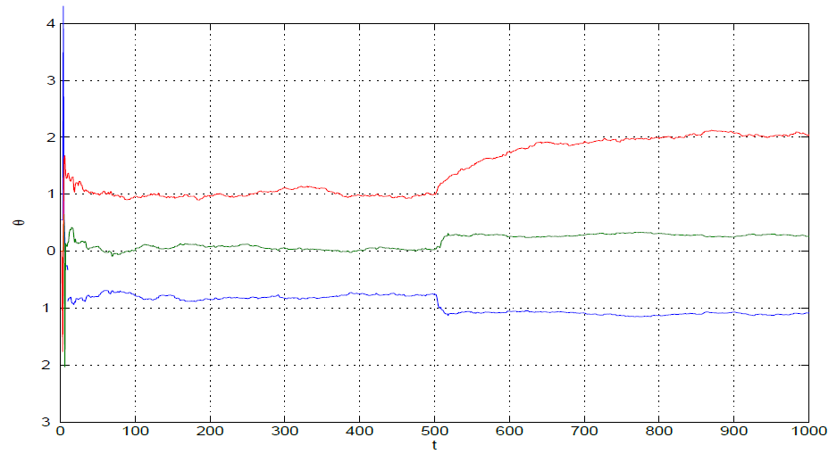
Evolution of parameter estimates using RLS algorithm ( λ= 1)
Evolution of parameter estimates using RLS algorithm (λ=0.99)

Slide 18
Pseudo-linear regression for ARMAX model
Consider a first order ARMAX system:
Where
y(t-1) and u(t-1) are known but e(t-1) is unknown.
We can replace e(t-1) by the prediction error ε(t-1). By this way, the previous RLS algorithm can be employed without modification.
ε₀ can be initialized as 0.

