Slide 1
(4) Random Variables

Slide 2
Introduction
In every measurement operation, random errors are always present. If we measure the same variable several times, the measured values will be different in each repeated trial.
The randomness or unpredictability of the value of a certain variable in a modeling context arises generally from the limits of scientiﬁc knowledge or the desire to work with models of low complexity.
Random signal can not be reproduced exactly in contrast to a deterministic signal.
The study of system identification requires good background on random variables and signals.

Slide 3
A random signal example
An example of an unpredictable signal is the acceleration measured on the rear wheel axis of a car during a particular time interval when it is driving on highway.
The signal is nondeterministic: no prescribed formula to generate such a time record synthetically.
The recording of the acceleration will be diﬀerent when it is measured for a diﬀerent period in time with the car driving at the same speed over the same road segment.

Slide 4
Generation of random signals
Artiﬁcial generation of random signals is of interest in simulation and prediction purposes.
Since these signals are nondeterministic, reproducing them exactly is not possible. A valid alternative is to generate a time sequence that has similar features to the original random signal.
An example of such a feature is the sample mean of all the 2000 samples of the time record in the previous Figure:
Where x(k) is the acceleration at time instant k.
There are other features to describe random variables and signals as we will see next.

Slide 5
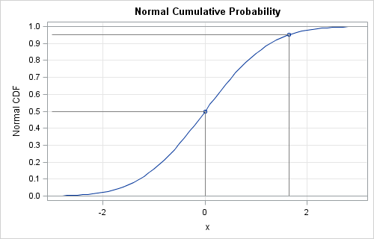
Cumulative distribution function (CDF)
The CDF function F_{X}(x) of a random variable X gives the probability of the event {X ≤ x}, which is denoted by

Slide 6
Cumulative distribution function (CDF)
From axioms of probability, the CDF has the following properties:

Slide 7
Probability density function (PDF)
More frequently used characterization of a random variable is the PDF. The PDF is the derivative of the CDF function
The PDF has the property:
and the probability of the event {a < X ≤ b} is given by

Slide 8
The expected value of a random variable
The CDF and PDF fully specify the behavior of a random variable in the sense that they determine the probabilities of events corresponding to that random variable. However, these functions cannot be determined experimentally in a trivial way
Fortunately, in many problems, it is sufficient to specify the behavior of a random variable in terms of certain features such as the expected value and variance of this random variable.

Slide 9
Expected value
The expected value, also called mean, of a random variable X is given by
The expected value is the average of all values, weighted by their probability. It is the value “expected” beforehand given the probability distribution.
The expected value is often called the ﬁrst-order moment.
The nth-order moment is given as

Slide 10
Variance
The variance of a random variable X is the second order centered moment of a random variable:
Sometimes the standard deviation is used:
The expression for the variance can be simpliﬁed as follows:
This shows that, for a zero-mean random variable (E[X] = 0), the variance equals its second-order moment E[X²].

Slide 11
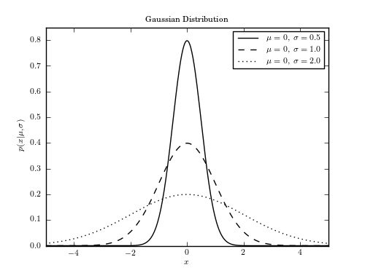
Gaussian random variable (normal)
A Gaussian random variable X has the following PDF:
Which is completely speciﬁed by the mean µ and variance σ²
MATLAB command: randn

Slide 12
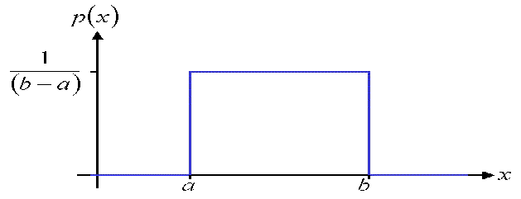
Uniform Distribution
A uniformly distributed random variable assumes values in a range from a to b with equal probability.
MATLAB command (rand) generates a uniformly distributed random variable in the range from 0 to 1.

Slide 13
Multiple random variables
It often occurs in practice that several random variables are measured at the same time. It may be the case that they are related.
The joint behavior of multiple random variables is described by the joint CDF or joint PDF functions.

Slide 14
Correlation
With the deﬁnition of the joint PDF of two random variables, the expectation of functions of two random variables can be deﬁned as well.
Two relevant expectations are the correlation and the covariance of two random variables.
The correlation of two random variables X and Y is

Slide 15
Covariance
Let µ_{X} = E[X] and µ_{Y} = E[Y] denote the means of the random variables X and Y, respectively.
Then the covariance of variables X and Y is
Intuition: the covariance describes how much the two variables change together (positive if they change in the same way, negative if they change in opposite ways) around their means.

Slide 16
Uncorrelated Random Variables
Two random variables X and Y are uncorrelated if their covariance = 0, i.e.
Examples:
The education level of a person is correlated with their income.
Hair color may be uncorrelated with income (at least in an ideal world).

Slide 17
Vector of Random Variables
The case of two RVs can be extended to the vector case.
Let X be a vector with entries X_{i} for i = 1, 2, . . . , n that jointly have a Gaussian distribution with mean:

Slide 18
Vector of Random Variables
And the covariance matrix of X is:
Remarks:

Slide 19
Random signals
A random signal or a stochastic process x is a sequence of random variable x₁, x₂,…, x_{N} with the index has the meaning of time step k.
Observing the process for a certain interval of time yields a sequence of numbers or a record that is called a realization of the stochastic process.
In system identiﬁcation, input and output signals will often be stochastic processes evolving over discrete time.

Slide 20
Stationary Process
Signal values at different time steps can be correlated (e.g. when they are the output of some dynamic system).
Nevertheless, signals are usually required to be stationary, in the sense that
That is, the mean is constant with time, whereas the covariance depends on only the relative positions of time steps, not their absolute positions.
Stationarity implies that the dynamics of the system generating the signal are invariant in time.

Slide 21
Ergodicity
Ergodicity oﬀers an empirical tool with which to derive an estimates of the expected values of a random signal, that in practice can be observed only via (a single) realization.
For a stationary random signal {x(k)} = {x(1), x(2), …, x(N)}, the time average converges with probability one to the mean value µ_{x} , provided that the number of observations N goes to inﬁnity.

Slide 22
Auto-covariance & Cross-covariance
The auto-covariance matrix of {x(k)} is
Similarly, the cross-covariance matrix of two discrete vector signals {x(k)} and {y(k)} is

Slide 23
Auto-correlation & Cross-correlation functions
The autocorrelation function r_{uu}(τ) of a stationary signal {u(k)} can be estimated as
Where τ is the lag time.
Similarly, the cross-correlation function r_{uy}(τ) between two signals {u(k)} and {y(k)} is defined as
MATLAB function xcorr can be used to calculate the sample auto and cross-correlation functions.

Slide 24
Zero-mean white noise
Let the stochastic process {e(k)} be a scalar sequence {e(1), e(2), ...}.
The sequence {e(k)} is zero-mean white noise if
White noise is a very important signal in system identification.
Zero mean
Values at different time steps are uncorrelated

Slide 25
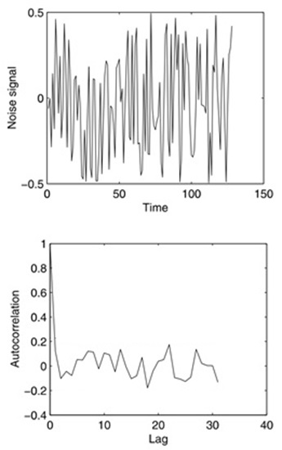
Example: White noise
A uniformly distributed white noise sequence u, generated with the MATLAB function rand, is shown.
u = -0.5 + rand(125,1);
Also shown is the associated normalized autocorrelation function, that is, r_{uu}(τ)/r_{uu}(0) for τ = 0,1,2,… calculated using xcorr(u).
The autocorrelation function indicates that only at zero lag the autocorrelation is significant.

Slide 26
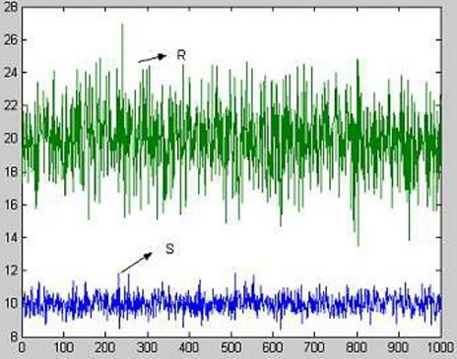
Example
Consider two random sequences S(k) and R(k), k=1,…,1000 generated using Matlab commands:
S = 3*randn(1000, 1) + 10;
R = 6*randn(1000, 1) + 20;
1. What is the approximate mean value of each signal?
2. What is the empirical variance of each signal?
3. What is the empirical covariance matrix of a vector sequence

Slide 27
Answer
Using Matlab, we can calculate the empirical (sample) mean values and covariances of the signals:
Note: it is highly recommended to write your own code to calculate the variance, covariance and correlation functions instead of using only MATLAB built-in functions.
mS = mean(S)
mR = mean(R)
covS = cov(S)
covR = cov(R)
Z = [S R];
covZ = cov(Z)
mS = 9.9021
mR = 20.2296
covS = 8.9814
covR = 36.3954
covZ = [ 8.9814 0.5103
0.5103 36.3954]

Slide 28
Input Signals
Random sequences are frequently used as input signals in system identification.
Input signals have a significant influence on the resulting parameter estimates.
As a trivial illustration, we may think of an input that is identically zero. Such an input will not yield full information about the input/output relationship of the system.

Slide 29
The input should excite the typical modes of the system, and this is called persistent exciting. In mathematical term this is related to the full rank condition of the matrix:
One of the simplest input signal is the step function (ones.m):
For systems with a large signal-to-noise ratio, step input can give information about the dynamics such as dominant time constant, rise time, overshoot and static gain. However, step input does not give sufficient changes to cover high frequency ranges.

Slide 30
Another input signal is the sum of sinusoids
With m frequency w_{j}, 0 ≤ w₁ < w₂ < ... < w_{m} ≤ π.
Gaussian white noise (randn.m):
they excite all frequencies.
very large values may occur which exceed physical process limits → not practical.
Amplitude constrained signals such as a uniformly distributed random sequence (rand.m) or the Pseudo Random Binary sequence (PRBS) are preferred.

Slide 31
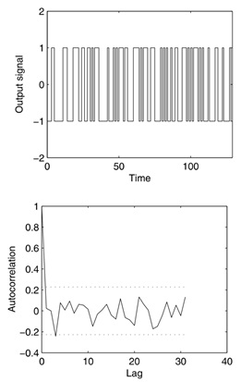
PRBS switches between two values and is generated using some speciﬁc algorithm such that its autocorrelation function approximates that of the white noise.
MATLAB command:
u = idinput(N,'prbs')

