Slide 1
Discrete Approximation of Continuous Systems
CSE 421 Digital Control
Lecture 3

Slide 2
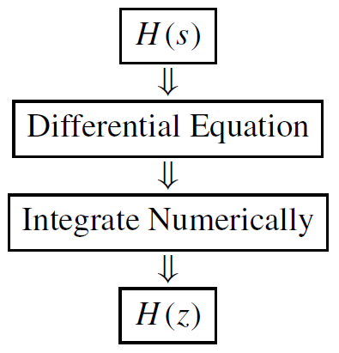
Introduction
One approach for Digital Controller Design is an indirect one. The procedure is as follows:
Design a continuous-time controller H(s)
Find a discrete system H(z) approximating the behavior of H(s) using numerical integration
Realize H(z) on a computer.

Slide 3
Example
Given the ﬁrst-order system
Cross-multiplying and using inverse Laplace transform we get
We integrate to obtain u(t),

Slide 4
In discrete time, we can express this integral in two intervals: [0, kT−T] and [kT−T, kT]
This area may be approximated in three ways:
• Forward rectangular
• Backward rectangular
• Trapezoidal

Slide 5
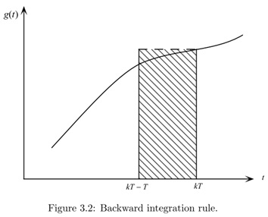
Forward & backward rules

Slide 6
Trapezoidal rule

Slide 7
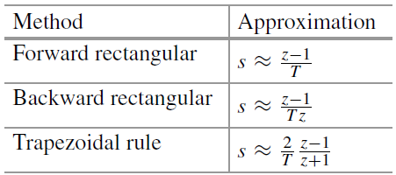
Mapping between s and z plane
Comparing the original
with the three H(z) we obtained, the following approximations for s are obtained.
This may be viewed as mapping from the s-plane to the z-plane.

Slide 8
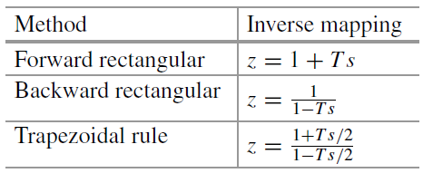
Comparison of Integration Rules
It is instructive to see where in the z-plane these approximations transform the left-half s-plane (the region of stable s-plane poles).
To this end, solve for the inverse mapping, then substitute for s = jω.

Slide 9
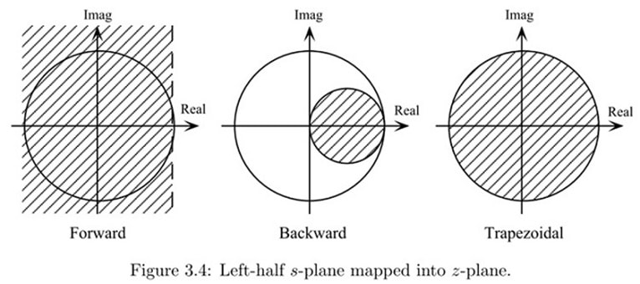
Comparison of Integration Rules
The mapping of the left-half s-plane are as shown below.
With forward rectangular rule, there is a possibility that a stable continuous system results in an unstable discrete approximation.
With trapezoidal rule, stable continuous system H(s) will result in a stable discrete system H(z) and vice versa.
Among these three methods, only trapezoidal rule is used in MATLAB. It is called “Tustin” approximation.

Slide 10
Example 1
With MATLAB, find the discrete approximation of the following continuous system. Use trapezoidal rule approximation and a sample period T = 0.05.
numc = [0 10]; % numerator & denominator
denc = [1 10];
sysc = tf(numc,denc); % Create continuous LTI system
T = 0.05; % Sampling period
sysd = c2d(sysc,T,’tustin’) % Discretize using trapezoidal rule; Rectangular rules are not supported
Transfer function:

Slide 11
Example 1, continued
Sometimes you need to extract the numerator and denominator from the LTI description of the system.
Using the result obtained above, here’s how to use tfdata:
[numd,dend] = tfdata(sysd,’v’)
numd = 0.2 0.2
dend = 1.0 -0.6
NOTE: Don’t forget the ’v’ or you’ll be in for grief!

Slide 12
Example 2
The continuous-time PID controller has the transfer function
Where the gain K_{c}, the integral time T_{i}, and the derivative time T_{d} are the controller parameters.
Derive the equivalent discrete-time controller transfer function using the backward Euler approximation.

Slide 13
Answer
First, we use the substitution
The discrete PID controller is given by the following transfer function:

Slide 14
Implementation of Difference Equations in Real Time
It is time to consider how to construct computer programs that will realize the difference equations we obtain.
Consider the second-order discrete transfer function:
with corresponding difference equation
We assume that there is an interrupt occuring every T seconds. When an interrupt occurs, variable FLAG is set to one.

Slide 15
Implementation of Difference Equations in Real Time
10 while (FLAG == 0) wait;
20 e = adc_in(); % Read error e_{k}
30 u = a1*u1 + a2*u2 + b0*e + b1*e1 + b2*e2; % compute u_{k}
40 dac_out(u); % Write output u(k) to D/A converter.
50 e2 = e1; % Propagate variables backwards for next sample
60 e1 = e;
70 u2 = u1;
80 u1 = u;
90 Goto 10; % Execute continuously.

