Slide 1
Measurements &Testing (1)a CSE 323a

Slide 2
About the course …
Grading Scheme:
50 | Semester work
50 | Lab
50 | Final
150 | Total
Course webpage:
http://www.amelanany.faculty.zu.edu.eg/

Slide 3
References:
Alan S. Morris, Measurement and Instrumentation Principles, Elsevier, 2001.
William Dunn, Introduction to Instrumentation, Sensors, and Process Control, Artech House, 2006.
William Bolton, Instrumentation and Control Systems, Elsevier, 2004.
Curtis Johnson, Process control instrumentation technology, Prentice-Hall, 6th ed., 2000.
The course Measurements Systems offered at Purdue University. Course materials are available at: https://engineering.purdue.edu/ME365/textbook.html
Steven Chapra and Raymond Canale, Numerical Methods for Engineers, 5th Edition, McGraw-Hill, 2006, Chapter 17.

Slide 4
Topics to be covered:
Topic | Reference
Basic electrical components (RLC) | Dunn, Ch. 3
Bridges
Signal conditioning
Filters | Dunn, Ch. 4 & Johnson, Ch. 2
Digital multi-meter & Oscilloscope | Morris Ch.7
Measurements of C, f, φ
Measurement system characteristics | Bolton Ch. 1, Morris
Statistical analysis of measurement errors | Bolton, Appendix A, Morris
Combination of errors | Bolton, Appendix A
Curve fitting using least squares | Chapra & Canale, Ch. 17.

Slide 5
Why Take Measurements?
Validation of theoretical models
Understanding of system behaviour
Monitor
Control
Fault detection

Slide 6
Measurement is multidisciplinary
To be able to do measurements well we need to understand many subjects which sometimes seem unrelated: bridge circuits, loading and op-amp circuits, frequency analysis, filtering, statistics, digital coding, …
We need to remind ourselves of the strong theme that runs through this course; every subject we will learn about is relevant to making good measurements.

Slide 7
Measurement is an art
When assembling a measurement system, there are many options that will achieve the same objectives.
You may have the choice of a highly expensive instrument that yields excellent signals, or a cheaper instrument that produces noisy signals and further processing will be needed to yield the required information.
You may also have a choice of how to measure the quantity you are interested in, e.g., you can measure displacement with a potentiometer, a strain gage, an optical probe or by integrating an accelerometer signal twice.

Slide 8
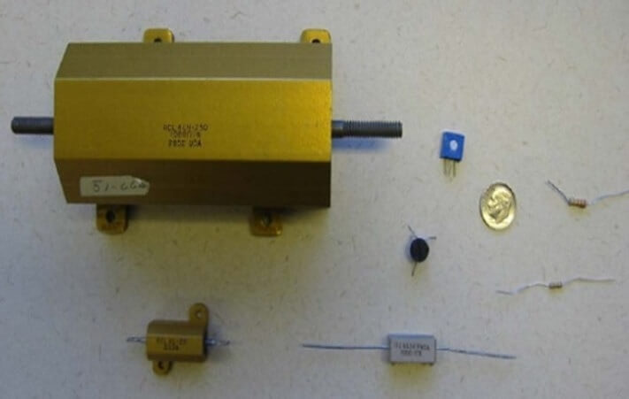
Resistors, Capacitors, and Inductors
The three basic passive elements used in electrical circuits.
Resistors are used as loads in electrical circuits.

Slide 9
Resistors
Resistor parameters: resistance, power rating, and tolerance.
Standard values: 10 12 15 18 20 22 27 33 39 47 56 68 82.
Resistors are color coded.

Slide 10
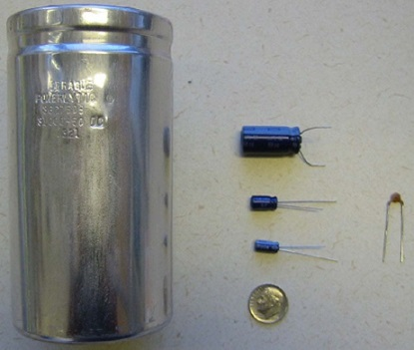
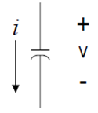
Capacitors
Capacitors are used in: dc blocking, level shifting, integrating, differentiating, filters, delay circuits.
All capacitors have maximum voltage ratings.
Capacitors range from 1 pF (10⁻¹²) to 0.1F. They have the same standard values as resistors.

Slide 11
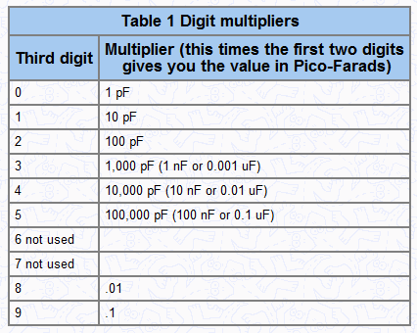
How to read puff capacitor codes?
Example:
Capacitor marking: 104
= 10 x 10⁴ pF
= 10⁵ x 10⁻¹² F
= 10⁻⁷ F
= 0.1μF.
Note: Typically, capacitors larger than 1 µF are polarized. puff capacitors are not polarized.

Slide 12
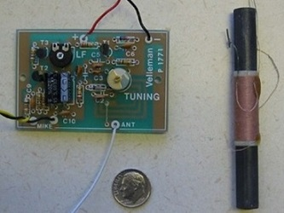
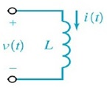
Inductors
Used as current limiting devices.
Found in relays, audio to electrical conversions, electromagnetic devices, light dimmers, and tuned circuits.
They are also the basis for transformers and motors.
Inductors vary from a few µH (etched on a pcb) to Henries.

Slide 13
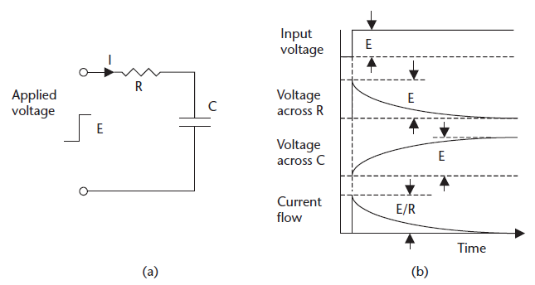
RC circuit
Let us apply a step input voltage to the following RC circuit.

Slide 14
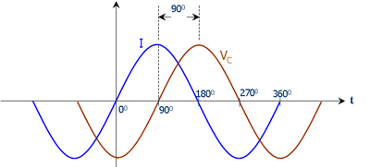
Both resistor current and voltage are maximum at the same time. The voltage is said to be in phase with the current.
In the capacitor, the voltage is zero when the current is maximum. That is the voltage lags the current (by a phase shift of 90°).
The voltage across the capacitor builds up exponentially, at a rate determined by the values of R and C:

Slide 15
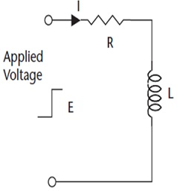
RL circuit
Now, let us apply a step input voltage to an RL circuit.
V_{R} and I_{R} are in phase.
V_{L} leads I_{L} by 90°.
V_{R} increases exponentially at a rate determined by the value of L and R.

Slide 16
Time constant
Time constant (τ): is the time taken by the response to reach 63.2% of its full change.
Time constant of RC circuit: τ = RC
Time constant of RL circuit: τ = R/L
Practically, the response will complete its full change in 4 to 5 time constants.
The notion of time constant applies not only to electrical circuits, but also to sensor outputs.
When there is a change in the measured variable, sensor output changes exponentially, so there is a delay before the sensor output reaches its final value.

Slide 17
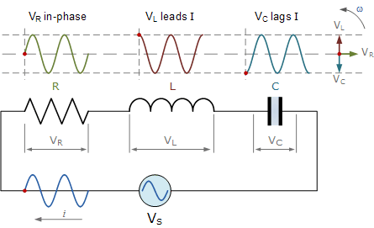
Series RLC: sine-wave inputs
Now we consider sine-wave inputs to a series RLC circuit.
The same phase shift rules apply.
V_{C} and V_{L} are 180° out of phase (they have opposite signs).

Slide 18
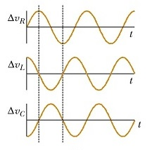
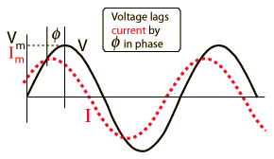
Series RLC: sine-wave inputs
The overall circuit is capacitive if
In this case, the current leads supply voltage by phase shift φ.
Interesting note: all signals have the same frequency.

Slide 19
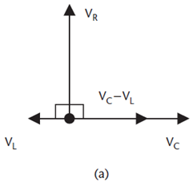
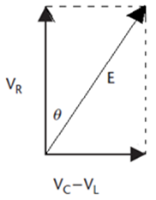
Vector addition
Since voltages and currents in capacitors and inductors are not in phase, they have impedance not resistance.
Impedance and resistance cannot be directly added. Instead, they can be combined using vectors.
Total input impedance of RLC circuit:
The current flowing in the circuit is:

Slide 20
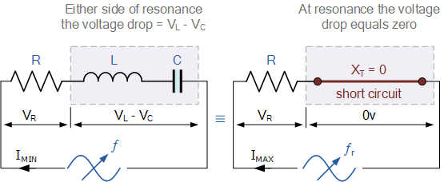
Resonance in RLC circuit
X_{L} and X_{C} are frequency dependent:
X_{L} increases with frequency while X_{C} decreases.
At certain frequency called the resonant frequency of the circuit X_{L} = X_{C}.

Slide 21
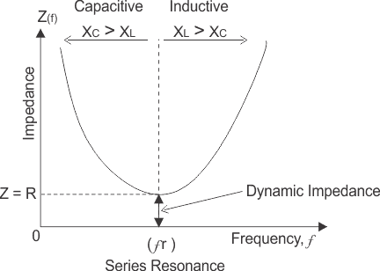
Resonance in RLC circuit
At resonance:
v_{L} and v_{C} become equal, opposite, and cancel,
total impedance becomes minimum and purely resistive Z = R,
current becomes maximum.
If input frequency is below resonant frequency X_{C} > X_{L}, the circuit is capacitive, otherwise, it is inductive.

Slide 22
Example
For a series RLC circuit, R = 27 kΩ, C = 2.2 nF, L = 33 mH, and the supply voltage is E = 20V.
What is the current flowing in the circuit if the input frequency = 35 kHz?
What is the resonant frequency of the circuit?
What is the current at resonance?

Slide 23
Answer
(a) At frequency f = 35 kHz,
(b) At resonance:
(c) The current at resonance is given by (noting that Z = R)

