Slide 1
Introduction
CSE 421 Digital Control
Lecture 1

Slide 2
Grading scheme
50 | Semester work
100 | Final
150 | Total
References:
Starr, G. Introduction to Applied Digital Controls, Springer 2020.
Ibrahim, D., Microcontroller Based Applied Digital Control. Wiley, 2006.
Philips, D., Nagle, H. and Chakrabortty, A., Digital Control System Analysis and Design, 4th Edition, Pearson, 2015.
Course webpage:
http://www.amelanany.faculty.zu.edu.eg/

Slide 3
Topics to be covered….
 | Topic | Reference
1 | Linear discrete systems | Starr, Ch 1 & 2
2 | Discrete approximation of continuous Systems | Starr, Ch 3
3 | Sampling and aliasing | Starr, Ch 4
4 | The z-transform | Ibrahim, Ch 6.2
5 | Block diagrams | Ibrahim, Ch 6.3
6 | Stability | Ibrahim Ch 8
7 | PID control
8 | Transform-based controller design | Ibrahim Ch 9
9 | Discrete-time state-space model | Starr, Ch 7
10 | State-space design of digital control systems | Starr, Ch 7
11 | System identification | Starr, Ch 8

Slide 4
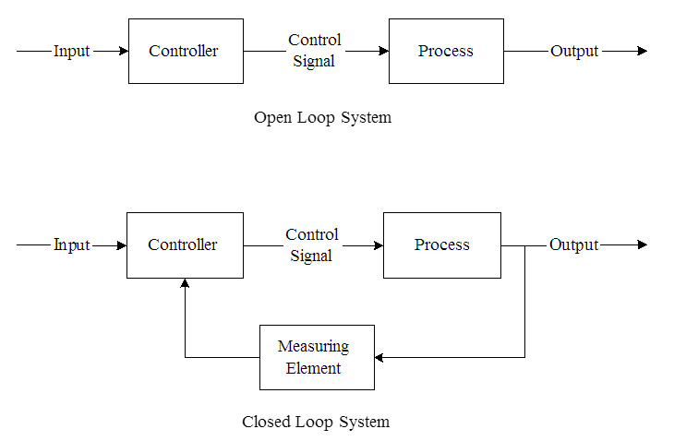
Objective of Control
To keep a certain variable at a certain value
Two approaches: Open loop & Closed loop (feedback) control.

Slide 5
Open vs. closed-loop control
Open-loop:
Keep plant Output close to some desired value (Input) by adjustment of Control Signal (according to some model).
Due to unknowns in system model and effects of external disturbances open-loop control is not accurate.
Closed-loop:
A measurement of plant Output is used to modify its input (Control Signal).
Controller receives measurement of plant Output, then generates suitable Control Signal value, hence closing the loop.

Slide 6
Advantages of closed-loop control
Minimize the effect of disturbance inputs on the output (Disturbance Rejection).
Exact plant model is no longer required. In other words, feedback control reduces sensitivity of the output to variations in plant parameters.
If the plant is unstable, then feedback control is necessary; Open-loop control can not be used in this case!

Slide 7
Continuous-time control systems
Generally, plant inputs and outputs are continuous signals in time and amplitude.
For example, if the speed of a motor is controlled using input voltage, both speed and voltage may change at any instant in time (continuous time) and can take any value within certain range (continuous amplitude).
In continuous-time control, the output is fed back, the error is calculated, and controller generates a control signal. This occurs at every time instant.

Slide 8
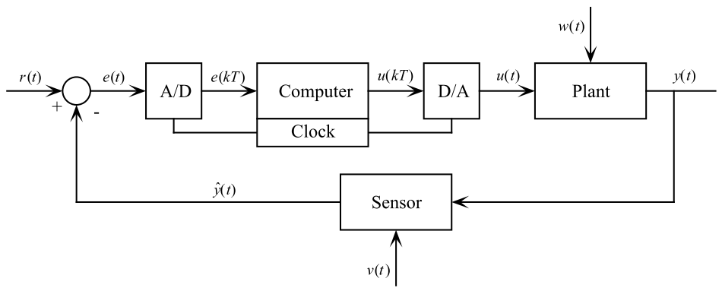
Digital control system
Computers and microcontrollers are widely used in control systems.
To control a physical system or process (which is usually analog) using a digital controller, digital-to-analog converter (DAC) and analog-to-digital converter (ADC) are required.

Slide 9
Sampling
The computer periodically samples the error signal every interval T called the sampling period. This is the role of the clock in the block diagram (in slide 8).
The sampling frequency in Hz is 1/T.
When a continuous signal e(t) is sampled, it becomes a discrete sequence denoted by e(kT), e(k) or e_{k}.
Discrete signals are mathematically deﬁned only at the sample instants t = kT, where k = 0,1,2,….
Digital control systems are also called discrete-time or sampled-data systems.

Slide 10
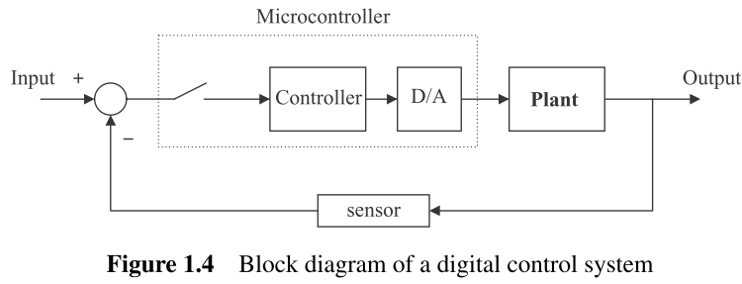
Analog-to-digital (A/D) converter
A/D converter samples analog signal (typically voltage), and converts the sample value into integer number (binary) suitable for processing by digital computer.
The A/D converter is approximated as a sampler (a switch).

Slide 11
A/D converter
A/Ds typically have unipolar ranges of 0–5V, 0–10V, or bipolar ranges of ± 5V, or ± 10V.
A/D conversion causes quantization error q which depends on the resolution of the converter in bits.
Common resolutions are 8 bits (256 levels), and 12 bits (4096 levels).
A 12-bit A/D of range ±10 volts would have a conversion quantum of q = 20/4096 = 4.88 mV.

Slide 12
Digital-to-analog (D/A) converter
D/A converts a digital (integer) number calculated by the computer into a voltage so as to drive the plant.
The voltage ranges and converter resolutions are the same as for the A/D converter.
D/A converter functions as a zero-order hold (ZOH), holding its output at a constant value until it receives the next discrete input.
Many microcontrollers incorporate built-in A/D and D/A converter circuits. Hence, they can be connected directly to analog signals.

Slide 13
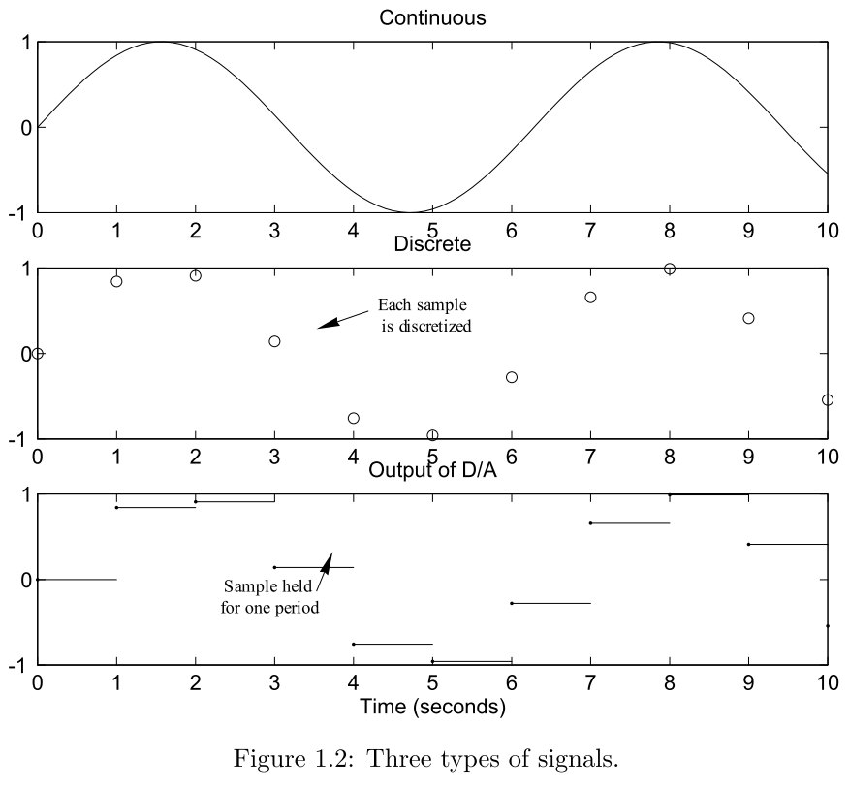
Continuous, discrete, and ZOH (output of D/A) signals

Slide 14
Digital vs. Analog Control
Digital control systems are so widely used that it is rare to see a completely continuous control system (Starr, 2020).
Intuitively, one would think that controllers that continuously monitor the output of a system and accordingly change their control signal would be superior to those that base their control on sampled values of the output.
This is in fact true! Had all other factors been identical for digital and analog control, analog control would be superior to digital control.
What, then, is the reason behind the change from analog to digital that has occurred over the past few decades?

Slide 15
Digital vs. analog control
Computers can sample signals at very high speeds (very small sampling periods). Therefore, they achieve performance that is essentially the same as that based on continuous monitoring of controlled variable.
Digital controller is implemented in software. So, it is easy to modify and to implement complex controller methods such as adaptive control. Analog control is difficult to modify once implemented in hardware and is restricted to PID controllers.
The cost of digital control systems is moderate, even for small, low-cost applications.

Slide 16
Other advantages
Use of computers in control systems is particularly valuable for a number of other reasons:
A computer can control multivariable processes.
Nonlinearities in sensor output can be linearized by the computer.
Networking of control computers allows a large process-control systems to operate in a fully integrated fashion.

Slide 17
Computer Control Algorithm
In order to use a computer to control a given system, it must execute the following algorithm:
Read desired value, R, from A/D converter
Read actual plant output, Y, from A/D converter
Calculate error signal, E = R − Y
Calculate the controller output, U
Send controller output to D/A converter

Slide 18
Computer Control Algorithm
The control algorithm is executed every sampling interval T. Hence, it is implemented as a code inside an endless loop.
Repeat Forever
Read desired value, R, from A/D converter
Read actual plant output, Y, from A/D converter
Calculate error signal, E = R − Y
Calculate controller output, U
Send controller output to D/A converter
Wait for the next sampling instant
End

Slide 19
Computer Control Algorithm
The control algorithm runs continuously but can be stopped manually by an operator or if some abnormal event occurs.
The loop must run exactly every sampling interval. For this purpose, two approaches are considered here:
Timer interrupt
Dummy code

Slide 20
Timer Interrupts
Available on most microcontrollers.
Controller algorithm is written inside a timer interrupt service routine (ISR), and the timer is programmed to generate interrupts at regular sampling intervals.
At the end of ISR, control returns to the main program, which either waits for the occurrence of next interrupt or performs other tasks (e.g. display data on LCD).
The use of interrupts provide accurate sampling intervals and allows the processor to do other tasks between sampling instants.

Slide 21
Timer Interrupts
Main program:
Wait for a timer interrupt (or perform some other tasks)
End
Interrupt service routine (ISR):
Read desired value, R
Read actual plant output, Y
Calculate error signal, E = R − Y
Calculate controller output, U
Send controller output to D/A converter
Return from interrupt

Slide 22
Dummy Code
This is based on a simple idea: Find execution time of instructions inside loop and add dummy code to adjust loop execution time so that it equals the required sampling interval.
Do Forever:
Read desired value, R
Read actual plant output, Y
Calculate error signal, E = R − Y
Calculate controller output, U
Send controller output to D/A converter
Dummy code
End
Problem: If the code inside the loop or CPU clock change, it will be necessary to readjust the dummy code ► not accurate

