Slide 1
Common Process Types
CSE 425 Industrial Process Control
Lecture 3
Copyright © Thomas Marlin 2013

Slide 2
Outline
Common process types
Self-regulating
- First order
- Second order
Integrating (Non self-regulatory)
Runaway
Dead time
Steady-state characteristics
Dynamic characteristics

Slide 3
Objective
Understand the process, predict its response for typical inputs (impulse, step) without any control
This gives us idea about what performance we could expect from the controller
Example: Bus vs. bicycle
Bus difficult to control, bicycle easy to control

Slide 4
Self-Regulating Processes
The process by itself (without any control) reaches equilibrium.
Most processes are self-regulating (car, motor speed)
No overshoot
First-order system is self-regulating as its step response reaches a steady state.
where τ_{p} is the time constant and K_{p} is the steady-state gain.

Slide 5
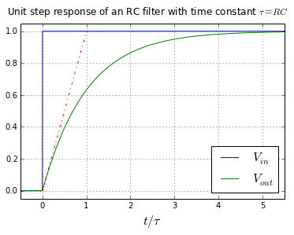
Self-Regulating Processes
First-order process is also called single capacity or first-order lag.
Capacity is a volume where mass or energy is stored.
First-order lag is the favorable dynamics: easy to control

Slide 6
Example
Level sensor
Level sensor
Liquid-filled
tank
valve

Slide 7
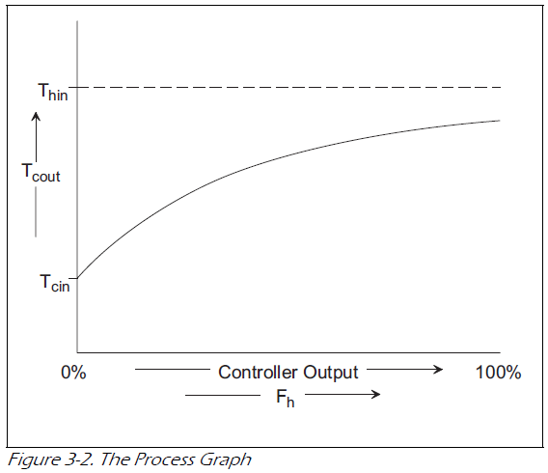
Steady-State Process Characteristics
Process Graph (for self-regulating processes): describes the I/O relationship in steady state
Changes with the load
PV
MV: Valve opening

Slide 8
Steady-State Characteristics
Operating point (in terms of PV):
it will be the function of the controller to find the valve opening (MV) required to achieve the desired PV value
Process Gain:
Slope of the line or tangent to process graph
May be +ve or –ve

Slide 9
Process Gain
The process gain (also called dc gain) is the percent (fractional) change in PV divided by the percent (fractional) change in MV after the process has fully responded to the change
The gain is dimensionless (%/%)
The process gain depends on the operating point.
This makes controller tuning more difficult.

Slide 10
Step response of a first-order model
The time constant τ determines the speed of the response.
If it is negative, the process is unstable.

Slide 11
Non-self regulating (integrating) process
Here, the output variable tends to “drift” linearly far from desired values without reaching equilibrium (fixed rate of increase).
For example, consider a tank whose flows are un-manipulated (The pump at the outlet keeps the outlet flow fixed regardless of the level (i.e. we do not apply control or manual correction).
Level sensor
Level sensor
Liquid-filled
tank
pump
valve

Slide 12
Integrating Processes
It has a pole s = 0.
These systems are termed “pure integrators” because they integrate the difference between in and out flows.
Feedback control is necessary for these processes.
To tune such process, we try to stabilize the level first before applying a step in the inlet valve

Slide 13
Question
Level sensor
Level sensor
Liquid-filled
tank
pump
valve
Plot the level for this scenario
F_{in}
F_{out}
time

Slide 14
Answer
Level sensor
Level sensor
Liquid-filled
tank
pump
valve
Level
F_{in}
F_{out}
time

Slide 15
Second-order models
where ω_{n} is the natural (undamped) frequency, ζ is the damping ratio, and K is the steady-state gain.
The system has two poles

Slide 16
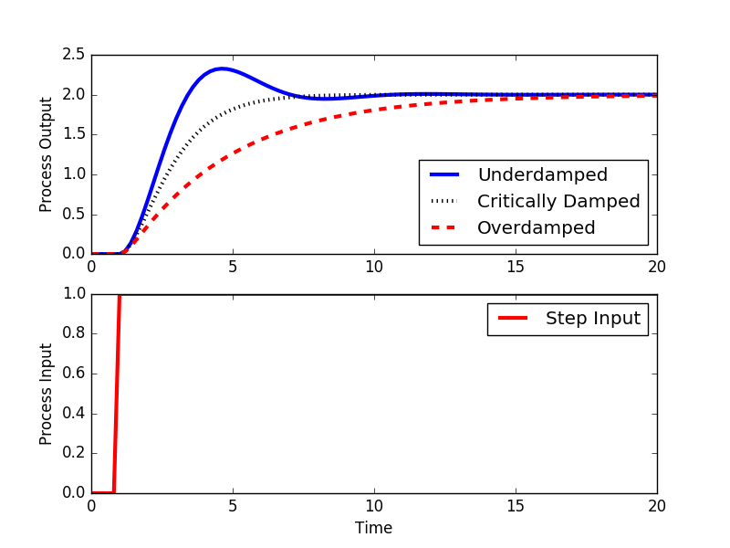
Second-order models
Usually, processing equipment doesn’t have oscillatory behavior (this can be a first-order or second-order over-damped process).
A 2nd process that exhibits oscillatory behavior (under-damped) is most often the result of implementing a controller. Exception is the car shock absorber (mechanical systems)

Slide 17
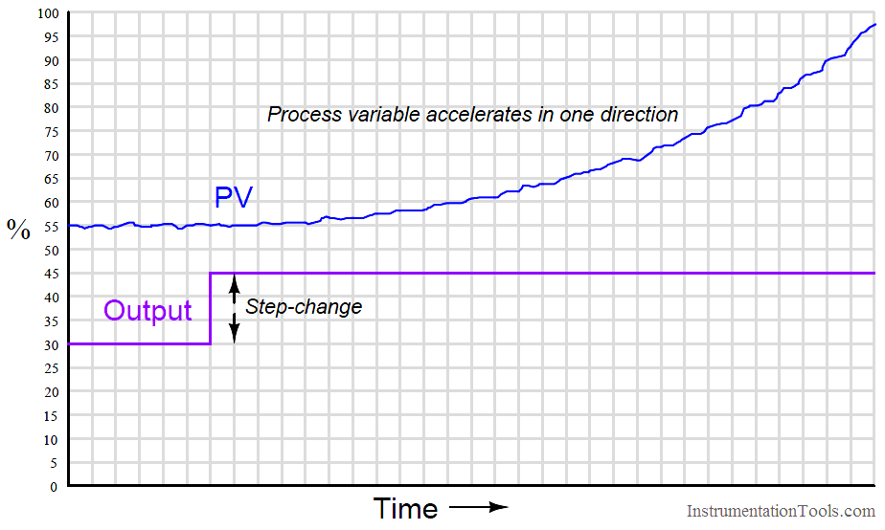
Runaway (Unstable) Processes
The process output keeps increasing very rapidly without reaching equilibrium (the rate is itself increasing).
Example: some exothermic reactions (Wade, (Chap. 3)

Slide 18
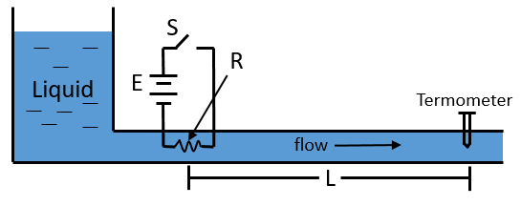
Processes with dead time
Many chemical processes involve a time delay between input and output (mostly measured in minutes).
This may be due to the time required for a slow chemical sensor (e.g. analyzer) to respond or for a fluid to travel down a pipe.
Time delay is also called dead time or transport delay.

Slide 19
Processes with dead time
The location of the sensor is determined by the process engineer, not the control engineer.
In feedback control, the process will not respond quickly to control actions. This causes the controller to over-react resulting in oscillatory response
Systems with long dead time are more difficult to control

Slide 20
Let’s consider plug flow through a pipe. Plug flow has no backmixing; we can think of this as a hockey puck traveling in a pipe.
What is the dynamic response of the outlet fluid property (e.g., concentration) to a step change in the inlet fluid property?

Slide 21
Laplace Transform of a dead time element
Y_{out}
θ = dead time
θ
U_{in}
time
The dynamic model for dead time is

Slide 22
Pade Approximation of Time Delay
Dead time can be approximated as a ratio of two polynomials in s using e.g. the first-order Pade approximation:

Slide 23
Example
Use ﬁrst-order Pade approximation to plot the unit-step response of ﬁrst order with a dead-time transfer function:
Making use of the first order Pade approximation, we can construct a plot with the approximation

Slide 24
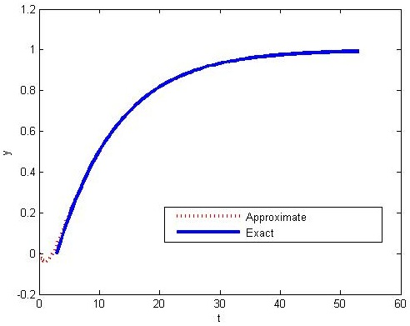
The approximation is very good except near t = 0, where the approximate response dips below. A better approximation can be obtained with, e.g., a second-order Pade approximation.

