Slide 1
(7)
Measurement Systems

Slide 2
Objectives
Review the basic elements of measurements-instrumentation systems.
List and recognize the static and dynamic characteristics used to describe their performance.

Slide 3
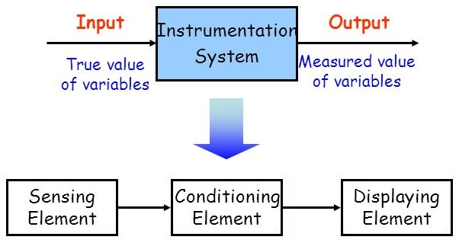
Instrumentation Systems
An instrumentation or measurement process can be viewed as a system whose input is the true value of the variable being measured and its output is the measured value.

Slide 4
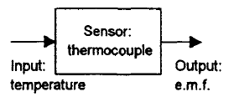
Sensor
The sensor is the element in contact with the process for which a variable is being measured.
It gives an output which depends in some way on the value of that variable.
For example, a thermocouple is a sensor which converts temperature changes into a small output voltage.

Slide 5
Signal conditioning
As we have seen in previous lectures, signal conditioning element converts the sensor output into a form suitable for further processing such as display or onward transmission in some control system.
For example, in the case of the resistance thermistor there might be a signal conditioner, a Wheatstone bridge, which transforms the resistance change into a voltage change, then an amplifier to make the voltage big enough for display.

Slide 6
Data presentation
Presentation of measured value in a suitable form for the operator such as a moving a pointer across a scale or presenting information on a visual display.
Alternatively, the signal may be recorded, e.g. on the paper of a chart recorder or transmitted to some other system such as a control system.

Slide 7
Characteristics of Measurement devices
The performance of measurement systems are described using several characteristics or indices. These characteristics can be categorized into:
Dynamic: which describe the transient behavior between the time a measured quantity changes value and the time when the instrument output attains a steady value in response.
Static: which is concerned only with the steady-state reading that the instrument settles down to, such as the accuracy of the reading etc.

Slide 8
1. Accuracy
Static Characteristics of Instruments
The accuracy of an instrument is a measure of how close is its output reading to the correct value. That is, how small is the error in the reading, or how much is the uncertainty in the measurement.
Tolerance is a term that is closely related to accuracy. It deﬁnes the maximum error expected in some value.
Accuracy is quoted as a tolerance ﬁgure, a percentage of reading, or a percentage of full-scale (f.s.) reading of an instrument.

Slide 9
A resistor having a nominal value 1000Ω and tolerance 5% might have an actual value anywhere between 950 and 1050Ω.
If a pressure gauge of range 0–10 bar has a quoted inaccuracy of $±$1.0% f.s., then the maximum error to be expected in any reading is 0.1 bar. This means that when the instrument is reading 1.0 bar, the possible error is 10% of this value.
Important rule: choose instrument which has measurement range appropriate to the spread of values being measured in order to achieve the best possible accuracy in the readings.
Thus, if we were measuring pressures with expected values between 0 and 1 bar, we would not use an instrument with a range of 0–10 bar.

Slide 10
2. Precision (repeatability)
Repeated measurements of the same value can vary due to random errors.
Environmental effects such as temperature and humidity changes and fluctuations in the power supply can affect the operation of measurement systems, and also the system you are taking measurements from. High voltage lines close by can also introduce measurement noise.
Precision describes how close are repeated measurements of the same value of a measured variable, or, equivalently, the instrument’s degree of freedom from random errors.

Slide 11
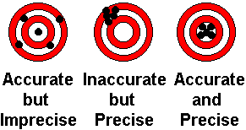
2. Precision (repeatability)
Precision is often, though incorrectly, confused with accuracy. High precision does not imply anything about measurement accuracy.
A precise instrument may be inaccurate.
Inaccurate measurements from a precise instrument are normally caused by a bias in the measurements, which is removable by recalibration.

Slide 12
3. Range or span
The range or span of an instrument defines the minimum and maximum values of a quantity that the instrument is designed to measure.

Slide 13
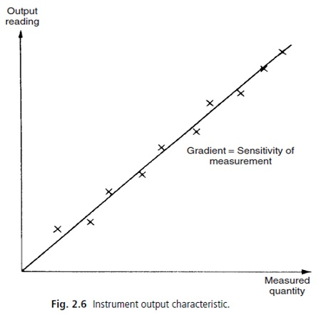
4. Linearity
It is desirable that the output reading of an instrument is linearly proportional to the quantity being measured.
In the figure shown, the x marks are typical output readings of an instrument when a sequence of input quantities are applied.
By fitting a straight line through these marks, it is clear that the device can be considered linear.

Slide 14
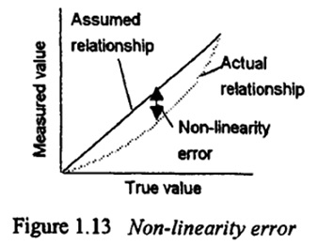
4. Linearity
The non-linearity error is defined as the maximum deviation of any of the output readings (marked x) from the assumed straight line.
Non-linearity is usually expressed as a percentage of full-scale reading.

Slide 15
5. Sensitivity of measurement
The sensitivity of a measurement device is defined as the ratio:
The sensitivity of measurement is the slope of the straight line drawn in the previous slide.

Slide 16
Example
The following resistance values of a platinum resistance thermometer were measured at a range of temperatures. Determine the measurement sensitivity of the instrument in Ω/˚C.
Solution:
By plotting these values on a graph, the relationship between temperature and resistance is a straight line.
For 30˚C change in temperature, the change in resistance is 7Ω. Hence the measurement sensitivity is 7/30 = 0.233Ω/˚C.
Temperature (˚C) | Resistance (Ω)
200 | 307
230 | 314
260 | 321
290 | 328

Slide 17
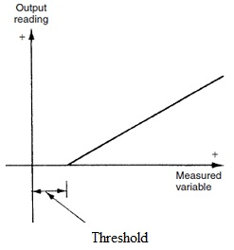
6. Threshold
If the instrument input is very gradually increased from zero, there will be some minimum value below which no change in the instrument reading is detected or observed. This minimum value defines threshold of the instrument.

Slide 18
7. Resolution
When an instrument is showing a particular output reading, there is a lower limit on the magnitude of the change in the input measured quantity that produces an observable change in the instrument output.
That is, resolution is the smallest change in the measured quantity that can be detected.
One of the major factors influencing the resolution of an instrument is how finely its output scale is divided into subdivisions (think in the position of the decimal point in an DMM display for example).

Slide 19
8. Sensitivity to disturbance
All calibrations and specifications of an instrument are only valid under controlled conditions of temperature, pressure etc. As variations occur in ambient temperature, certain instrument characteristics change. The sensitivity to disturbance is a measure of the magnitude of this change.
Such environmental changes affect instruments in two main ways, known as zero drift and sensitivity drift.
Zero drift describes the effect where the zero reading of instrument is modified by a change in ambient conditions. This causes constant error allover the full range of measurement of the instrument.

Slide 20
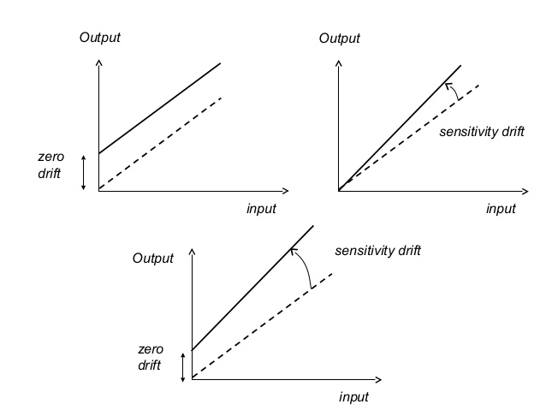

Slide 21
8. Sensitivity to disturbance
The bathroom scale is often prone to bias. It is usual to find a reading of perhaps 1 kg with no one stood on the scale. If someone of weight 70 kg were to get on the scale, the reading would be 71 kg, and if someone of weight 100 kg were to get on the scale, the reading would be 101 kg.
Zero drift is normally removable by calibration. In the case of bathroom scale, a thumbwheel can be turned until the reading is zero with the scale unloaded.
Zero drift is also found in instruments like voltmeters that are affected by ambient temperature changes. Typical unit of such zero drift is V/°C. This is called the zero drift coefficient related to temperature changes.
If the characteristic of an instrument is sensitive to several environmental parameters, then it will have several zero drift coefficients, one for each environmental parameter.

Slide 22
8. Sensitivity to disturbance
Sensitivity drift defines the amount by which an instrument’s sensitivity varies as ambient conditions change. It is quantified by sensitivity drift coefficients that define how much drift there is for a unit change in each environmental parameter that the instrument characteristics are sensitive to.
Sensitivity drift is measured in units of the form (angular degree/bar)/°C.
An instrument may suffer from both zero drift and sensitivity drift at the same.

Slide 23
Example
A spring balance is calibrated in an environment at a temperature of 20˚C and has the following deflection/load characteristic.
It is then used in an environment at a temperature of 30˚C and the following deflection/load characteristic is measured
Determine the zero drift and the sensitivity drift per ˚C change in ambient temperature.
Load (kg) | 0 | 1 | 2 | 3
Deflection (mm) | 0 | 20 | 40 | 60
Load (kg) | 0 | 1 | 2 | 3
Deflection (mm) | 5 | 27 | 49 | 71

Slide 24
Solution
At 20˚C, deflection/load characteristic is a straight line with:
0 mm deflection for no load and Sensitivity = 20 mm/kg.
At 30˚C, deflection/load characteristic is still a straight line with:
5 mm deflection for no load and Sensitivity = 22 mm/kg.
Zero drift per ˚C change in ambient temperature =
Sensitivity drift per ˚C change in ambient temperature =

Slide 25
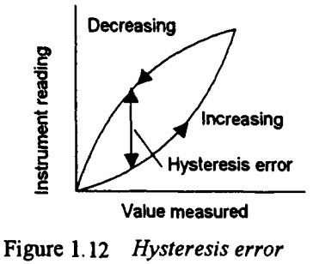
9. Hysteresis error
Hysteresis error is the difference in outputs resulted from the same value of quantity being measured according to whether that value has been reached while the measured variable is increasing or decreasing.
Thus, you might obtain a different value from a thermometer used to measure the same temperature of a liquid if it is reached by the liquid warming up to the measured temperature or it is reached by the liquid cooling down to the measured temperature.

Slide 26
Dynamic characteristics of instruments
The dynamic characteristics of an instrument describe its behavior between the time the measured quantity changes value and the time when the instrument output attains a steady value in response.
To study the dynamics of a measuring system, it is described as an ODE:
where
u is the measured quantity,
y is the output reading and
a₀...a_{n}, b₀ ... b_{m} are parameters.

Slide 27
Dynamic characteristics
Simpliﬁed cases of the previous equation are applicable in normal measurement situations. For example, if we limit consideration to that of step changes in the measured quantity only, then the previous equation reduces to:
Further simpliﬁcations can be made which collectively apply to nearly all measurement systems.

Slide 28
Zero order instrument
If all the coefﬁcients except a₀ are zero, then:
where K is a constant known as the gain or the instrument sensitivity deﬁned earlier. Any instrument that behaves according to this equation is said to be of zero order.

Slide 29
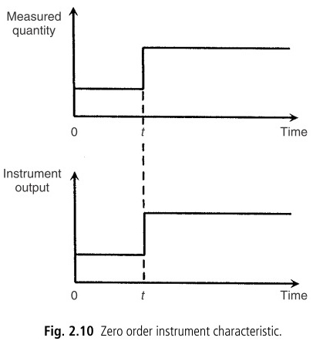
Zero order instrument
Following a step change in the measured quantity at time t, the instrument output moves immediately to a new value at the same time instant t, as shown.
A potentiometer, which measures motion, is a good example of such an instrument, where the output voltage changes instantaneously as the slider is displaced along the potentiometer track.

Slide 30
First order instrument
If all the coefﬁcients except a₀ and a₁ are zero then:
Where K is called the steady-state gain or the sensitivity of the instrument and τ is called the time constant.

Slide 31
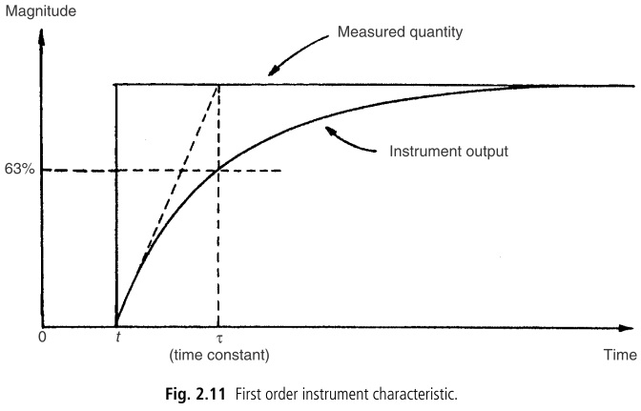
First order instrument
A large number of instruments are ﬁrst order. This is of particular importance in control systems where it is necessary to take account of the time lag that occurs between a change in the measured quantity and the corresponding change in the reading. Fortunately, the time constant of many ﬁrst order instruments is small relative to the dynamics of the process being measured, and so no serious problems are created.

Slide 32
Second order instruments
The standard equation for a second order system or instrument is given by
Which is usually written as
Where ω_{n} is the undamped natural frequency, η is the damping ratio, and K is the gain.

Slide 33
Second order instruments
The shape of the step response of a second order system depends on the value of the damping ratio (η).
Clearly, the extreme response curves (A) and (E) are grossly unsuitable for any measuring instrument.
Commercial 2nd order instruments, such as accelerometer, are generally designed to have a damping ratio (η) somewhere in the range of 0.6–0.8 to achieve a relatively fast response with small overshoot.

