Slide 1
(2) Bridge Circuits

Slide 2
Introduction
Many transducers translate a change in the quantity you wish to measure into a change in impedance, i.e., resistance, capacitance or inductance. For example a strain gage, changes strain ( Δl/l) into a change in relative resistance (ΔR/R_{o}).
In order to be suitable for electronic measurement systems, impedance changes should be converted into voltage changes.
This can be done using e.g. voltage divider. The voltage across the impedance is measured with a voltmeter or a computer equipped with analog to digital conversion boards.

Slide 3
Voltage Divider
V_{s} is the supply voltage and R₁, R₂ are the divider resistors.
The variation of V_{R} with either R₁ or R₂ is nonlinear.
The effective output impedance of the divider is R1//R2 (ideally, output impedance should be zero).
The current flows to both R₁ and R₂. The power rating of both resistors should be considered.

Slide 4
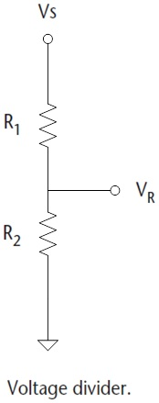
Example 1
The resistive elements in a strain gauge are 5kΩ each. If R₂ is the fixed element and R₁ is the element measuring strain, what is the change in R₁ that produce 0.01V change in output voltage. Assume a supply of 10V.

Slide 5
Answer
With no strain, R₁ = R₂. Hence, V_{R} = 5V. The question is then what is value of R₁ that produces 5.01 V and 4.99V.
We realize that the relation between changes in resistance ΔR and the corresponding changes in output voltage ΔV is nonlinear.

Slide 6
Problem with voltage divider
From the previous example, the change in impedance is often very small compared to the total impedance of the transducer and the resulting signal will have a large DC shift (5V in the our example).
We are interested in the small deviations of the signal away from this large DC shift.
A bridge circuit solves this problem by creating a voltage output that is proportional to the change in impedance rather than the absolute value of the impedance.

Slide 7
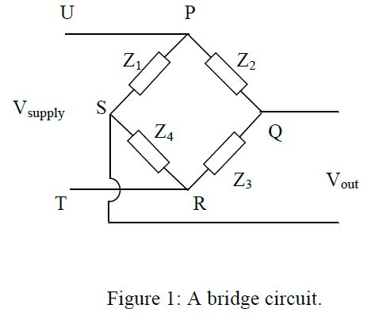
The bridge circuit
The bridge consists of four impedances {Z₁, Z₂, Z₃, Z₄}, or arms connected in the form of a diamond with the supply and measuring instruments connected across the bridge.

Slide 8
The bridge circuit
One impedance is part of the transducer. We say that it is an active arm of the bridge. The other arms are fixed.
Sometimes, more than one arm are active to increase sensitivity and also to compensate for temperature effects.

Slide 9
Balancing the bridge
When the output voltage V_{out} = 0, the bridge is said to be balanced. To balance the bridge
Therefore, the condition for balance is:
Note: the voltmeter which measures V_{out} should have a high resistance, so that it does not load the bridge circuit.

Slide 10
Example 2
A pressure transducer consists of a diaphragm with a strain gauge cemented to it to detect diaphragm deﬂections. The strain gauge has a nominal resistance of 120Ω and a sensitivity 338 mΩ/bar. The gauge forms one arm of a bridge and the other three arms each has a resistance of 120Ω.
(a) If, in order to limit heating effects, the maximum allowable gauge current is 30 mA, calculate the maximum allowable bridge supply voltage.
(b) If the maximum bridge supply voltage is used, calculate the bridge output voltage when measuring a pressure of 10 bar.

Slide 11
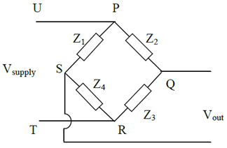
Answer
The resistors in the bridge circuit are: R₁ = R₂ = R₃ = 120Ω and the nominal value of the sensor resistance R₄ = 120Ω.
Deﬁning I to be the current ﬂowing in path PSR of the bridge, we can write:
V_{s} = (R₁ + R₄) x I
As the maximum allowable value for I is 0.03A, then:
V_{s} = 0.03(120 + 120) = 7.2 V
Thus, the maximum allowable bridge supply voltage is 7.2V.

Slide 12
(b) For an applied pressure of 10 bar, the resistance change is 3.38 Ω, i.e. the value of R₄ becomes 123.38 Ω.
The bridge output voltage is found is

Slide 13
Bridge linearity
Let us consider a bridge with R₁ = R₂ = R₃ = 100 Ω and V_{s} = 10 V.
Now, let us plot the bridge output voltage ΔV (V_{QS}) as R₄ varies from 0 to 500 Ω.

Slide 14
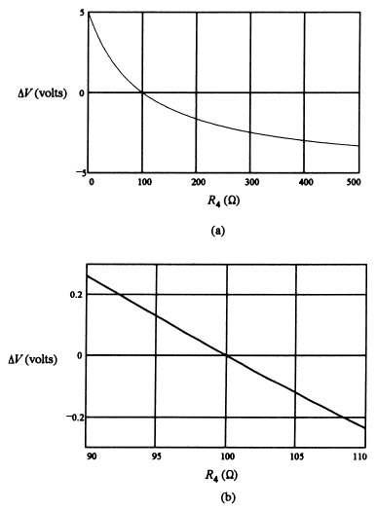
Bridge linearity
Bridge output voltage ΔV is nonlinear for large changes in R₄ around its nominal value, 100 Ω.
If the range of resistance variation is small around the null value (say, 90 to 110 Ω), then the variation of ΔV with R₄ is relatively linear.
Amplifiers can be used to amplify this voltage variation to a useful range.

Slide 15
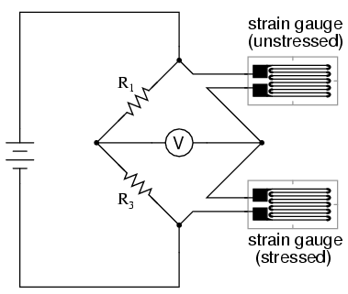
Temperature compensation
Resistive sensors such as strain gauges are temperature sensitive.
In order to minimize temperature effects on the measurement of strain and other physical quantities, a pair of sensors are configured in bridge circuit as shown.
With temperature changes, resistance of both strain gauges change by an equal percentage, so the bridge remains balanced.
Under strain, only resistance of stressed gauge will change and the bridge will not remain balanced; the voltmeter will detect strain changes.

Slide 16
ac Bridge Circuits
The basic concept of dc bridges can be extended to ac bridges.
In this case, the bridge supply is ac voltage, ac meters are used, and the resistive elements are replaced with impedances.
This type of setup can be used to measure small changes in resistance, capacitance, inductance, or combination of them as is the case in some sensors such as capacitive pressure sensor.

Slide 17
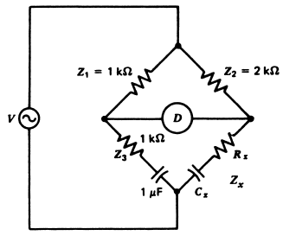
Example 3
An ac bridge employs impedances as shown in the Figure below. Find the value of R_{x} and C_{x} when the bridge is nulled.

Slide 18
Answer
For the bridge to be balanced, we need
As real and imaginary parts must be independently equal

Slide 19
Assignment
For the following bridge circuit, all bridge arms are strain gauges with nominal values of R_{o} each.
Let us assume that, after stretching and contracting, the impedances in the bridge take the following values:
Z₁ = R_{o} + ΔR, Z₂ = R_{o} - ΔR,
Z₃ = R_{o} + ΔR, Z₄ = R_{o} - ΔR.
Calculate the output voltage of the bridge in terms of V_{supply}, R_{o} and ΔR. Is the relationship between V_{out} and ΔR linear?

