Slide 1
Stability of Discrete Systems
CSE 421 Digital Control
Lecture 7

Slide 2
Introduction
A discrete-time system given by the following transfer function
is stable if all poles (roots of characteristic equation D(z) = 0) lie inside the unit circle in z-plane (i.e. their magnitudes are less than 1).
To check the stability of discrete systems:
Find the roots of D(z) = 0 (easy to do using MATLAB command roots.
Use Jury’s test.
Use Routh–Hurwitz criterion .

Slide 3
Example 1
Find the value of T for which the following closed-loop discrete-time system is stable.
Solution:
The transfer function of the closed-loop system is

Slide 4
Thus the system is stable as long as T < 0.549.

Slide 5
Jury stability test
Jury’s test is similar to Routh–Hurwitz stability criterion used for continuous systems.
To use Jury’s test, the characteristic equation of discrete system of order n is written as follows:

Slide 6
Jury test for 2nd order systems
For a 2nd order system to be stable the following 3 conditions have to be satisﬁed.

Slide 7
Jury test for higher order system
For higher order system, there are extra conditions to check.
First, build the following array:

Slide 8
Jury test for higher order system
The following set of conditions have also to be satisﬁed.
Conditions (I) and (II) are necessary and sufﬁcient for the characteristic equation to have all roots inside the unit circle.

Slide 9
Example 2
Using Jury’s test, determine the stability of the unity feedback system whose open-loop transfer function is given by
Solution

Slide 10
Example 3
Determine the stability of the system having the following characteristic equation:
Solution

Slide 11
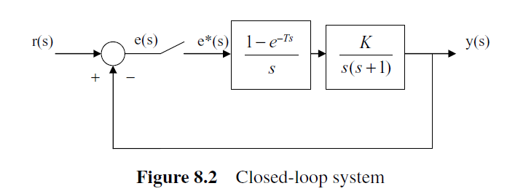
Example 4
The block diagram of a sampled data system is shown below. Use Jury test to determine the value of K for which the system is stable. Assume that K > 0 and T = 1 s.

Slide 13
Apply Jury test:
The third condition is
Combining all inequalities, the system is stable for K < 2.4

Slide 14
Example 5
Determine the stability of the system having the following characteristic equation:
|b₀|=0.75< |b₃|=1.5
|c₀|=1.6875> |c₂|=0.75
System is unstable!

Slide 15
Routh–Hurwitz Criterion
Stability of a sampled data system can be analyzed by transforming the system characteristic equation into the s-plane and then applying the well-known Routh–Hurwitz criterion.
A bilinear transformation is usually used to transform the interior of the unit circle in the z-plane into the left-hand s-plane (or w-plane). For this transformation, z is replaced by
giving the characteristic equation in w,

Slide 16
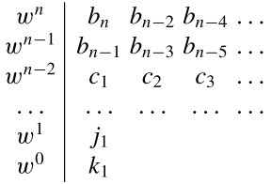
Routh–Hurwitz Criterion
Routh-Hurwitz array is formed as shown.
The ﬁrst two rows are obtained from the equation directly and the other rows are calculated as shown.
The number of roots in the right hand side in s-plane is equal to the number of sign changes in the ﬁrst column of the array.
For a stable system, all coefﬁcients in the ﬁrst column must have the same sign.

Slide 17
Example 6
The characteristic equation of a sampled data system is
Determine the stability of the system using Routh–Hurwitz criterion.

Slide 18
Now, we form Routh array:
No sign change in the first column → system is stable.
To check the answer, we can find the magnitude of the roots of the characteristic equation of the discrete system using Matlab command
abs(roots([2 1 1 1]))
This gives 0.823, 0.823, 0.739, i.e. all roots inside the unit circle and, hence, the system is stable.

