Slide 1
System Structures
CSE 425 Industrial Process Control
Lecture 4
Copyright © Thomas Marlin 2013

Slide 2
Process Structures
Simple dynamic elements can yield complex dynamics when combined in typical process structures.
Series
Parallel
Recycle

Slide 3
Systems in Series
q_{i}
Examples:
The transfer function between inlet flow q_{i} to 2nd tank level is 2nd order.
q_{i}
T
T
Interacting series:
Flow between tanks depends on level in 2nd tank.
Non-interacting series:
Flow between tanks doesn’t depend on level in 2nd tank.

Slide 4
Non-interacting Series
The block diagram of a non-interacting series is:
The transfer function of the series is:
v(s)
F₀(s)
T₁(s)
T₂(s)
T_{meas}(s)
G_{valve}(s)
G_{tank1}(s)
G_{tank2}(s)
G_{sensor}(s)

Slide 5
Multi-capacity processes
If each element in the series is first order, the series is called multicapacity process:
The overall gain is product of gains of each element.
The series is slower (more sluggish) than any single element. The more tanks we have in a series, the longer we have to wait until the last tank “sees” the changes that we have made in the ﬁrst one.

Slide 6
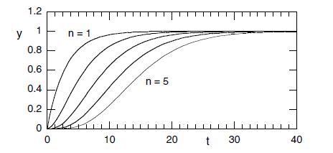
Numerical Example
Assume that all stages in a multi-capacity process have the same time constant, then the whole system can be modeled as
Let us simulate this system for n = 1, 2, 3, 4, 5.
The response becomes more sluggish as the number of elements in the series increases.
tau = 3;
G = tf(1,[tau 1]);
step(G);
hold
step(G*G);
step(G*G*G);
step(G*G*G*G);
step(G*G*G*G*G);

Slide 7
Approximation of high-order processes
In the previous figure, the initial response is small and can be ignored. This can be represented with pure dead time.
In practice, high-order processes can be well approximated with ﬁrst-order process plus dead-time (FOPDT):
For example, consider the following 4th order system:

Slide 8
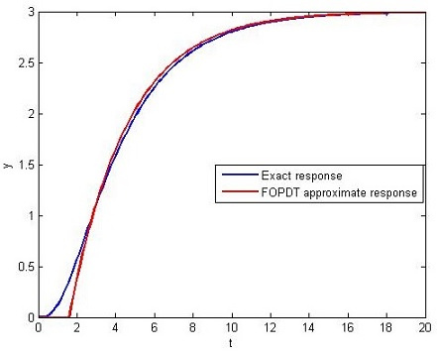
The response of this system is dominated by the largest time constant 3 (dominant pole at -1/3).
Accordingly, we may approximate the full-order function as
where 1.6 is the sum of the smaller time constants 0.1, 0.5, and 1.
As shown, the approximation is reasonable for t large enough so that the pole at − 1/3 can indeed be considered dominant.

Slide 9
Class Exercise:
Sketch the step response for the system below.
τ = 2
θ = 2
τ = 2
θ = 2
Step

Slide 10
Parallel Structures
Parallel structures result when there are two paths between input and output, e.g. a flow split, where the paths have different time constants.
Example process systems
Block diagram
A → B → C
G₁(s)
U(s)
Y(s)
G₂(s)

Slide 11
Transfer Function of a Parallel Structure
Assume that both elements in parallel are first order, then the overall model is
Combining both terms gives a second-order function with a zero
Where
As we know, the inherent dynamics is governed by the poles, however, the zeros have interesting effects on the response.

Slide 12
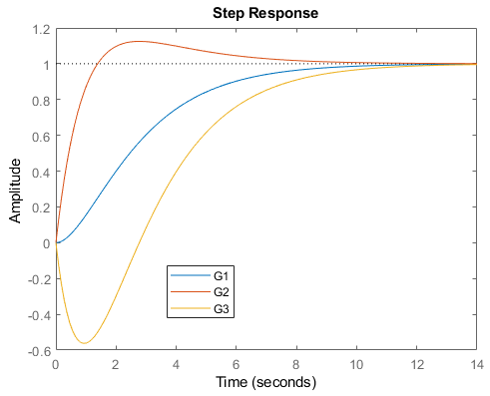
Example
Let us compare the response of three systems:
Which would be
difficult
to control?

Slide 13
Example
Inverse response (e.g. in G₃) is caused by two competing processes – the faster of which takes the process first in a direction opposite to the steady state.
Parallel structures can experience complex dynamics due to the presence of zeros and this may be difficult to control.

Slide 14
Recycle Structures
Recycle structures result from recovery of material and energy. They are essential for profitable operation.
They strongly affect dynamics. Recycle can be considered analogous to a positive feedback mechanism and thus can make stable processes unstable.
Systems with recycle have longer response time (larger time constants).

Slide 15
Example
Determine the effect of recycle on the dynamics of the given chemical reactor (faster or slower)? and the overall steady state gain.
H₁(s)
+
G(s)
Y₀(s)
Y(s)
+
H₂(s)

Slide 16
Mason’s gain formula
Gives the transfer function between two variables in a much easier way than block diagram reduction.
System determinant | Δ = 1 – Σ L_{i} + Σ L_{i}L_{j} - Σ L_{i}L_{j}L_{k} + …
Forward path gain | F_{i} = product of transfer functions along ith forward path from input to output
Forward path determinant | Δ_{i} = Δ after deleting all loops touching F_{i} (Δ_{i} = 1 if F_{i} touches all loops).
Loop path | A path that starts from one variable and back to the same variable.
Non-touching loops | Two loops that don’t share a common variable.

Slide 17
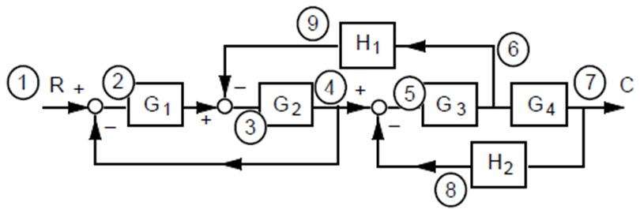
Example: Find transfer function C/R.
L₂ and L₃ are not touching (they do not have common variable).
F₁ touches all loops.

