Slide 1
(10)
PID Control

Slide 2
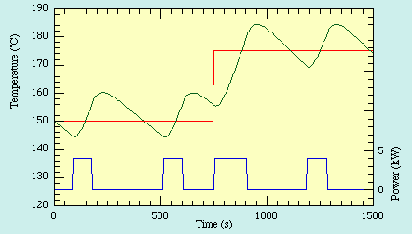
On-Off Control
First, recall that on-off control is the simplest form of control.
However, it is not accurate. The actual output will keep oscillating around the desired Set point.
PID control provides smoother operation than on-off control.
Set point
Error
Output

Slide 3
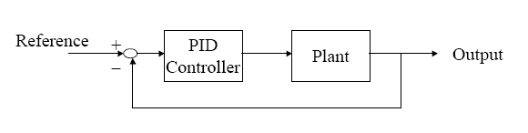
PID Controller
PID stands for Proportional-Integral-Derivative.
More than half of the industrial controllers are PID.
e
u
u(t) … control signal
e(t) … error signal
K_{c} … controller gain
T_{i} … integral time
T_{d} … derivative time

Slide 4
Electronic PID Controller

Slide 5
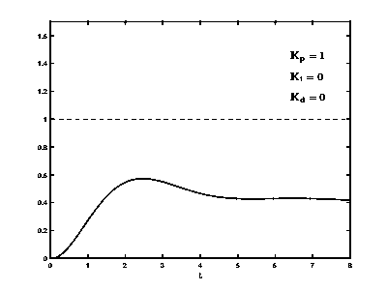
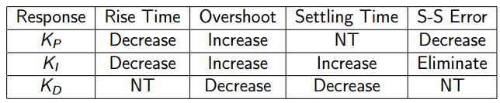
https://commons.wikimedia.org/wiki/File:PID_Compensation_Animated.gif
Characteristics of P, I, and D action
Each mode has specific advantages and limitations.

Slide 6
Proportional action
The controller output is proportional to the instantaneous error e(t).
The proportional mode responds immediately to instantaneous errors.

Slide 7
Integral action
Integral action eliminates steady-state error (integration accumulates past errors and hence can provide non zero value when the present error is zero).
At steady-state, the whole PID controller output is due to integral mode alone. Hence, it is called the persistent mode.
Integral action leads to oscillatory behavior with excessive overshoot and settling time. So, we should lower the proportional gain when we add integral control.
Integral mode is slow. So, it is combined with P mode.
Integral time (T_{i} ) is the time the integral action needs to repeat the proportional action. This is easy to see with PI control if we take the error to be a constant in the integral.

Slide 8
Derivative action
Derivative control action is based on how fast the error is changing with time (rate of error change).
If the sign of error change is opposite to proportional or integral terms, PID action will be lower than PI. This acts like a brake improving transient response (reducing overshoot and settling time).
Derivative action predicts future error and responds in advance. Thus, it is called the predictive mode.
Derivative action is not useful for systems with noisy signals. So, in practice, derivative action is filtered.

Slide 9
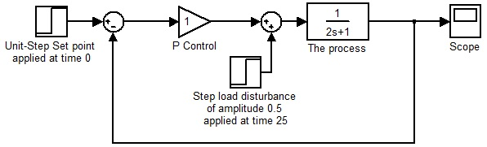
Simulation example
In this example we simulate the response of a feedback loop with P and PI controllers for a first order process.
We study the response for step changes in both set point and load disturbance.

Slide 10
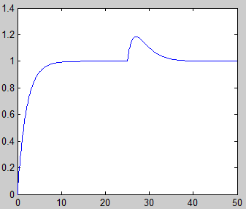
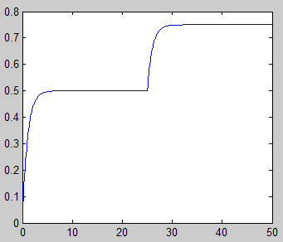
P control alone can not remove the offset neither for set point nor load disturbance changes!
PI control removes offset for both set point and load disturbance changes!

