Slide 1
Introduction
CSE 425 Process Control
Lecture 1

Slide 2
About the course
Grading Scheme
45 | Semester work
80 | Final
125 | Total
Reference textbook
H. Wade, Basic and Advanced Regulatory Control: System Design and Application, 2nd edition, 2004.
T. Blevins and M. Nixon, Control Loop Foundation—Batch and Continuous Processes, 2011.
D. Seborg, T. Edgar, D. Mellichamp, and F. Doyle, Process dynamics and control, Wiley, 3rd edition, 2011.
Course webpage:
http://www.amelanany.faculty.zu.edu.eg/

Slide 3
Topics to be covered:
Introduction Blevins, 2.4
The feedback loop
Common dynamic systems
System structures
PID control
PID modifications
PID Tuning
Cascade control
Feedforward control, Ratio control
Multi-loop interaction

Slide 4
Process
Operation (chemical or physical) used to convert feed materials into products.
Examples: mixing - separation - heating - cooling - filtering – compression - etc.
The term process is used for both the processing operation and the processing equipment.
Nearly every product we use today is the output of some process industry (Food – Medicine – Paper – Rubber – Oil - Cosmetics – Fertilizers)
The design of such processes are part of process engineering (under chemical engineering)

Slide 5
Process Industries
Oil and gas
Petrochemicals
Power
Pulp and paper
Food and beverages
Pharmaceuticals
Water/wastewater
Steel
Glass
Textiles
Metals, mining & minerals

Slide 6
Process Control
Methods used to control Process Variables (PV) when manufacturing a product.
PV examples: Temperature – Pressure - Concentration of chemicals - Liquid levels
Process control maintains a PV at the desired operating conditions despite any disturbance. This is achieved by comparing measurements with their desired values and then adjust Manipulated Variables (MV), mainly flow rates, accordingly.
Process control is the largest application area for control systems engineering.

Slide 7
Why Process Control?
1. Safety
2. Environmental Protection
3. Equipment protection
4. Product quality
5. Profit

Slide 8
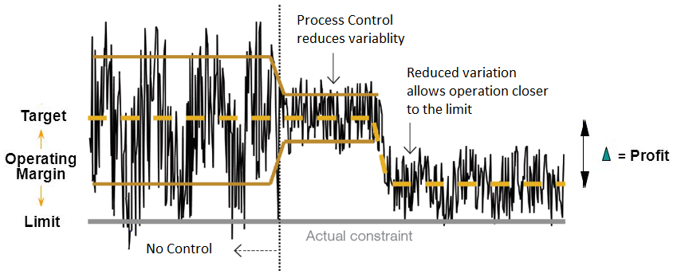
Benefits of Process Control
Reducing variability increases PROFIT

Slide 9
Automation Vendors

Slide 10
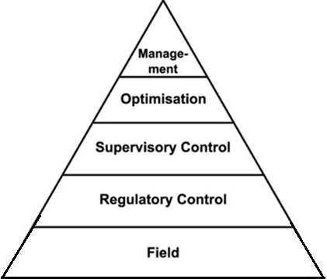
Process Control Hierarchy
We will focus on Regulatory control.
Scheduling & Planning
DCS
PID
Process & Instrumentation
Field: i.e. close to the process

Slide 11
Types of Control
Regulatory (continuous) control
Logic control (PLC)
Interlock control (safety-oriented logic control)
stop a pump if the liquid level it pumps is below certain level.
open a relief valve if the gas pressure in the tank is above a certain level
Sequence control
washing machine program
bottle filling machine

Slide 12
Common Industrial Controllers
Single station/loop stand-alone controller
Distributed Control Systems (DCS)
Programmable Logic Controllers (PLC)

Slide 13
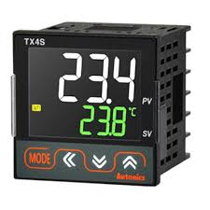
Stand-alone Controller
Single PID controller
More than one PID can be implemented on the same device: e.g. 2 or 4
Why manual mode? If the tuning is not correct, the operator may control the process manually
Auto/Manual

Slide 14
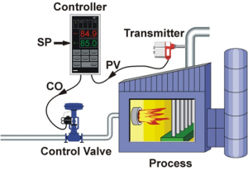
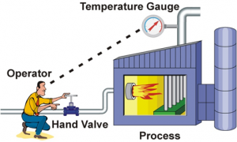
Manual vs. Automatic Control
https://blog.opticontrols.com/archives/344

Slide 15
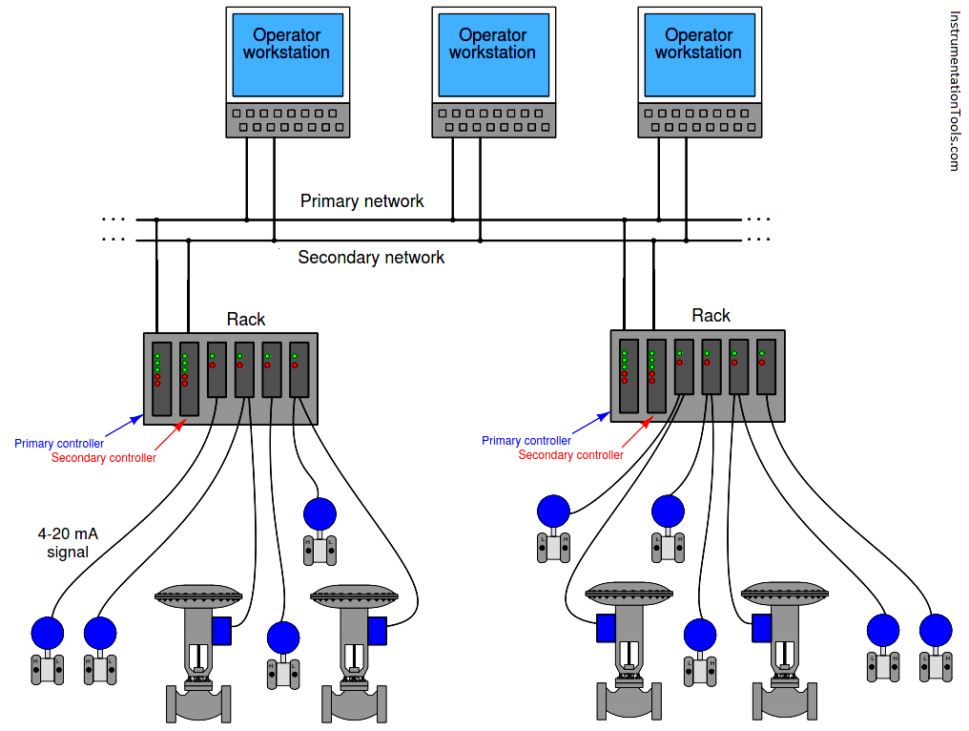
DCS
In DCS, the control functionality are distributed among several Control Processors through out the entire site
(Blevins and Nixon, pp. 22-30)

Slide 16
DCS
Each CP can handle 1000s loops.
The amount of cabling needed if all devices had to connect to a central CP is avoided.
Each rack has two CPs for redundancy
DCS also contains:
Operator workstation
Engineering workstation (for maintenance)
Server (called historian) to store data
CPs and stations are connected using network Ethernet switches.
DCS is integrated with Emergency Shut Down (ESD) System for Safety purposes

Slide 17
DCS
Each rack has I/O modules to interface to field devices.
DI & DO points: for logic, interlock or sequence control
AI & AO points: for regulatory control
IO count determine the size of the project (Small project may contain only 400 IO points)
The most important feature of a DCS is the Scan time or processing cycle (200-500ms) which is suitable for most loops
DCS is programmed using function blocks as in SIMULINK
Blocks for PID controller, input and output modules

Slide 18
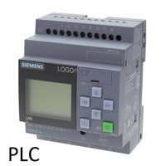
PLC
PLC focuses mainly on digital and logic operations
DCS focuses more on analog inputs and is suitable for processes with advanced control loops
There is some overlap between PLC and DCS. Vendors try to take a share of the market of the other. For example, you can find analog PID in a PLC.
ESD safety systems is implemented using a PLC because of its short Scan cycle, only 20 ms
DCS needs a network while PLC does not

Slide 19
Human-Machine Interface (HMI)
A HMI is a user interface or screen that presents process data to a human operator, in the control room, and through which the operator controls the process
Communication
Cables potentially hundreds of meters long
Final element
v1
T
Central control room
Displays of variables, calculations, and commands to valves.
Sensors
A
C_{B}
v2
Final element

Slide 20
HMI
HMI mimics plant units (reactor, pipes, …) in front of the operator
The control engineer design displays for each specific plant:
process display
trend display of variables; used in tuning
alarm display: to inform the operator if a certain variable hits a given threshold (three levels of alarm: High – High High – High High High)
Colors are used to inform the operator the state of valves and other devices
If we click on a certain block, an overlay of faceplate pops up (looks like stand-alone controller)

Slide 21
Communications using Modbus
Modbus is a standard communication protocol used to connect industrial electronic devices.
PLCs, transmitters, etc.
Modbus uses the RS485 or Ethernet as its wiring type.
Modbus supports communication to and from multiple devices connected to the same cable or Ethernet network.

Slide 22
Control system documentation
Piping and instrumentation (P&I) drawings provide documentation for plant design.
Standard symbols are used.
FC
F = flow
L = level
P = pressure
T = temperature
- - - - control signal
TC
LC
A

Slide 23
YouTube Resources
Process Control Course by Dr. Ahmed Ismail, Cairo University, 4th year - 2nd term, EECE 2019
https://www.youtube.com/watch?v=vaI_FOfrXgM
ABB Process Automation
https://www.youtube.com/playlist?list=PLOgEb39vsYlu2WFdWSe5kvOtmJyC-ew2e

