Slide 1
(3)
Linear Regression and Least Squares Method

Slide 2
Linear Regression
A linear regression is a way to express a dependent variable, called the regressed variable, y(k), in terms of an independent vector variable ϕ(k), called the regressors, using a linear relationship
Where y(k) ∈ R, ϕ(k) = [ϕ₁(k), ϕ₂(k) . . . , ϕ_{n}(k)]^{T} ∈ R^{n}, k = 1,..., N are known. The parameter vector θ ∈ R^{n} is unknown and is to be found from some given data.

Slide 3
Examples

Slide 4
The least squares method
Given a model structure, an input data sequence {u(1), u(2), …, u(N)} and the corresponding output sequence {y(1), y(2), …, y(N)}, we wish to calculate the parameter vector θ in the linear regression model.
To illustrate the procedure, let us use I/O data to find the best model of the following form:
This is a first-order difference equation with two unknown parameters a and b. Note that a feed-forward term was not included in equation because it is virtually never seen in a physical system (unlike a controller).

Slide 5
With the I/O data, we can write the following set of equations
These are N equations in 2 unknowns a and b. As the number of equations > number of unknowns, there is no value for a and b to satisfy exactly all equations (over-determined system of equations).

Slide 6
It is hardly the case that the regression model is able to exactly match the given input-output data.
This may be because the true system is more complex and the linear regression model is just a rough approximation, the system may have other input variables which are not taken into account by the model, or the data has additive noise.
Due to these reasons, in practice it is a good idea to use N > n. In this case, the system can no longer be solved exactly, but only in an approximate sense.

Slide 7
Let us assume additional term ε(k) in each equation accounting for noise and modeling error at time instant k.
The error ε(k) is usually called the residual. The residual is the difference between the measured output and the output predicted by the model:
In other words, the residual refers to the part of the measured output which can not be explained by the model.

Slide 8
The previous set of equations can be written in matrix form,
We want to find θ (a and b) that best approximate all equations fairly well (minimize errors ε(1), ε(2),…, ε(N)). One possibility is to make the sum of all errors,
Minimum. V(θ) is called cost or objective function. However, sum of errors is not good choice. Why?

Slide 9
To penalize both positive and negative equation errors ε(k), we can instead use the sum of squares of equation errors (SSE) as a cost function:
and look for θ that makes SSE minimum, that is:
This is the well-known least-squares problem. The sum of squares is the most commonly used cost function. It is differentiable and has a global minimum (for linear-in-the-parameters models).

Slide 10
Denoting the measured and the predicted output vectors, respectively, as
a model can be found by using the measured output as a target of the output predicted by the model.
In vector form

Slide 11
The SSE cost function can be expressed as
By this way, we expressed SSE in terms of parameter vector θ. Our goal is to find θ that makes SSE minimum. This is an optimization problem.

Slide 12
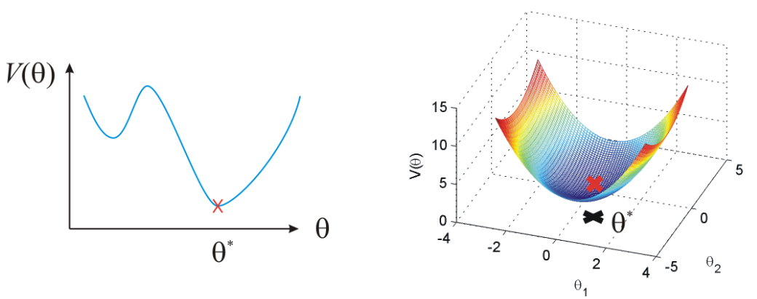
From calculus, the SSE is minimal when its first derivative with respect to θ is zero
Note that ε^{T}ε is scalar while θ is a vector (of size 2x1 in our example). The derivative of a scalar function with respect to a vector is called the gradient.
In order to proceed, we need to review some rules of the gradient.

Slide 13
The gradient: rule 1
Consider a scalar linear function f of two parameters a, b:
The gradient of f with respect to θ (a, b) is the vector:

Slide 14
The gradient: rule 2
Now, consider a quadratic function:
The gradient of f with respect to θ is:
So, we have the following rule:

Slide 15
With these rules, we return back to least squares problem:
Setting the gradient to zero gives the so-called normal equations
This finally gives the least squares estimate:

Slide 16
It remains to ensure that this value of θ corresponds to a minimum and not a maximum.
For this we need to evaluate the Hessian, the second derivative of the cost function SSE with respect to θ,
The Hessian Ф^{T}Ф is positive definite (refer to the appendix for a proof) and hence the least squares estimate corresponds to a minimum of the cost function SSE.

Slide 17
Example
Consider the following model
where u(k) is the input at instant k, y(k) is the output, and ε(k) is an equation error. Given the following input output data:
deduce the regression matrix Φ
calculate the least squares estimate of a and b.
calculate the model output
calculate the residuals
t | 1 | 2 | 3 | 4 | 5
u(t) | 1 | 2 | 4 | 5 | 7
y(t) | 1 | 3 | 5 | 7 | 8

Slide 18
Answer
We can write:

Slide 19
Hence, the least squares estimate is given as:

Slide 20
Using the estimate of a and b, the model output is given by
Hence the residuals are

Slide 21
Example: Estimating a scalar
Consider a simple model given by
Given N data y(1), y(2),…,y(N) we can write in matrix form:
The least squares estimate is given by
The estimate is the intuitive average of all measurements, ﬁltering out the noise.

Slide 22
Note on model order selection
The choice of the model order (i.e. the number of parameters) is up to the designer.
The designer may perform multiple ﬁts with diﬀerent orders and select the lowest order ﬁt that yields acceptable agreement.
Selecting a model of too-high order means that you use the “extra” parameters to ﬁt noise in the data.

Slide 23
Least squares estimate using MATLAB
In MATLAB, finding the least squares estimate can be done by several ways. The most naive one is (denoting the matrix Ф as Ph and the vector θ as theta):
theta = inv(Ph'*Ph) * (Ph'*Y)
But since this requires the inversion of a square matrix, a better approach is
theta = pinv(Ph)*Y
MATLAB implements this technique using the shorthand notation
theta = Ph \ Y

Slide 24
Notes on the least squares estimate
The minimum value of SSE cost function can be found as
The least squares estimate can be calculated if Ф^{T}Ф is invertible. This requires that the data matrix Ф has a number of independent columns equals the number of unknown coefficients. This boils down to a good choice of the model (order n, regressors ϕ) and having informative data. This condition is known as persistent excitation.

Slide 25
The least-squares estimate can be given geometric interpretation. Recall that the least-squares estimate was found by equating the gradient to zero:
Let the column vectors of Ф be {Ф₁, Ф₂ , …, Ф_{n}}. These vectors form a subspace R^{n} in the space R^{N}.
The condition Ф^{T} ε = 0 means that the error vector is perpendicular to each column of Ф.

Slide 26
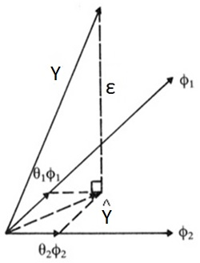
We seek θ that achieves a linear combination of {Ф₁, Ф₂ , …, Ф_{n}} such that Yˆ approximates Y as closely as possible. The best approximation Yˆ in the least-squares sense is given by the orthogonal projection of Y onto the subspace spanned by {Ф₁, Ф₂ ,…, Ф_{n}}.
Geometrical illustration of the least squares solution for the case N = 3, n = 2 (N is the number of data points and n is the number of parameters).

Slide 27
An alternative expression for the calculation of the least squares estimate can be found by noting that
The advantage is that the matrix Φ of large size N × n no longer has to be formed, only smaller matrices n × n and vectors of size n x 1 are directly processed.
Remaining issue: the sum of N terms can grow very large, leading to numerical problems: (matrix of very large numbers)−1· vector of very large numbers.
Solution: Normalize element values by diving them by N. In equations, N simplifies so it has no effect on the analytical development, but in practice it keeps the numbers reasonable.

Slide 28
Appendix: Positive deﬁnite matrices
Consider the following scalar quadratic function f
Where M is matrix of size n × n and x is vector of size n × 1.
If for all x (except when x is the zero vector), f is positive, then M is called a positive definite matrix.
For example, let x be a two valued vector x = [x₁, x₂]^{T}.
For a positive deﬁnite M, f(x) looks like a bowl resting on the origin. For a negative deﬁnite M, f(x) looks like a bowl resting upside down. For M indefinite ( f(x) is positive in some regions and negative on others) , f(x) takes the form of a saddle. In all cases f(x) is zero when x = [0, 0]^{T}.

Slide 29
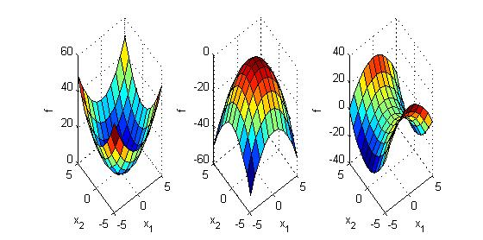
(a) (b) (c)
Figure: plot of quadratic function f(x) = x^{T}Mx for three cases: (a) M positive definite (origin is the minimum point), (b) M is negative definite (origin is the maximum point), and (c) M is indefinite (origin is a saddle point).

Slide 30
Theorem
If a matrix M = Φ^{T}Φ, then it is positive deﬁnite.
Proof: The quadratic form of M is
The function f(x) is always positive (except when x = 0). Hence a matrix of the form Φ^{T}Φ is positive deﬁnite.

