Slide 1
(5)
DMM & Oscilloscope

Slide 2
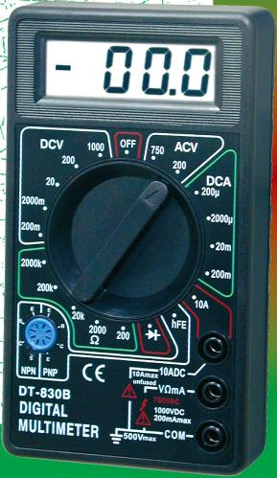
Digital Multi-meter (DMM)
DMM can be used to measure:
DC voltage
AC voltage
current
resistance
BJT (β test)
diode test
short circuit test, etc.

Slide 3
Digital Multi-meter (DMM)
Basically, DMM can only measure DC voltage. Current, resistance, or AC voltage are converted into DC voltage.
A main component of DMM is the Analog-to-Digital converter (ADC) which converts the measured analog DC voltage into a digital quantity to be displayed on the LCD.

Slide 4
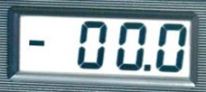
Digital Multi-meter (DMM)
The range determines the maximum voltage to be measured. In the same time, it changes the position of the decimal point on LCD. This determines how refined or precise is the reading. This is called the resolution.
DMMs have high input impedance (~10MΩ), which will not load down sensitive circuits.
Next are some notes about measurements using DMM.

Slide 5
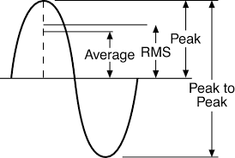
AC Voltage Measurement
Let us first remember what is meant by average and RMS values of an AC signal.
For pure sine wave:

Slide 6
AC Voltage Measurement
The RMS value of an AC signal is the equivalent DC voltage that dissipates the same heat (energy) as the AC signal.
In AC volt measurement, most DMMs, in reality, measure the average but displays the RMS value using the correction:
Therefore, measuring complex waveforms (other than pure sine) gives wrong RMS value. A True RMS meter is needed in this case!

Slide 7
Current measurements
To measure current:
Turn the power to the circuit off
Open the circuit
Connect the meter in series with the circuit
Re-establish power.
Care must be taken because the meter is now a part of the circuit.

Slide 8
Current measurements
Although most DMMs have a maximum current capability of 10A, in practice, only small currents are measured with a DMM, such as 4-20 mA found in most process control systems.
One common mistake is to measure voltage with the test leads in the current input jacks (their input impedance is 0.1~8Ω, i.e. a short circuit). Most DMM current input jacks are fused for protection. You will blow the fuse if you test in this manner.

Slide 9
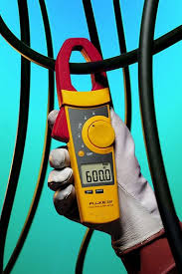
Clamp-on meters
A safe method for measuring currents (of at least 1A) is the clamp meter which avoids the requirement of breaking the circuit being measured. The meter clamps onto a current-carrying conductor, and the output reading is obtained by transformer action.

Slide 10
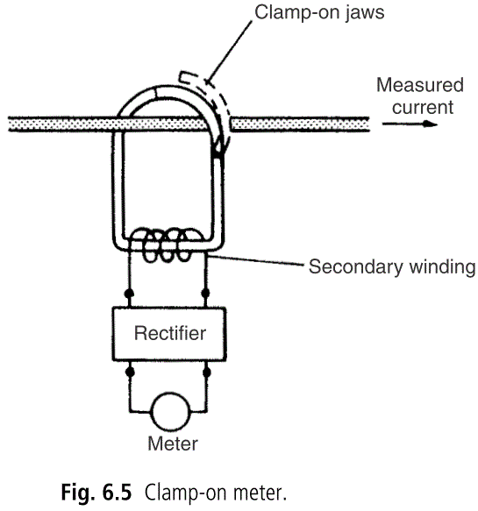
Clamp-on meters
The clamp-on jaws of the instrument act as a transformer core and the current-carrying conductor acts as a primary winding. Current induced in the secondary winding is rectiﬁed and applied to a meter.

Slide 11
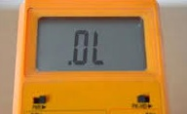
Resistance measurements
To measure resistance:
Turn power to circuit OFF to obtain accurate resistance readings and to protect the meter.
Disconnect one lead of the resistor from the circuit to eliminate the effect of components in parallel with the resistor being measured.
Place the meter in the (Ω) function. The meter will display “OL” indicating an infinite reading.
Place the test leads on each side of the resistor and choose a suitable range with the dial.

Slide 12
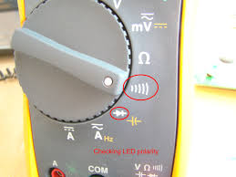
Continuity measurement
Continuity is a great test circuit connections, switches and fuses.
The meter gives an audible alarm signal if the two points in the circuit are connected.
Most meters will indicate continuity from 0 to 50Ω.

Slide 13
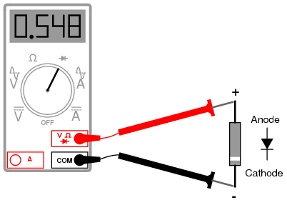
Diode test
To test a diode with a DMM, the diode function applies an appropriate voltage and then measures the voltage drop across the diode.
In the forward direction, the voltage drop should be around 0.5±0.2V while in the reverse direction, you should see an “OL” on the display.

Slide 14
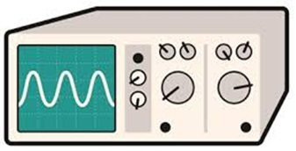
The Oscilloscope
The scope is used to displays a time varying voltage waveform. The vertical (Y) axis represents voltage and the horizontal (X) axis represents time.
From the graph many information about the signal can be obtained such as: shape, amplitude, period, frequency, phase, DC and AC components, noise, etc.

Slide 15
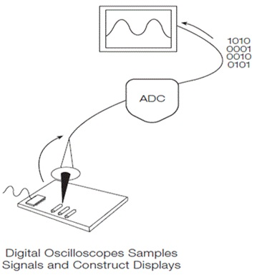
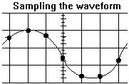
Digital storage oscilloscope (DSO)
DSO acquires the waveform as a series of samples, converts them into digital words, and stores them in memory. The stored values can be displayed on the screen, using interpolation to smooth the waveform shape between data points.

Slide 16
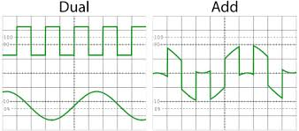
DSO capabilities
Capture and view transient events that may happen only once.
Offer many math operations done on displayed waveforms such as addition, multiplication, integration, Fast Fourier Transform.
Measurement cursors to take accurate readings.
Interface to the computer.

Slide 17
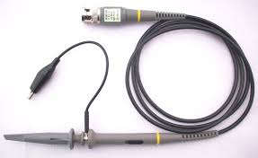
Oscilloscope front panel
The front panel includes a display screen, knobs, and buttons used to control signal acquisition and display.
The front panel also includes input connectors for the probes.
Oscilloscopes have high input impedance, typically 1MΩ. Therefore, they have negligible loading effect in most measurement situations.

Slide 18
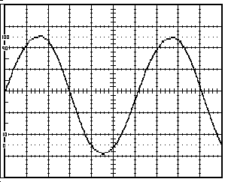
Oscilloscope front panel
The grid markings on oscilloscope screen consists of 8-by-10 major divisions.
There are also tick marks called minor divisions.

Slide 19
Oscilloscope front panel
To measure a waveform you need to adjust (volt/division) and the “sweep rate” (time/division).
To get accurate measurements, make the waveform occupies most of the display vertically and at least two cycles horizontally.

Slide 20
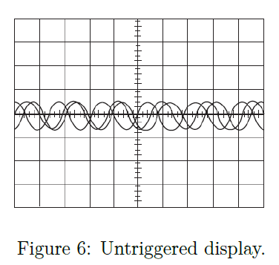
Trigger System
Imagine the jumble on the screen that would result if each sweep started at a different place on the signal.
Trigger stabilizes the waveform by controlling where, on a waveform’s voltage and slope, the display trace or sweep begins each time.
By this way, periodic signals such as sine waves appear static on the oscilloscope display.

Slide 21
Trigger Level and Slope
Oscilloscope pauses each time the sweep reaches the extreme right side of the screen. The scope then waits until the input waveform reaching a user-specified threshold voltage before drawing the next trace.
The trigger point is determined by the level (voltage) and slope (+ve or –ve edge).

Slide 22
Trigger Modes: Auto vs. Normal
In Auto mode the oscilloscope sweeps, even without a trigger. This ensures that the display will not be frozen if the signal does not cause a trigger.
In normal mode the oscilloscope only sweeps if the input signal reaches the trigger point; otherwise the display will be frozen on the last acquired waveform.
In practice, you will probably start with auto mode because it requires less adjustment and then use normal mode because it lets you see just the signal of interest.

Slide 23
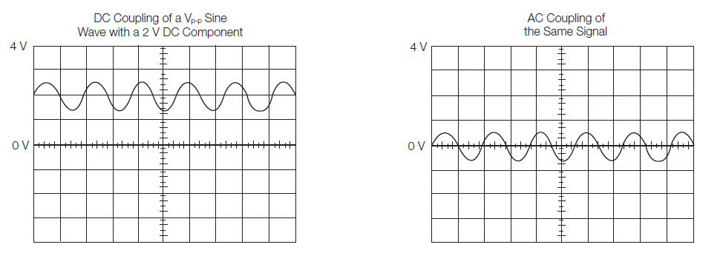
Input Coupling (DC – AC – GND)
DC coupling shows the whole signal (AC+DC components) .
AC coupling blocks the DC component of a signal (you see the waveform centered around 0 V). This is useful when the entire signal (AC+DC) is too large for the volts/div setting.
Ground coupling (GND) disconnects the input signal from the vertical system, which lets you see a horizontal line on the screen that represents 0 V.

Slide 24
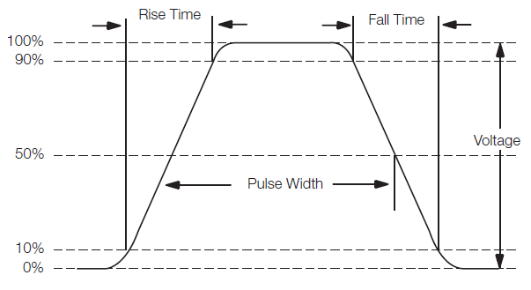
Pulse Measurements
In many applications, the shape of pulses is important. Pulses can become distorted and cause a digital circuit to malfunction. Standard pulse measurements are pulse width and pulse rise time.

Slide 25
Pulse Measurements
Rise time is the time a pulse takes to go from low to high voltage. By convention, the rise time is measured from 10% to 90% of the full voltage of the pulse. This eliminates any irregularities at the pulse’s transition corners.
Pulse width is the time the pulse takes to go from low to high and back to low again. By convention, the pulse width is measured at 50% of full voltage.

Slide 26
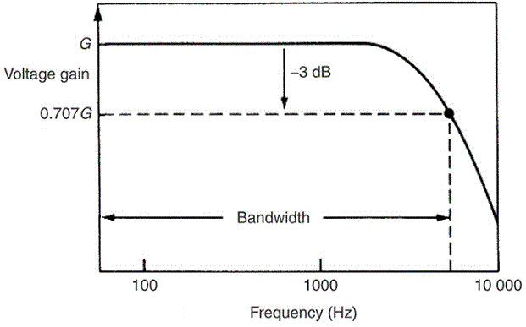
Oscilloscope Bandwidth
Most important speciﬁcations of an oscilloscope are the bandwidth and rise time.
Bandwidth is the maximum frequency over which the oscilloscope ampliﬁer gain is within -3dB of its peak value (~ 70.7% of maximum value).
When applied to signal-amplitude measurement, the oscilloscope is only usable at frequencies up to about 0.3 times its speciﬁed bandwidth.

Slide 27
The rise time
Oscilloscopes are normally designed such that:
Bandwidth x Rise time = 0.35
Thus, for a bandwidth of 100 MHz,
Rise time = 0.35/10⁸ = 3.5 ns.
Therefore, this oscilloscope is able to display pulses with rise time no less than 3.5 ns. Faster pulses can not be well displayed with this oscilloscope.

