Slide 1
Basic Concepts
CSE 425 Industrial Process Control
Lecture 2

Slide 2
Basic Concepts
Mathematical Modeling
Feedback loop
Setpoint change vs. load upset
Linearization

Slide 3
Need for dynamic models
Dynamic models give insight on the process to be controlled.
This enables us to determine what performance issues we can improve and what we can not.
In addition, most controller design methods needs a model of the process.

Slide 4
Mathematical Models
Input change, e.g., step in coolant flow rate
Effect on output variable
Process
T
A
Math models
help us answer
these questions!
How does the
process
influence the
response?
How far?
How fast
“Shape”

Slide 5
Basis for Modeling
Physical laws such as Newton’s method, Ohm’s law, and material balances.
Overall Material
Component Material
Energy

Slide 6
Modeling procedure
Identify relevant variables.
Apply suitable conservation balances and formulate the model.
Examples of variable selection
liquid level → total liquid mass
temperature → energy balance
concentration → component mass balance

Slide 7
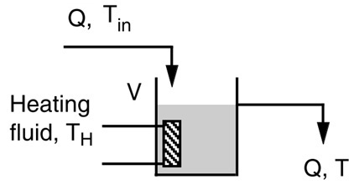
Example
Stirred-tank heater is a common process example.
We are interested in the control of temperature of the liquid inside the tank.
Let us deduce the basic model equation.

Slide 8
The heat balance, in standard heat transfer notation, is
heat accumulated in tank in interval dt
heat transferred into tank from inlet liquid in a time interval dt
heat transferred into tank from heater in a time interval dt
Where Cp is the specific heat, U is the overall heat transfer coefficient, ρ is density, V is volume, and Q is flow rate.
Dividing by dt and grouping variables together:

Slide 9
We do some manipulations:
Taking Laplace transform gives:
The process is described by two first-order transfer functions.

Slide 10
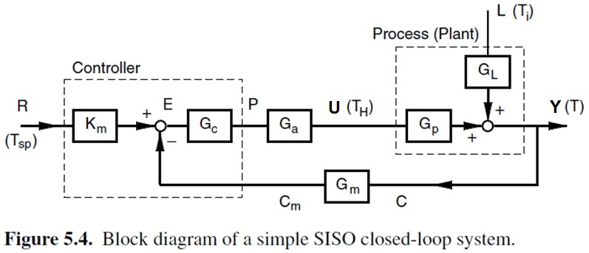
The feedback loop
The following is a possible feedback loop for the stirred tank heater.

Slide 11
Components of a Control Loop
Four Main blocks:
Process: the heart of the loop; we have to understand the dynamics of the process well without a controller.
Controller: this is the brain of the loop
Sensor or transmitter
Actuator or final control element
Four variables:
Process Variable (PV): controlled variable
Desired or Reference value: Setpoint (SP)
Manipulated Variable
Disturbance or load

Slide 12
Transmitters & Final Control Elements
Transmitter
Contains the sensor
Convert sensor output voltage into current
Called two-wire transmitter
Standard transmitter o/p range: 4-20 mA
Current is used (instead of voltage) to avoid voltage drop over the wire
There are binary sensors (output 0/1 or present/not present)
Final control element
e.g. valve, heater, or a variable-speed Pump
Standard control signal for a pressure 3-15 psig
Occasionally, we need current -> psi (I/P converter)

Slide 13
Closed-Loop Transfer Functions
The closed loop transfer functions relating the output Y to the set pint R and the disturbance L are given by:
The dynamics and stability of the closed-loop system are governed by the characteristic polynomial, 1+G_{m}G_{c}G_{a}G_{p}, which is the same whether we are looking at set-point or disturbance changes.
Effect of setpoint changes (Servo problem)
Effect of disturbance changes (Regulator problem)

Slide 14
Servo vs. Regulatory Control
When we change a speciﬁc operating condition, i.e. the set point, we would like, for example, the outlet temperature to follow our command.
This is what we call servocontrol.
The outlet temperature of the tank is subject to external disturbances (called load changes).
Suppressing or rejecting the effects of disturbances is called regulatory control.

Slide 15
Control system: design issues
Determine the role of various variables:
What we need to control,
What we need to manipulate,
What the sources of disturbances are.
State design objective and speciﬁcations:
Servo or regulation,
Desired response
Design the control system:
Select proper sensors, transmitters, and actuators.
Select proper controller or control strategy.
Tune the controller.

Slide 16
Process Examples
Lime mud filter
Paper machine basis weight
Boiler combustion pressure
Steam drum water level for a boiler
Distillate composition in a distillation column
Ammonia plant hydrogen-to-nitrogen
What are the PV, MV, load disturbance for these processes?

Slide 17
Linearization
The previous model of stirred-tank heater is linear. This enables us to write a transfer function of the system.
However, for nonlinear systems, we can not write a transfer function.
Fortunately, if we keep the changes around the operating point small, the nonlinear model can be approximated by a linear model. This is called linearization.

Slide 18
Linearization
We are looking for a straight line approximation to the nonlinear function about some point x= x_{s}
The accuracy of the approximation depends on
non-linearity
distance of x from x_{s}
y =1.5 x² + 3 about x_{s} = 1
Because control system maintains variables near desired values, linearization is often (but, not always) valid.

Slide 19
Linearization
To obtain the required approximation, expand in Taylor Series and retain only constant and linear terms.
This is the only variable
Remember that these terms are constant because they are evaluated at x_{s}
We define the deviation variable: x* = (x - x_{s})

Slide 20
Example
Given the following nonlinear model
Using linearization, draw the approximate unit step response of the system at u = 25.
Show the initial and final values of the exact and approximate responses on the graph.
Comment on the results.

Slide 21
Answer
Let us define the operating point:
u_{s}: the steady state input (u_{s}= 25)
y_{s}: the steady state output corresponding to u_{s}
Also define the deviation variables around the operating point.
y* = y – y_{s} and u* = u – u_{s}
To find y_{s}, substitute in the model by u = u_{s} = 25 and set the derivatives to zero
Using Taylor expansion, the nonlinear term can be approximated around u = u_{s} as:

Slide 22
Answer
Substituting in the model yields
Noting that:
We can write:
This a first order ordinary differential equation and hence, we can find the transfer function as

Slide 23
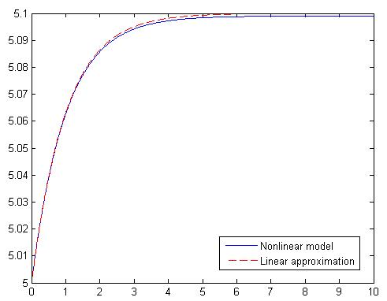
Comparison
Let us compare the output of the linearized model to the original nonlinear model, assuming that the input u changes from 25 to 26 (unit step input).
Output, y
Time, seconds

Slide 24
% This program shows how well the linear approximation compared to the nonlinear model
% ydot + y = sqrt(u)
% The linear model (around operating point us=25, ys=5) has the following transfer function:
% 0.1
% Y*/U*= ----------
% s + 1
% where y* and u* are deviations around the operating point:
us = 25; ys = 5;
% Time range of simulation
dt=0.01; t=0:dt:10;
% Simulating the nonlinear model for a step change du in the input around us = 25
du = 1; % Try other values (e.g 2.0, 5.0, 10.0) to see how well the approximation is
y(1)=ys;
for i=1:length(t)-1
ydot= -y(i)+sqrt(us+du);
y(i+1) = y(i)+ydot*dt;
end
plot(t,y), hold on
% Simulating the linear approximation
y_sim=du*step(0.1,[1 1],t)
plot(t,y_sim+ys,'--r')

Slide 25
Linearization: general formula
Consider a first-order ordinary differential equation:
with y(0) = y_{s}.
Then the corresponding linearized model is:

