Slide 1
(8) Model Validation

Slide 2
Introduction
Model validation is a crucial step to evaluate the quality of estimated models.
If validation is unsuccessful, previous steps in the system identification workﬂow must be redone – e.g., the model structure can be changed.

Slide 3
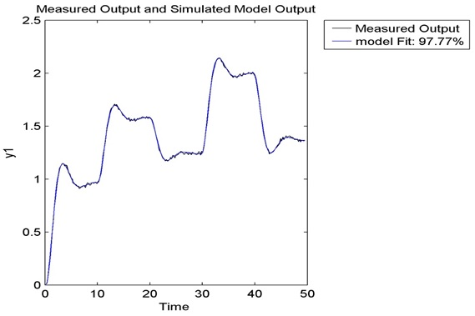
Motivation
So far, we validated and selected models by examining plots of predicted vs. measured outputs.
In this section we will learn about additional statistically-based validation tests, namely the correlation tests of the residual error.

Slide 4
Test (1): Whiteness of the residual error
Residual error is the difference between the measured output and the output predicted by the model:
Residual error represents the information in the measured output which can't be explained by the model.
For a good model, the residuals must be a set of random numbers caused by experimental errors. Any trend such as a gradual rise or a slight curve in the plot of the residuals invalidates the results. Ideally, residuals ε(k) should be zero-mean white noise.

Slide 5
Autocorrelation function of ε(k)
Given the residuals, an estimate of the their autocorrelation function,
can be obtained as:

Slide 6
Autocorrelation function of ε(k)
If the residual ε(k) is purely random (zero-mean white noise), we should have
Note that the variance of the residuals is given by r_{ε}(0).
Define the normalized auto-correlation function as:
The condition x(τ) = 0 for τ≠0 almost never holds exactly for data taken from an actual experiment. Instead, the auto-correlation function usually exhibits small values for τ ≠ 0.

Slide 7
Testing the Whiteness of ε(k)
It can be shown, for large number of data points N, that x(τ) is distributed according to the following Gaussian distribution
Therefore, if
then we can assume, with 99% confidence, that x(τ) or r_{ε}(τ)=0, and we can conclude that the residuals are white.

Slide 8
Tests (2): Independence of the residuals on past inputs
If the model is accurate, it should entirely explains the inﬂuence of inputs u(k) on future outputs y(k+τ).
Therefore, future residual errors ε(k+τ)
should only be inﬂuenced by the disturbances, and be independent of past inputs u(k).

Slide 9
Cross-correlation of ε(k+τ) & u(k)
If ε(k+τ) are uncorrelated with past input u(k), the cross-correlation
should be zero for τ ≥ 0.
Estimation from data and normalization:

Slide 10
Independence test
Like before, for large N, x(τ) is distributed according to the following Gaussian distribution
Therefore if:
then we can assume, with 99% confidence, that x(τ) or r_{εu}(τ) = 0, and we can conclude that the future residuals are independent of past inputs.

Slide 11
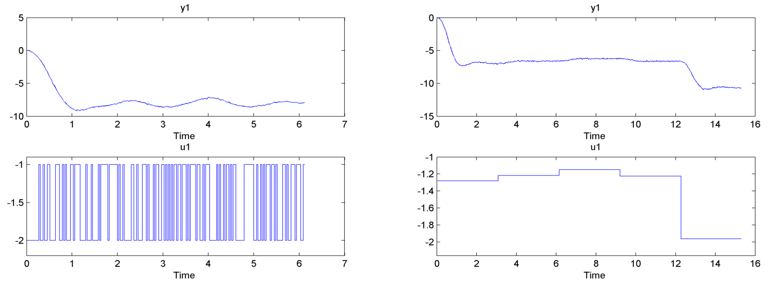
Example
Assume that the real system to be identified has an output-error (OE) form of order 3:
The identification and validation data are as shown:

Slide 12
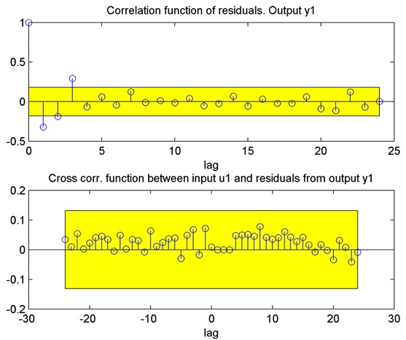
First, we try to identify an ARX model:
mARX = arx(id, [3, 3, 1]);
resid(mARX, val);
The model fails the whiteness test and, therefore, the model is rejected. This is because the system is not within the model class, leading to an inaccurate model.

Slide 13
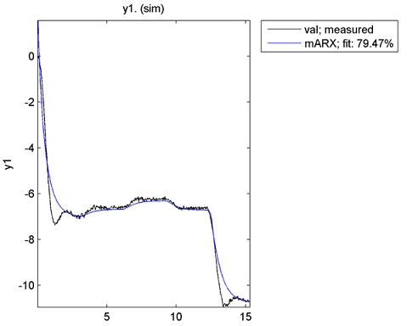
Simulating the ARX model on the validation data conﬁrms that the model is not so accurate.

Slide 14
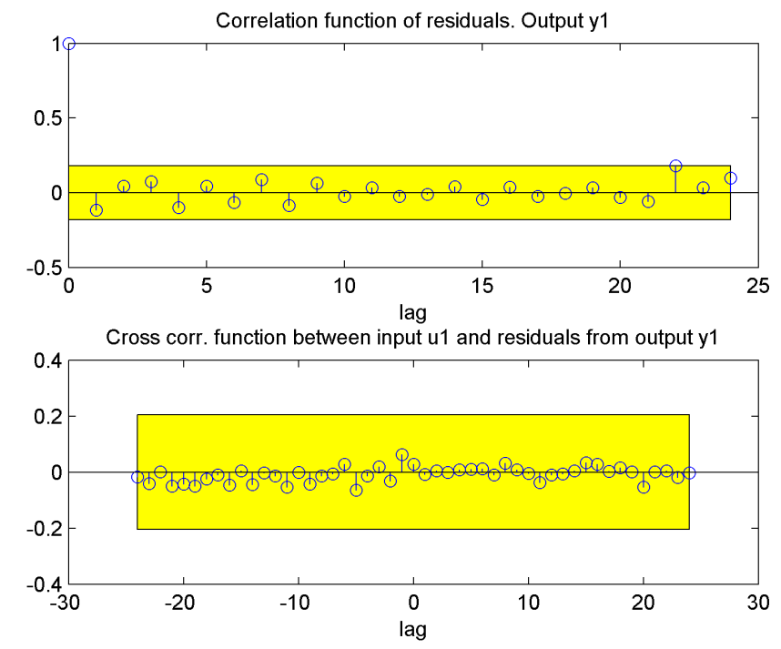
Now, let us try an OE model:
mOE = oe(id, [3, 3, 1]);
resid(mOE, val);
As can be seen, the OE model passes the two tests and therefore should be accepted. The reason is that the OE model class contains the real system.

Slide 15
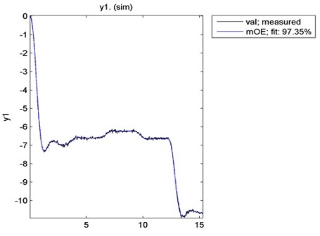
Simulating the OE model on the validation data conﬁrms the good quality of the model.

