Slide 1
Discrete Systems
CSE 421 Digital Control
Lecture 2

Slide 2
Introduction
In discrete-time systems, we deal with sequences of discrete numbers and not continuous-time functions. The discrete numbers:
may come from sampling a continuous variable, or
generated within a computer.
The tools used in analyzing continuous variables will no longer work. We need new tool: the z transform.
The z-transform bears exactly the same relationship to discrete variables that the Laplace transform bears to continuous variables.
The z-transform is the basis for transform-based digital control system design.

Slide 3
Objectives
In these slides, we study the following topics:
Difference equations
The z-transform
The discrete transfer function
Relationship between z-plane pole locations and transient response & stability
Correspondence between discrete signals and the continuous signals (i.e. mapping between s and z planes)

Slide 4
Difference Equations
Physical systems are modeled using continuous-time differential equations, while discrete systems are represented by difference equations.
In the block diagram below, an A/D converter samples a continuous variable e(t) to produce discrete variable e(kT). The computer processes e(kT) to produce discrete output u(kT).

Slide 5
To generate the k^{th} output sample u_{k}, the computer can make use of past inputs and outputs:
If the function f is linear, the relationship becomes a linear difference equation:
Now, if initial conditions and input are given, the output can be calculated simply by evaluating the difference equation recursively.

Slide 6
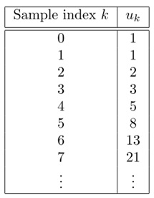
Example 1
The following difference equation has no input:
It computes the sequence known as Fibonacci numbers.
By recursive substitution, the values of u₂, u₃, u₄,… are found. As you would probably say that this system is unstable.
Although any difference equation with a given input can be “solved” in this manner, we need a better way to solve or predict the behavior of discrete systems.

Slide 7
Solving Difference Equations
To solve a linear differential equation, we assume a solution of the form u(t) = Ae^{st} where s is a complex variable.
Similarly, let us assume that the solution of difference equation takes the form u(k) = Az^{k} where z is complex variable and k is the sample or discrete-time index.
Substituting in the previous difference equation yields:
The two roots of the characteristic equation are:

Slide 8
The solution is therefore
where A₁ and A₂ can be found from initial conditions to be 0.276 and 0.724, respectively. Hence the solution is
The solution has two “modes”. The mode associated with root -0.618 will decay. However, that associated with root 1.618 will grow.
Since z is a complex variable, we can speak of the z-plane, a complex number plane.
Observation: if any root of the characteristic equation of discrete system has magnitude |z| > 1, i.e. lies outside the unit circle of the z-plane, the system is unstable.

Slide 9
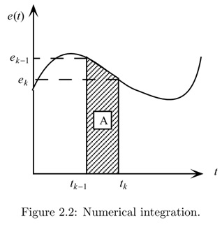
Example 2
Consider the numerical integration of a continuous time variable, as shown graphically.
We want to calculate the integral of the function e(t) from t = 0 to t_{k} using only samples e₀, e₁, …, e_{k−1}, e_{k}.
We assume that u_{k−1} (the integral from t = 0 to t_{k−1}) is known. Thus we just want a procedure to take the “next step.”

Slide 10
Trapezoidal Integration
The integral can be approximated in several ways. Here, we use trapezoidal integration, in which we approximate the integral by computing the area A of the trapezoid in the figure. Thus
Assume constant step size, so t_{k} − t_{k−1} = T, thus

Slide 11
The z-Transform
Given a discrete sequence e_{k} = {e₀, e₁, e₂, . . .}, the z-transform of this sequence is
The sample values e_{k} are the coefficients of the power series.

Slide 12
Discrete Transfer Function
For a discrete system, the transfer function H(z) represents the z-transform of the output U(z) over the z-transform of the input E(z) assuming zero initial conditions.
Hence, the z-transformed output is given by
Let’s apply the z-transform to the difference equation for trapezoidal integration.

Slide 13
Transfer function can be expressed using positive or negative powers of z. Each has its use.
Poles and zeros of discrete transfer function are defined in the same way as continuous transfer function. To ﬁnd poles and zeros, we use the version of H(z) with positive powers of z.
We can also convert a transfer function to difference equations by cross-multiplication and applying inverse z-transform.

Slide 14
The Unit Delay
Consider the following difference equation
It means that the present value of output equals the previous input sample.
Taking z-transform of both sides, we obtain the transfer function
Thus the transfer function z⁻¹ is a delay of one sample period (a unit delay). These may be placed in series to achieve delay of multiple samples.

Slide 15
The Unit Pulse Response
In continuous systems, the transfer function of a system is equal to the Laplace transform of system’s unit impulse response. A similar relationship holds for discrete systems. Consider a system with transfer function
Let the input e_{k} be a unit discrete pulse δ_{k}, i.e.
The z-transform of the unit pulse is given by
Hence U(z) = H(z), and the discrete transfer function H(z) is the z-transform of the system’s unit pulse response.

Slide 16
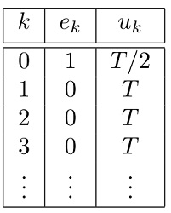
Example
Let’s see if this works on the trapezoidal integrator.
The unit pulse response is given in the table.
Now, we find the z-transform of the unit pulse response:
which is the same transfer function obtained before.

Slide 17
Closed-form series summations

Slide 18
Dynamic Response of Discrete Systems
As a designer, it is important to have a good “feel” for the correlation between z-plane pole location and system response.
We have already seen the most basic correlation of stability; if any pole of the discrete transfer function is outside the unit circle, the system is unstable.
Our approach here is to take three basic discrete functions, unit step, exponential, and damped sinusoid, and examine their z-transform (pole locations).

Slide 19
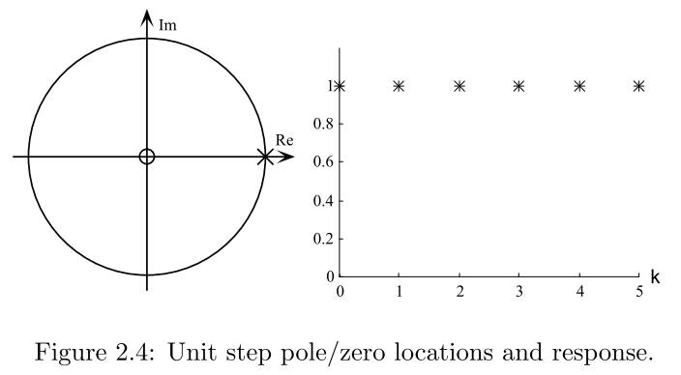
Unit step
The unit step function is given by e(k) = 1, k ≥ 0. Its z-transform is
The unit step has a pole at z = 1 and a zero at z = 0.
A sketch of the pole and zero locations for the unit step and the corresponding discrete behavior are shown.

Slide 20
Exponential Signal
The discrete exponential function is given by
The z-transform is given by
which has a single real pole at z = r, plus a zero at z = 0.
The discrete behavior depends on the value of r as shown next.

Slide 21
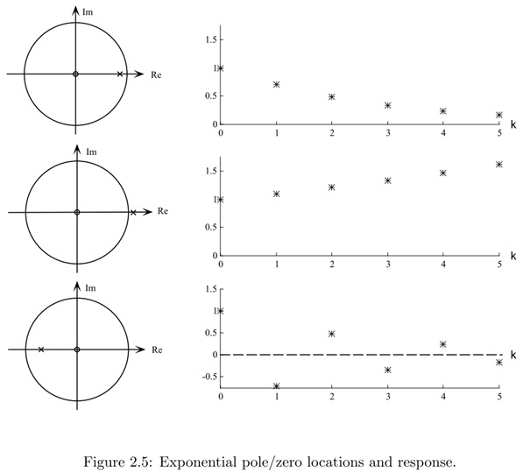
If |r|<1 (pole inside unit circle), response decays.
If |r|>1, response grows; i.e. system is unstable.
If −1<r<0 (pole on negative real axis), the response will alternate signs. This case is unique to discrete systems and has no counterpart in continuous domain.
The closer the pole to the origin (the smaller r), the faster the decay.

Slide 22
Damped sinusoid
The discrete damped sinusoid is given by
Here, we treat each term separately, then add the z-transform of both terms at the end.

Slide 23
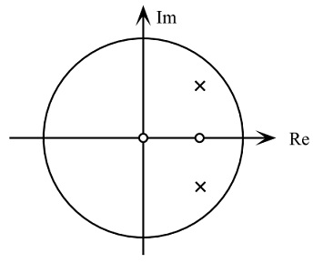
Adding both expressions yields
The poles of E(z) are complex conjugates:
The zeros are real, at 0 and r cos θ and are in line with the poles.

Slide 24
Example
Consider a discrete damped sinusoid with r = 0.7 and θ = 45° = π /4
The plot of this discrete function is shown below along with pole/zero locations.

Slide 25
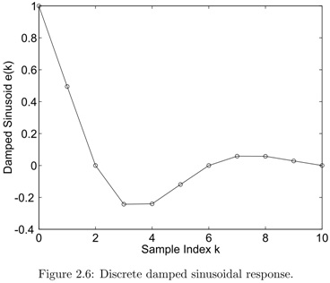
Note that the samples are connected with straight lines for viewing clarity only. In discrete system nothing truly exists (or defined) between the samples.
The number of samples/cycle of complex poles is determined by their angle θ. Given e_{k} = cos kθ, let N be the number of samples per oscillation period, we must have Nθ = 2π , hence N = 2π/θ = 8 samples/cycle.

Slide 26
Poles, zeros, and transient response
As in continuous systems, higher-order discrete system response is always a combination of ﬁrst order (exponential) and second order (damped sinusoidal) terms.
The notion of dominant poles carries over to discrete systems also. The dynamic response of the system is dominated by poles close to point z = 1 in the z-plane.
Effect of Zeros on Dynamic Response: Zeros speed up the response and increase overshoot (or undershoot).

Slide 27
Discrete & Continuous Signals
It is time to make a connection between discrete and continuous systems, and a link between z and s domains.
Consider a continuous damped sinusoid signal y(t)
Now, sample y(t) with sample period T to get the following discrete signal

Slide 28
Discrete & Continuous Signals
Comparing s-plane and z-plane poles, we find that they are related by
This is a general relationship between poles of continuous signals and their discrete counterparts. This mapping between s and z plane is very useful in controller design.
Note: this mapping is not applicable to the zeros in s- and z-planes.
Let’s examine mapping between some contours in s and z planes.

Slide 29
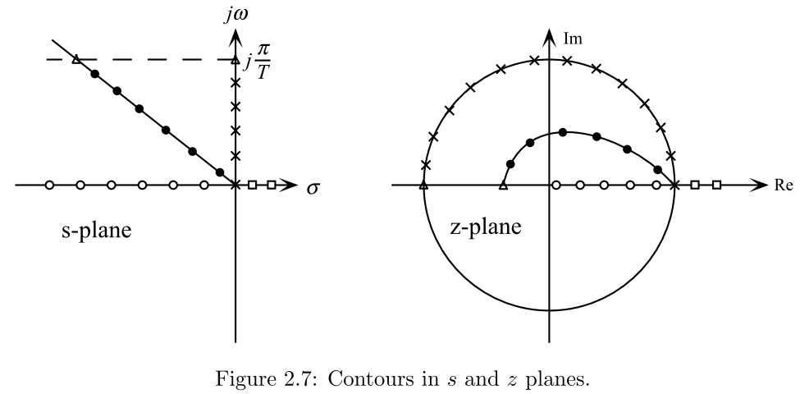
s-plane origin maps into point z = 1.
s-plane negative real axis maps into the z-plane real axis [1,0].
s-plane jω axis maps into z = e^{jωT} (the unit circle). As a point moves on the s-plane jω axis, the corresponding z-plane point travels around the unit circle. When s = jπ/T, then z = −1. Stability boundary in s-plane (jω axis) maps into stability boundary in z-plane (unit circle).
Line of constant damping ratio in s plane (radial line in the s-plane) maps into a logarithmic spiral in the z plane.

