Slide 1
Compensator Design
Acknowledgement: Slides are due to Dr. Imtiaz Hussain, Mehran University of Engineering & Technology, Pakistan. URL :http://imtiazhussainkalwar.weebly.com/

Slide 2
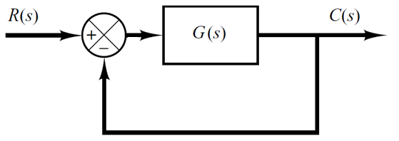
Introduction
A feedback control system that provides acceptable performance without any necessary adjustment is rare.
To improve performance, we insert a an additional component or circuit called compensator, G_{c}(s).

Slide 3
Compensator Design
We want to design (calculate) the compensator such that the closed-loop system has certain:
Transient response characteristics (peak time, overshoot, settling time, …).
Steady state error for step, or ramp inputs.
As these performance specifications can be defined in terms of the location of closed-loop system poles, the root-locus approach is so powerful in the design of compensators.

Slide 4
Compensation via Root Locus
The design by the root-locus method is based on reshaping the root locus of the system by adding poles and zeros to the system’s open-loop transfer function and forcing the root loci to pass through desired closed-loop poles in the s-plane.
The basic assumption is that the closed-loop system has a pair of dominant closed-loop poles.

Slide 5
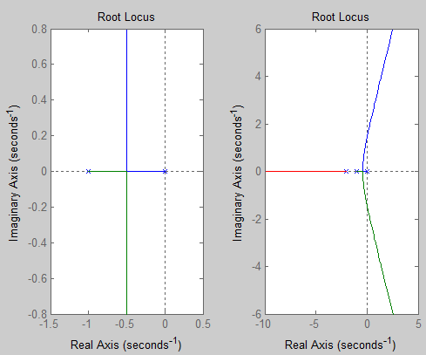
Effect of Addition of Poles on Root Locus
The addition of a pole to the open-loop transfer function has the effect of pulling the root locus to the right, tending to lower system relative stability and to slow down the settling of the response.
Add a Pole at -2

Slide 6
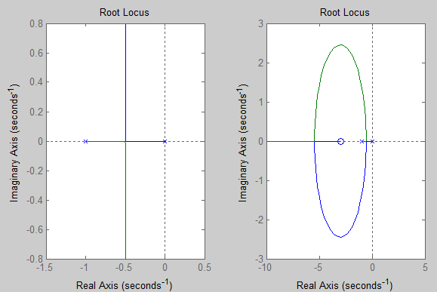
Effect of Addition of Zeros on Root Locus
The addition of a zero to the open-loop transfer function has the effect of pulling the root locus to the left, tending to increase system relative stability and to speed up the settling of the response.
Add a zero at -3

Slide 7
Structure of the compensator
The compensator may be a simple gain or may be a dynamic system such as lag, lead, or lag-lead component.
We have four main types of compensators.
Two for improving transient response:
Proportional-Derivative (PD)
Lead compensator
And two for improving steady-state error:
Proportional-Integral (PI)
Lag compensator
We will only study this type.

Slide 8
PD Compensation
Proportional control is simply a gain.
Increasing the gain yields fast response (low rise time), low steady state error, but with large overshoot.
Proportional-Derivative (PD) control is used to reduce the overshoot (i.e. improve the transient response).
PD controllers are represented by following transfer function
Ideal PD compensator can only be realized with active electronic networks using operational amplifiers.

Slide 9
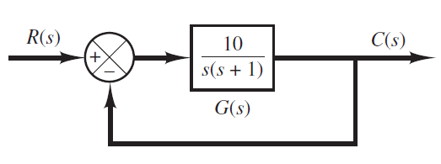
Example
Consider the following position control system.
It is desired to design a PD compensator G_{c}(s) so that the dominant closed poles have the damping ratio 0.5 and undamped natural frequency 3 rad/sec.

Slide 10
From the desired specifications (damping ratio 0.5 and undamped natural frequency 3 rad/sec), the desired dominant closed-loop poles are:
The desired location of closed loop poles can also be located graphically where
And w_{n} = 3 corresponds to a circle of radius 3.

Slide 11
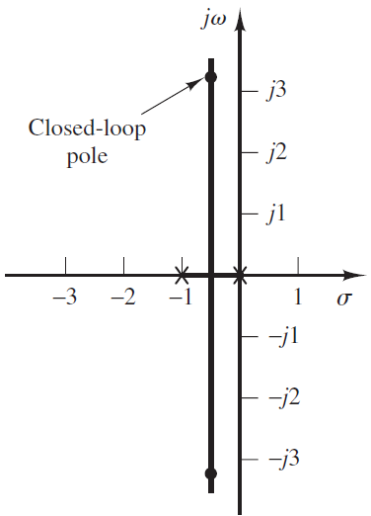
Let us draw the root Locus plot of the given system.
It clear that the desired poles are not on the root locus. In other words, gain adjustment alone cannot yield the desired closed loop poles.
Desired Closed Loop Pole

Slide 12
Even without drawing the root locus, we can deduce, from the angle condition, that the desired poles are not on the root locus. Therefore, let us use a PD compensator. This corresponds to the addition of a zero.
To calculate the angle of deficiency, apply Angle Condition at desired closed loop pole. This angle must be contributed by the zero (at s = -z) of PD compensator so that the new root locus is to pass through the desired locations.
Desired Closed Loop Pole
-2
-1
101º
120º
-2
-1

Slide 13
To calculate the required compensator gain K_{c}, we apply the magnitude condition at the desired pole location.
Hence, the final PD controller is

Slide 14
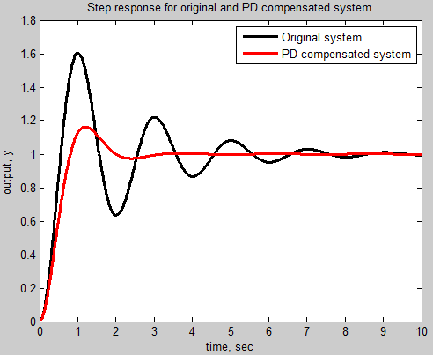
It is interesting to compare the closed-loop step response with and without the compensator.
As we can clearly see, there is a significant improvement in the transient response using the designed PD compensator.

