Slide 1
(6)
Measurements of
Capacitance, Phase, and Frequency

Slide 2
Capacitance measurement
Measurement of capacitance is of interest since the output of some sensors, such as capacitive level gauge and capacitive displacement sensor, is in the form of a change in capacitance.
Capacitance can be measured accurately by AC bridge circuits commercially available.
However, let study two simple methods for capacitance measurement.

Slide 3
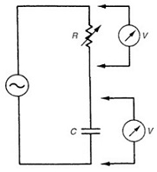
Capacitance measurement
Method 1: the unknown capacitor is connected in series with a variable resistance and the circuit is excited with sinusoidal voltage of frequency f.
The resistance R is adjusted until V_{R} = V_{C}. At this point, X_{R} = X_{C} and thus:
Method 2: put the capacitor in an RC circuit and measure its time constant τ = RC

Slide 4
Phase measurement
Some instruments or transducers, such as transit-time ultrasonic ﬂowmeter and radar level sensor, convert the measured variable into a phase change.
The simple method for measuring the phase difference between two signals is to use a 2-channel oscilloscope. The two signals are both displayed (vs. time) and a suitable time base (time/div) is chosen such that the time between the crossing points of the two signals can be measured.

Slide 5
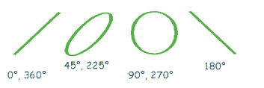
Measurement of phase using X–Y mode
Another useful technique for approximate phase measurement is to plot the two signals (of equal magnitude) on the X–Y mode available in oscilloscope.
The plot obtained is called Lissajous figure.
Lissajous figures could be ellipse, circle or straight line.

Slide 6
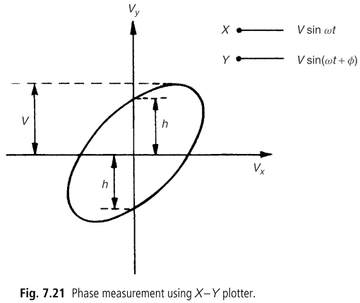
Measurement of phase using X–Y mode
Let X and Y inputs given by:
From Lissajous figure,

Slide 7
Frequency measurement
Frequency measurement is required as part of those devices that convert measured physical quantity into a frequency change, such as turbine ﬂowmeter and Doppler-shift ultrasonic ﬂowmeter.
To measure the frequency of a signal, we can display it on oscilloscope, measure its period T, and then calculate the frequency f = 1/T. However, the accuracy of this method is limited to ±5% of the reading.
More accurate methods for measuring frequency are:
Digital counter-timer
Phase-locked loop (PLL)

Slide 8
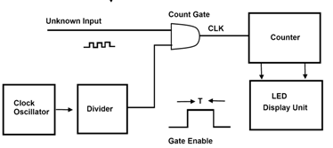
Digital counter-timer
The most accurate frequency measuring instrument.
The essential component of a counter-timer is an oscillator that provides a very accurately known and stable reference frequency, typically 100 kHz or 1MHz.
The oscillator output is applied to an AND gate.

Slide 9
Digital counter-timers
Successive pulses at the reference frequency alternately open and close the gate.
The input signal, of unknown frequency, is transformed into a train of pulses and applied to the gate. The number of these pulses passing through the gate is proportional to the frequency of the unknown signal.
To measure lower frequencies, a series of decade frequency dividers are provided. These increase the time between the reference frequency pulses by factors of ten, and a typical instrument can have gate pulses separated in time by between 1 µs and 1 second.

Slide 10
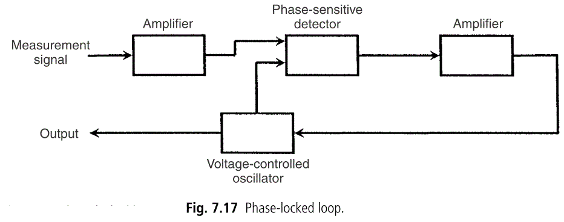
Phase-locked loop (PLL)
A PLL is a circuit consisting of a phase-sensitive detector, a voltage controlled oscillator (VCO), and ampliﬁers, connected in a closed-loop system.
In a VCO, the oscillation frequency is proportional to the applied voltage.

Slide 11
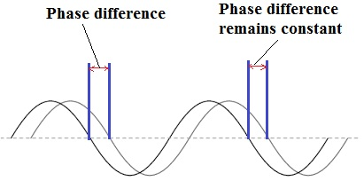
Phase-locked loop (PLL)
Before describing the operation of PLL, we review the notion of phase difference between two sinusoids.
If the phase difference is constant during successive cycles, then this indicates that the two sinusoids have the same frequency.

Slide 12
PLL Operation
The phase-sensitive detector compares the phase of input signal with the phase of VCO output.
Any phase difference generates an error signal, which is ampliﬁed and fed back to the VCO. This adjusts the frequency of the VCO output.
This process continues until reaching steady state.
At steady state, VCO input is constant and VCO output has the same frequency of the input signal. The circuit becomes locked to the frequency of the input signal.
The DC output of VCO is proportional to input signal frequency.

