Slide 1
(6) Model Structures

Slide 2
ARX model structure
In ARX model structure, the output y(k) at the current discrete time step is computed based on previous input and output values:
This is equivalent to
e(k) is the noise at step k.
Model parameters: a₁, a₂, b₁, and b₂.
Name: AutoRegressive (y(k) a function of previous y values) with eXogenous input (dependence on u)

Slide 3
Polynomial representation
Defining the Backward shift operator q⁻¹:
Then:
Therefore, the ARX model is written compactly:

Slide 4
Remarks
Usually, the ARX model is the first model to try in system identification.
The ARX model is quite general, it can describe arbitrary linear relationships between inputs and outputs.
However, the noise enters the model in a restricted way, and later we introduce models that generalize this.

Slide 5
Estimation of ARX model
This can be done using linear regression
Objective: minimize the mean squared error:
Equation error

Slide 6
Identification problem
We form the linear system
Remark: zero- and negative-time values for u and y can be taken equal to 0 (assuming the system is in zero initial conditions).
This finally gives the least squares estimate:

Slide 7
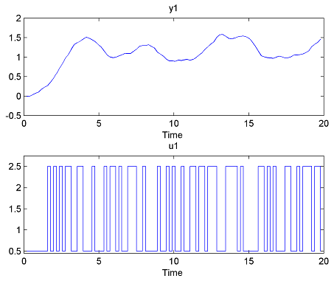
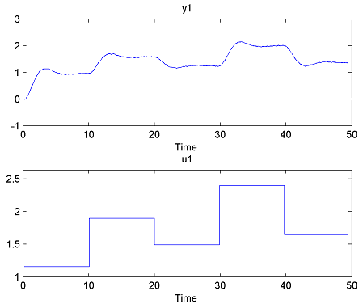
MATLAB Example
Consider we are given the following, separate, identification and validation data sets.
plot(id); and plot(val);
Remarks: Identification input: a so-called pseudo-random binary signal, an approximation of (non-zero-mean) white noise. Validation input: a sequence of steps.

Slide 8
Identifying an ARX model
model = arx(id, [na, nb, nk]);
Arguments:
1- Identification data.
2- Array containing the orders of A and B and the delay nk.

Slide 9
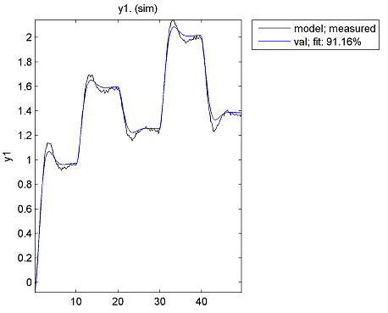
Model validation
Assuming the system is second-order, in the ARX form, and with one sample period delay, we take na = 2, nb = 2, nk = 1.
Validation: compare(model, val);
Results are quite bad.

Slide 10
Structure Selection
Better idea: try many different structures and choose the best one.
Na = 1:15;
Nb = 1:15;
Nk = 1:5;
NN = struc(Na, Nb, Nk);
V = arxstruc(id, val, NN);
struc generates all combinations of orders in Na, Nb, Nk.
arxstruc identifies for each combination an ARX model (on the data in 1st argument), simulates it (on the data in the 2nd argument), and returns all the MSEs on the first row of V (see help arxstruc for the format of V).

Slide 11
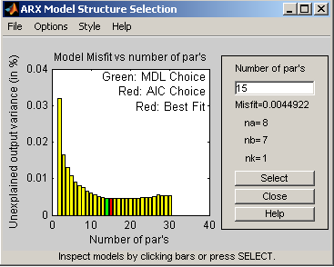
Structure selection (continued)
To choose the structure with the smallest MSE:
N = selstruc(V, 0);
For our data, N= [8, 7, 1].
Alternatively, graphical selection: N = selstruc(V, ’plot’);
Then click on bar corresponding to best (red) model and the button “Select”.

Slide 12
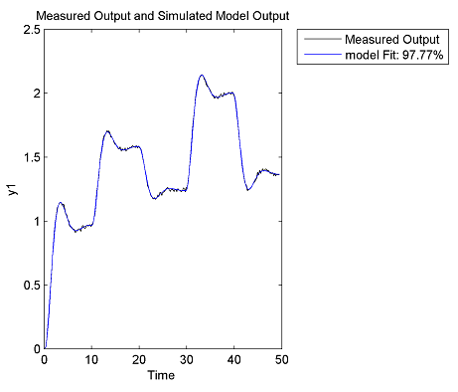
Validation of best ARX model
model = arx(id, N);
compare(model, val);
A better fit is obtained.

Slide 13
Special case of ARX: FIR
Setting A = 1 in ARX model, we get:
(where h(0), the impulse response at time 0, is assumed 0 – i.e. system does not respond instantaneously to changes in input)

Slide 14
Difference between ARX and FIR
Since ARX includes recursive relationships between current and previous outputs, it will be sufficient to take orders na and nb (at most) equal to the order of the dynamical system.
FIR needs a sufficiently large order nb (or length M) to model the entire transient regime of the impulse response (in principle, we only recover the correct model as M -> ∞).
-> more parameters -> more data needed to identify them.

Slide 15
General Model Structure
where G and H are discrete-time transfer functions – ratios of polynomials. Signal e(t) is zero-mean white noise.
By placing the common factors of the denominators of G and H in A(q⁻¹), we get the more detailed form:
where A,B,C,D, F are all polynomials.
Very general form, all other linear forms are special cases of this. Not for practical use, but to describe algorithms in a generic way.

Slide 16
ARMAX model structure
Setting F = D = 1 (i.e. orders nf = nd = 0), we get:
AutoRegressive, Moving Average (referring to noise model) with eXogenous input (dependence on u).
Example:
Identifying an ARMAX model
mARMAX = armax(id, [na, nb, nc, nk]);
Arguments: Identification data and the orders of A, B, C and the delay nk.

Slide 17
Overall relationship
ARMAX to ARX: Less freedom in modeling disturbance.
ARX to FIR: More parameters required.

Slide 18
Output error model
Other model forms are possible that are not special cases of ARMAX, e.g. Output Error, OE:
obtained for na = nc = nd = 0, i.e. A = C = D = 1.
This corresponds to simple, additive measurement noise on the output (the “output error”).
Identifying an OE model
mOE = oe(id, [nb, nf, nk]);
Arguments: Identification data and the orders of B, F, and the delay nk.

