Slide 1
Sampling and Aliasing
CSE 421 Digital Control
Lecture 4

Slide 2
Introduction
A digital control system operates on discrete signals obtained from sampling continuous signals.
In order for the samples to be good representative of the original signal, the sampling rate should be large enough; otherwise, aliasing could occur.
In these slides, we discuss the condition under which aliasing problem can be avoided.

Slide 3
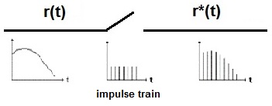
Ideal Sampling
A sampler is basically a switch closing every T seconds to generate a sampled signal r*(t) from a continuous signal r(t).
The process can be described as a multiplication of r(t) with an impulse train to generate r*(t) or a sequence of samples r(kT):

Slide 4
Recovery of r(t) from r(kT)?
It seems that r(t) can be recovered from r(kT) if T is small or the sampling frequency w_{s} = 2π/T is high. The question is how small T is enough?
To answer this question we study the frequency spectrum of the sampled signal r∗(t).

Slide 5
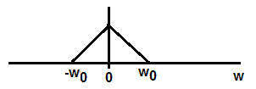
Frequency spectrum of r∗(t)
As we have seen, r*(t) is represented as:
Let the frequency spectrum of r(t) be R(w) and assume that it is band limited from –w₀ to w₀ as shown.
The frequency spectrum of r*(t):

Slide 6
R∗(w)
Two things happen to the frequency spectrum of r(t) when it is sampled:
The magnitude of the sampled spectrum is 1/T that of the continuous spectrum, i.e. it is scaled by 1/T.
The summation indicates that there are an inﬁnite number of repeated spectra in the sampled signal, and they are repeated every ω_{s} = 2π/T along the frequency axis.

Slide 7
Example 1
Consider continuous function r₁(t) band-limited to ω_{s}/2.
The original amplitude spectrum |R₁ (jω)| and the sampled spectrum |R∗₁ (jω)| are shown below.
As can be seen, the spectrum R₁ (jω) can be extracted from the repeated spectra R∗₁ (jω) using an ideal LPF with cutoff frquency ω_{s}/2 (the Nyquist frequency). The ﬁlter passes the original spectrum and rejects the repeated spectra.

Slide 8
Sampling Rate
A continuous time signal band limited in the interval (-w_{o},w_{o}) can be recovered uniquely by its samples if the sampling frequency ω_{s} > 2w_{o}.
Therefore, the first rule is: sample at least twice the largest frequency in the signal of interest.
In practice, ω_{s} > 10w_{o}.
Another Issue: If the signal of interest contains noise (unwanted signal usually of high frequency), it will appear as a low frequency signal after sampling ➔ Aliasing Problem.

Slide 9
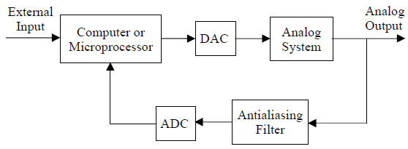
Antialiasing filter
To remove the effect of noise, an anti-aliasing ﬁlter is used, before sampling, to ﬁlter out those frequencies above ω_{s}/2. Otherwise, those unwanted frequencies will erroneously appear as lower frequencies after sampling.
Control scheme with an antialiasing filter

Slide 10
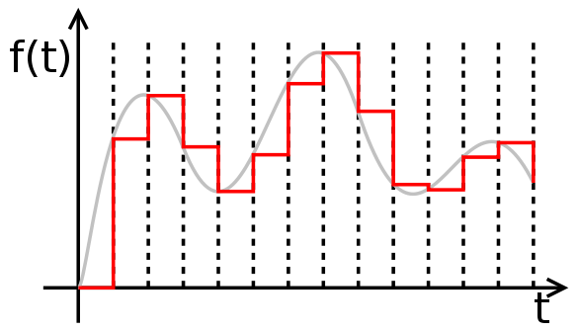
Zero-order hold
It is not possible to implement an ideal LPF.
In practice, ZOH is used to reconstruct continuous signal from discrete samples. It holds the last sample value until a new sample arrives. This is the exact behavior of a D/A.

Slide 11
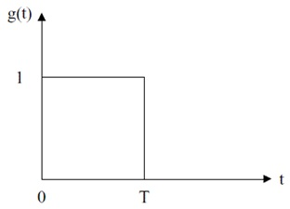
ZOH
ZOH is an approximate LPF and can accurately follow the input signal if the sampling time T is small compared to the transient changes in the signal.
The impulse response of a ZOH is shown below.
From which, the transfer function of ZOH can be deduced as:

Slide 12
Example
A continuous signal r(t) is applied to an ideal sampler followed by a ZOH as shown below. Sketch the signal waveforms after the sampler and the ZOH.
Answer

