Slide 1
(2) Pressure, Flow, Level, Temperature and Light Measurements

Slide 2
Pressure Measurement
Pressure is the force per unit area expressed in pounds per square inch (psi) or Pascals (1 Pa = N/m²).
Examples:
Atmospheric pressure is the pressure on the Earth’s surface due to the weight of the gases in the atmosphere.
A liquid or gas exerts a pressure on its surroundings and on the bottom and walls of their container.
Differential pressure (∆p) is the pressure measured with respect to another pressure. If the pressure is measured with respect to atmospheric pressure, it is called Gauge pressure.

Slide 3
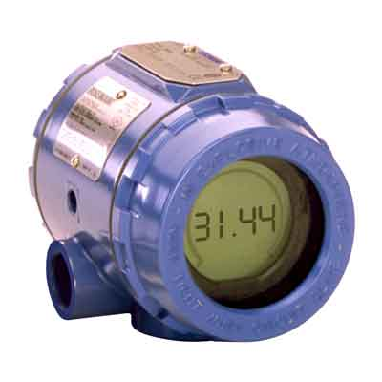
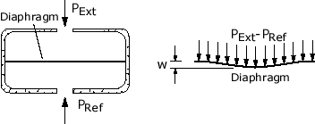
In industry, the measurement of fluid pressure involves monitoring the elastic deformation of diaphragms and tubes.
Diaphragm is a thin film (made from rubber for low pressures and stainless steel for high pressures) supported on rigid frame.
When pressure is applied to the diaphragm, it becomes slightly spherical.
The displacement of the center of a diaphragm is proportional to the pressure difference on both sides.
Diaphragm deformation can be monitored by a displacement sensor such as a strain gauge or piezoelectric effect.

Slide 4
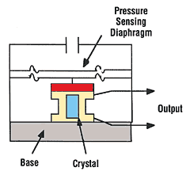
Piezoelectric pressure sensor
Some types of crystals, such as quartz, generate electrical charges on their surfaces when they are compressed. This effect is called piezo-electricity.
As the diaphragm moves, a potential difference appears across the crystal proportional to pressure exerted on crystal surface. This voltage can be amplified, and hence the device can be used as a pressure sensor.

Slide 5
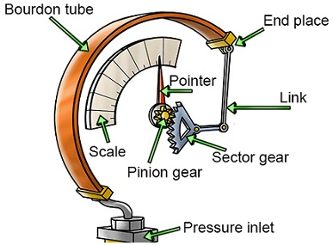
Bourdon tube is a commonly used pressure gauge. It is a C-shaped tube made from stainless steel or phosphor bronze.
When the pressure inside the tube increases the closed end of the tube opens out. This moves the pointer on the scale.
The outer edge of the tube has larger surface than the inner portion. Therefore, when pressure is applied to the tube, the outer edge is subject to a larger total applied force and hence the free end of the tube moves outward.

Slide 6
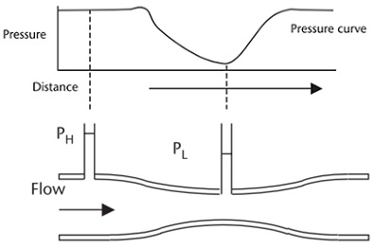
Flow rate measurement
Many industrial processes require specific flow rates for their optimum performance. Also, determining the cost of many liquids and gases requires accurate measurement of flow rate.
Two common flow rate transducers: Venturi tube and Rotameter.
Venturi tube uses a reduction in tube size. When a fluid flows through the constriction, velocity increases while pressure decreases according to Bernoulli’s equation.

Slide 7
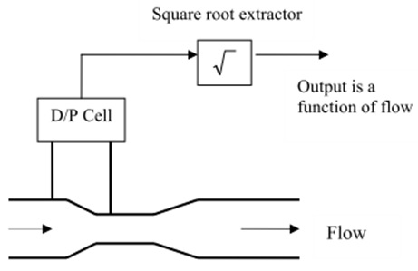
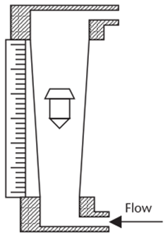
Flow rate is proportional to the square root of the pressure drop. Therefore, a D/P cell is a used to measure the differential pressure before and at the constriction and then a square root extractor is used to obtain a measure of the flow.
Rotameter is a cheap and reliable variable-area flow meter used for direct visual indication of flow rate.
It has a float in a tapered vertical tube with the fluid flow pushing the float upwards.
At equilibrium, the weight of the float is equal to the force on it due to the flowing fluid. The distance to which the float rises in column is proportional to the flow rate.

Slide 8
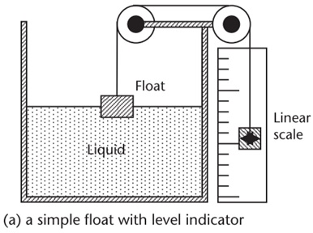
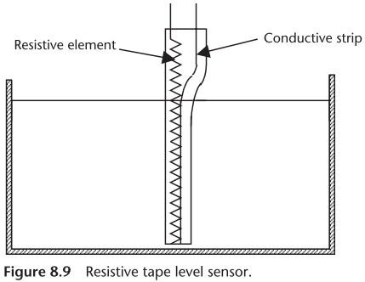
Level Measurement
Some methods for measuring liquid level:
(1) Float sensor: The float material is less dense than the density of the liquid, and floats up and down on top of the material being measured. The float sensor has a linear output with level height.
(2) Resistive tapes: A resistive element is placed in close proximity to a conductive strip in an easily compressible nonconductive sheath. The pressure of the liquid pushes the conductive strip against the resistive element, shorting out a length of the resistive element proportional to the depth of the liquid.

Slide 9
Temperature Measurement
Temperature is the most widely measured variable.
All physical parameters are temperature-dependent, making it necessary in most cases to measure temperature along with the physical parameter, so that temperature corrections can be made to achieve accurate parameter measurements.
In chemical reactions, temperature control is important since reactions are temperature-dependent.
Some common temperature sensors are given next.

Slide 10
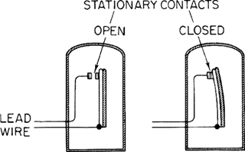
(1) Bimetallic strips
A bimetallic strip consists of two different metal strips of the same length bonded together.
The two metals have different coefficients of expansion. Therefore, when heated, the two strips expand differently.
This can be used to open or close electric circuits, as in the simple thermostat commonly used with domestic heating systems.
They are robust, relatively cheap, but are fairly slow.

Slide 11
(2) Resistance temperature detector (RTD)
RTD is resistive element made from e.g. platinum or copper alloys.
The resistance of most metals increases in a reasonably linear way with temperature according to the following equation:
where R_{T} is the resistance at a temperature T °C, R₀ the resistance at 0°C and α is the temperature coefficient of the metal.
For example, if the resistance of a platinum resistor at 0°C is 110Ω and the temperature coefficient of resistance for platinum is 0.00385 Ω/°C, then the resistance at 480°C will be 110[1+0.00385(480)] = 313.28Ω.
Care should be taken to prevent the electrical current from heating the device and causing erroneous readings.

Slide 12
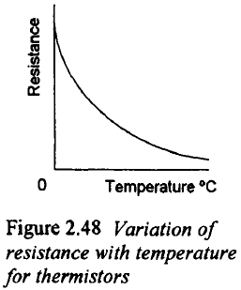
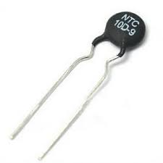
(3) Thermistors
Thermistors are semiconductor material with high negative temperature coefficient of resistance (i.e. very sensitive elements).
Requires linearization.
However, its sensitivity and low cost make it useful in many applications.
Care has to be taken to minimize the effects of internal heating.

Slide 13
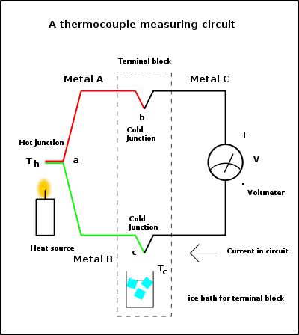
(4) Thermocouple
The basis for the use of thermocouple as a temperature sensor is the thermoelectric or Seebeck effect which states that: “when a conductor is subjected to a thermal gradient, it generates voltage”.
The thermocouple involves two different metals.
One end of the two metals are joined together and put at temperature T_{h} (the hot junction).
The other end of both metals are put at a temperature T_{c} (the cold junction). The potential difference is measured between these two ends.

Slide 14
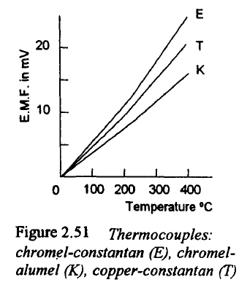
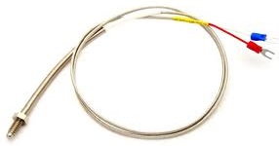
(4) Thermocouple
The potential difference depends on the two metals used and the temperature difference between the two junctions.
The Figure shows how the e.m.f varies with temperature for a number of commonly used pairs of metals (usually given reference letters).
In principle, the cold junction should be held at 0°C.
Time constant of a thermocouple: typically, 100 milliseconds.

Slide 15
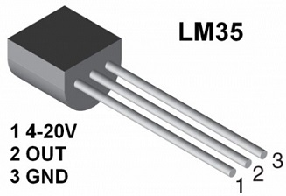
IC temperature sensors
LM35: the output is a linear function of temperature (~ 10 mV/°C) when the supply voltage is 5 V.
DS18B20: is a digital thermometer provides 9 to 12-bit (configurable) temperature readings.

Slide 16
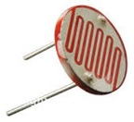
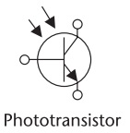
Light Measurement
The detection and conversion of light intensity into electrical signals are done using photocells such as:
Photo-resistors: are devices whose resistance changes with light intensity. As the light intensity increases, their resistance decreases. Examples of these materials are selenium, and cadmium sulfide.
Photo-transistor: Light generates hole-electron pairs which cause base current I_{B}.

