Slide 1
(6) Programmable logic Controllers

Slide 2
Programmable Logic Controller (PLC)
Programmable logic controllers are special-purpose computers optimized for industrial control tasks.
PLC has interfacing for input and output devices such as transducers, switches, and motors.

Slide 3
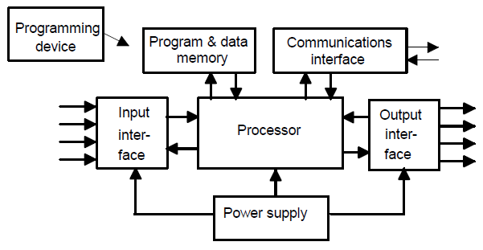
Programmable Logic Controller (PLC)
PLC performs logic, sequencing, timing, counting, arithmetic as well as PID control.
PLC has a programmable memory to store instructions.
Programmed using several languages.

Slide 4
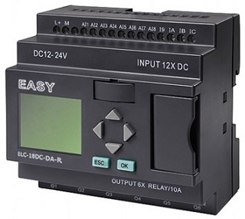
Small vs. Modular PLC
Small PLC
self-contained units for use with e.g. 20 digital inputs and outputs points.
Modular PLC
This type is extendible. Additional input or output modules can be added ► can be used for larger numbers of inputs/outputs.

Slide 5
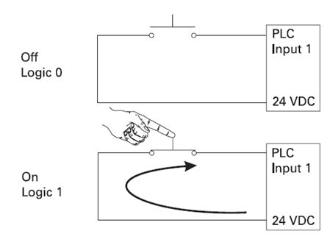
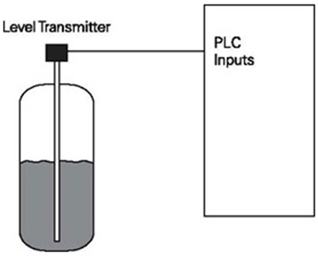
Types of PLC input & output
PLC can handle digital or analog inputs/outputs.

Slide 6
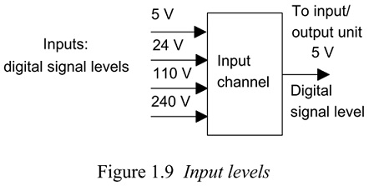
Digital Input Unit
PLC can receive DC or AC voltages of several levels.

Slide 7
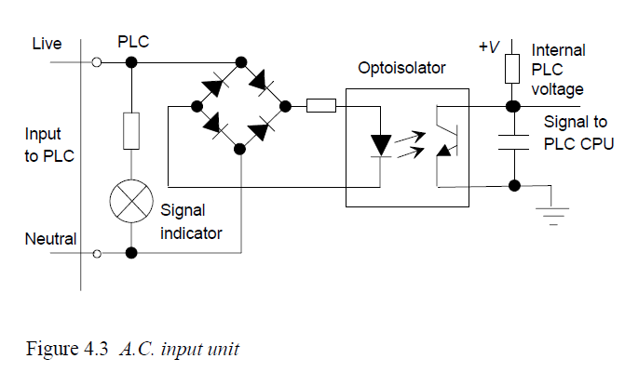
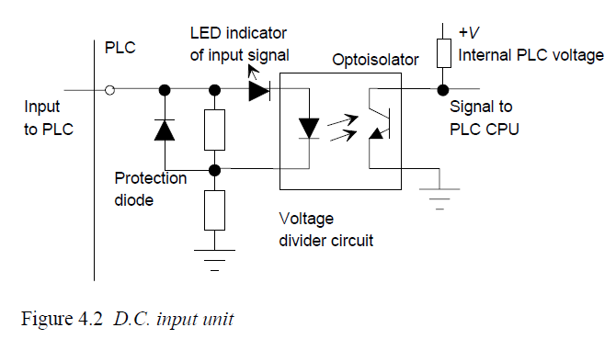
Optoisolators (optocouplers) provide isolation.

Slide 8
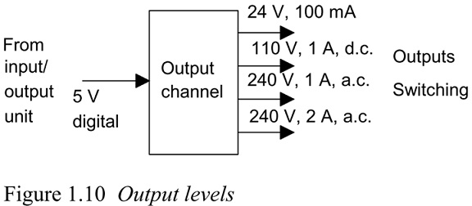
Digital Output Unit
Also, PLC output can handle DC or AC voltages of several levels.

Slide 9
Types of PLC outputs
A fuse is used to protect against overcurrent.

Slide 10
Relay type output
In this type, the PLC output is used to operate a relay.
Relay output can switch currents of the order of a few amperes in an external circuit.
Suitable for a.c. and d.c. switching.
Slow to operate.

Slide 11
Transistor type output
Here, a transistor switches the current through the external circuit.
Considerably faster switching action.
Strictly for d.c. switching.

Slide 12
Triac output
TRIAC is a three-terminal electronic device, which works as a switch for AC signals. With a small current injected on the GATE, it enables a relatively high AC current between its terminals.
In PLC, the triac switches current through the external circuit.
Faster switching action (compared to a relay).
Strictly used to control external loads connected to a.c. power supply as it needs the zero crossing to turn off (it would not switch off on DC).

Slide 13
I/O addresses
In PLC, the inputs and outputs are identified by their addresses.
This is the address of the input or output in the memory of the PLC.
Each PLC manufacturer has its own notations for addressing input and outputs.

Slide 14
Siemens I/O Numbering
I0.0
Q2.0
I designates a logic input
Q designates a logic output.
The first number identifies the byte.
The second number identifies the bit.
Image register space for digital I/O is always reserved in increments of eight bits (one byte).

Slide 15
LG I/O Numbering
%I0.0.0
%Q0.2.0
I designates a logic input and
Q designates a logic output.
The first number identifies the base number.
The second number identifies the slot.
The third number identifies the bit.

Slide 16
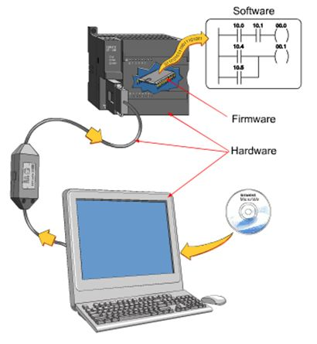
PLC programming languages
Ladder diagrams (LAD),
Instruction list (IL),
Sequential function charts (SFC).
Ladder programming is intended to be used by engineers without great knowledge of programming.
Adopted by most PLC manufacturers. However each have their own versions.

Slide 17
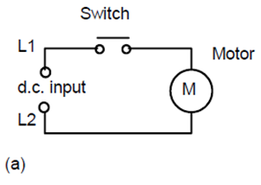
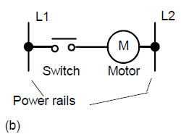
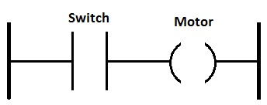
Ladder diagrams
Ways of drawing the same electrical circuit

Slide 18
The Rung
power rails
In ladder diagrams this symbol
is called a contact and represents an input to the PLC.
In ladder diagrams this symbol is called a coil and represents an output from the PLC.

Slide 19
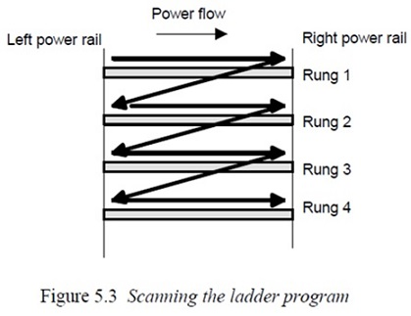
Ladder program
Vertical lines are called power rails while horizontal lines are called rungs.
Each rung on the ladder defines one operation in the control process.

Slide 20
Ladder programming notes
Each rung must start with an input or inputs and must end with at least one output.
The term input is used for a control action, such as closing the contacts of a switch connected to the PLC.
The term output is used for a device connected to the output of a PLC, e.g. a motor.
A particular device can appear in more than one rung of a ladder.

Slide 21
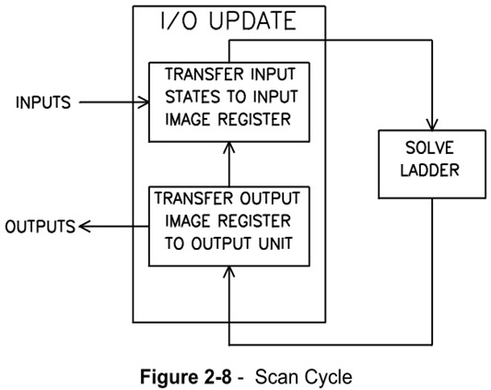
PLC scan cycle

Slide 22
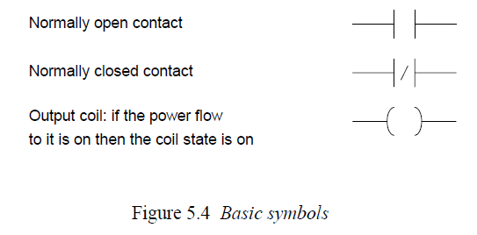
Normally Open/Normally Closed Notation
In ladder diagram, electrical devices are shown in their normal condition.
Thus a switch which is normally open (NO) until some object closes it, is shown as open on the ladder diagram.
A switch that is normally closed (NC) is shown closed.

Slide 23
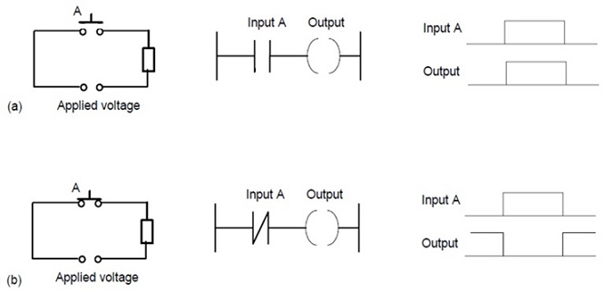
Example
What is the logic statement that describes the relationship between the output and input for each of the following two examples?
Output = A
Output = A

